Slide 1




PDS
Computer Vision
Kolla Ansible OpenStack Installation (Ubuntu server 22.04)
.
https://github.com/siagianp
https://www.youtube.com/@AmelOline/videos
https://github.com/amelcharolinesgn2/Cloud-Infrastructures
https://github.com/amelcharolinesgn2/ClouD-Infrastructure-SISKA-2025
https://github.com/amelcharolinesgn2/CCNA-1-v7
https://github.com/amelcharolinesgn2/CCNA-2-v7
https://github.com/amelcharolinesgn2/CCNA-3-v7
https://github.com/amelcharolinesgn2/CCNA-4-v7
https://github.com/amelcharolinesgn2/ANJAR_CCNP_Lab
https://github.com/amelcharolinesgn2/CloudSim
https://github.com/amelcharolinesgn2/AWS Certificate
https://github.com/amelcharolinesgn2/OpenStack
https://github.com/amelcharolinesgn2/IoT_simulator-mqtt-NodeRed
Notes:
https://github.com/mikeroyal/Google-Cloud-Guide
https://belajarlinux.id/openstack-upload-image-atau-iso/

Slide 2
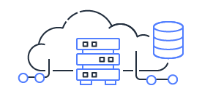
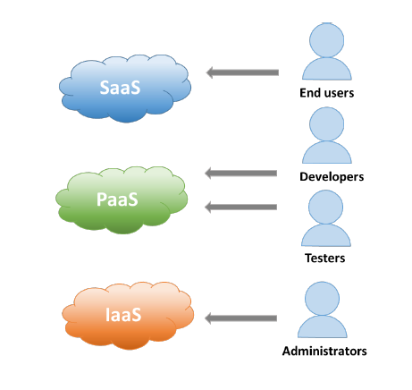


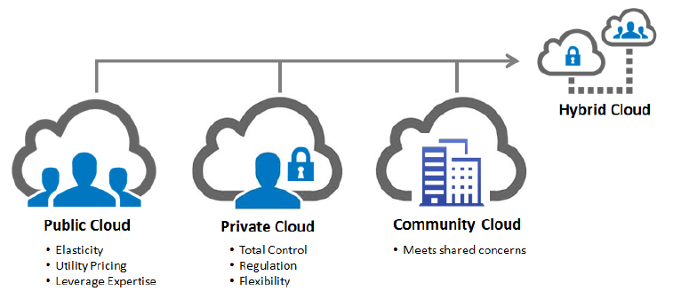
IaaS
PaaS
SaaS
Notes:
https://belajarlinux.id/jenis-jenis-cloud-computing/
https://belajarlinux.id/mengenal-apa-itu-kolla-ansible/

Slide 3
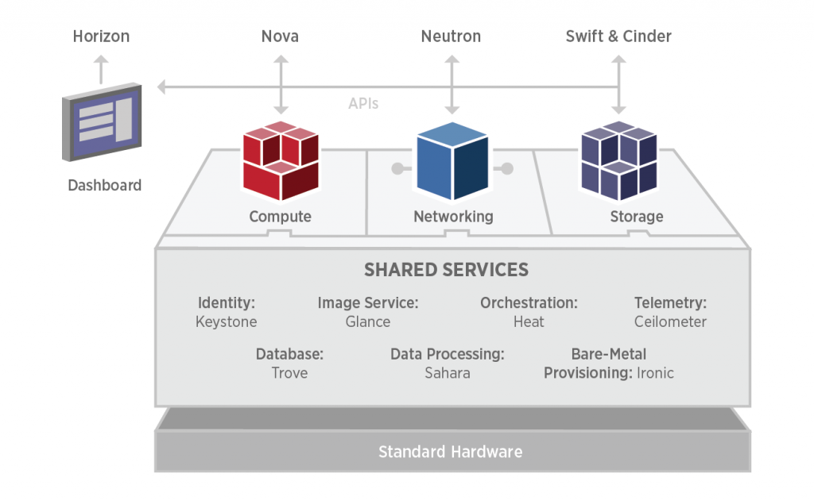
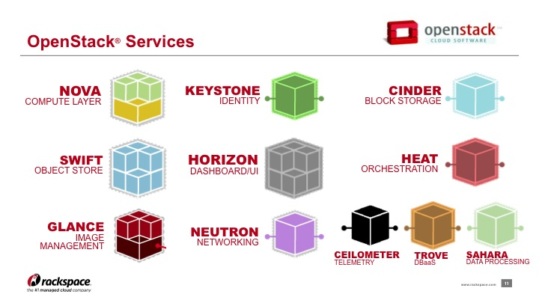
Arsitektur Openstack
Notes:
https://belajarlinux.id/openstack-definisi-dan-arsitektur/

Slide 4
Openstack Services
Infrastructure components
Kolla Ansible melakukan deploy container untuk project Openstack berikut:
Aodh
Barbican
Bifrost
Blazar
Ceilometer
Cinder
CloudKitty
Congress
Designate
Freezer
Glance
Heat
Horizon
Ironic
Karbor
Keystone
Kuryr
Magnum
Manila
Mistral
Murano
Neutron
Nova
Octavia
Panko
Rally
Sahara
Searchlight
Senlin
Solum
Swift
Tacker
Tempest
Trove
Vitrage
Vmtp
Watcher
Zun
Service Openstack berikut:
Ceph implementation for Cinder, Glance and Nova.
Collectd, Telegraf, InfluxDB, Prometheus, and Grafana for performance monitoring.
Elasticsearch and Kibana to search, analyze, and visualize log messages.
Etcd a distributed reliable key-value store.
Fluentd as an open source data collector for unified logging layer.
Gnocchi A time-series storage database.
HAProxy and Keepalived for high availability of services and their endpoints.
MariaDB and Galera Cluster for highly available MySQL databases.
Memcached a distributed memory object caching system.
MongoDB as a database back end for Panko.
Open vSwitch and Linuxbridge backends for Neutron.
RabbitMQ as a messaging backend for communication between services.
Redis an in-memory data structure store.
Notes:
https://belajarlinux.id/mengenal-apa-itu-kolla-ansible/
https://releases.openstack.org/
Deploy All-in-One OpenStack with Kolla-Ansible on Ubuntu 22.04
https://www.scribd.com/document/822144481/openstack-kolla-Ansible-AIO-Multinode-Documentation
Deploy All-in-One OpenStack with Kolla-Ansible on Ubuntu 22.04
https://kifarunix.com/deploy-all-in-one-openstack-with-kolla-ansible-on-ubuntu-22-04/#google_vignette
Automated Multinode OpenStack Deployment with Kolla-Ansible
Updated on July 29, 2025 by Lauren Morley
https://openmetal.io/resources/blog/automated-multinode-openstack-deployment-with-kolla-ansible/
https://gist.github.com/gilangvperdana/356296c8f4c6726859da290321087e71
https://serverfault.com/questions/1130614/kolla-ansible-deployment-fails-on-ubuntu-22-04-while-waiting-for-nova-compute-s

Slide 5

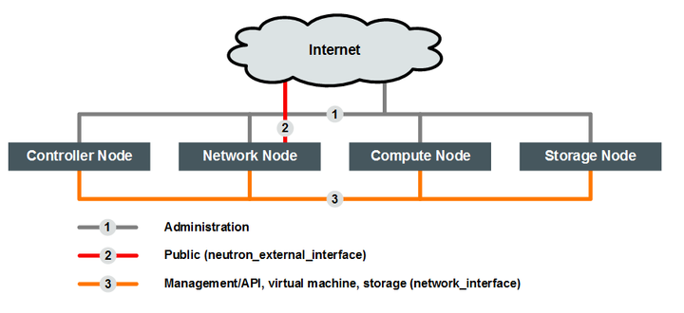
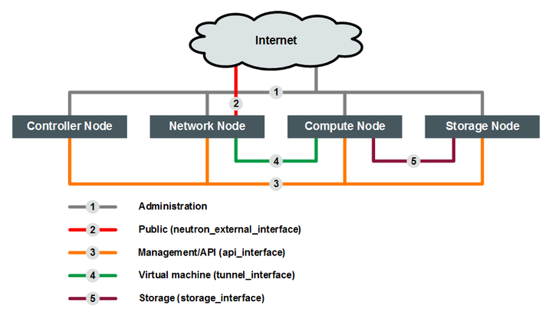
Oracle® OpenStack
Notes:
https://docs.oracle.com/cd/E90981_01/E90982/html/kolla-openstack-network.html

Slide 6
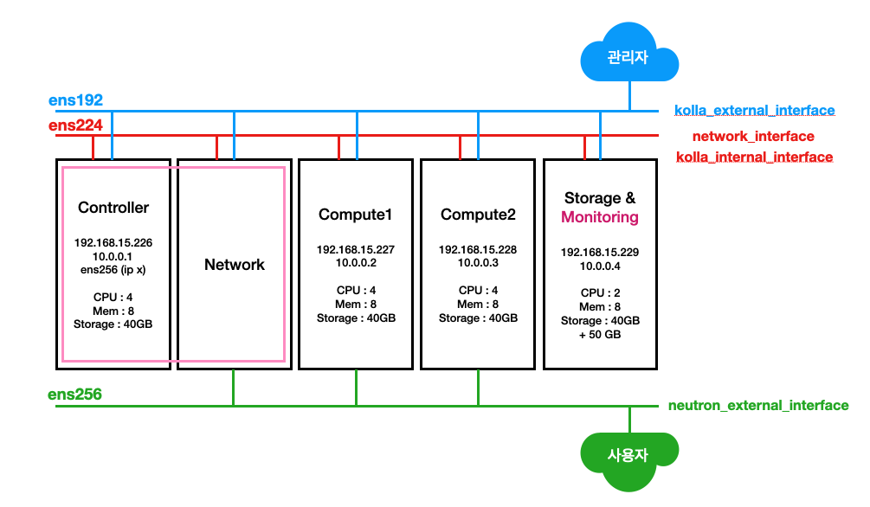
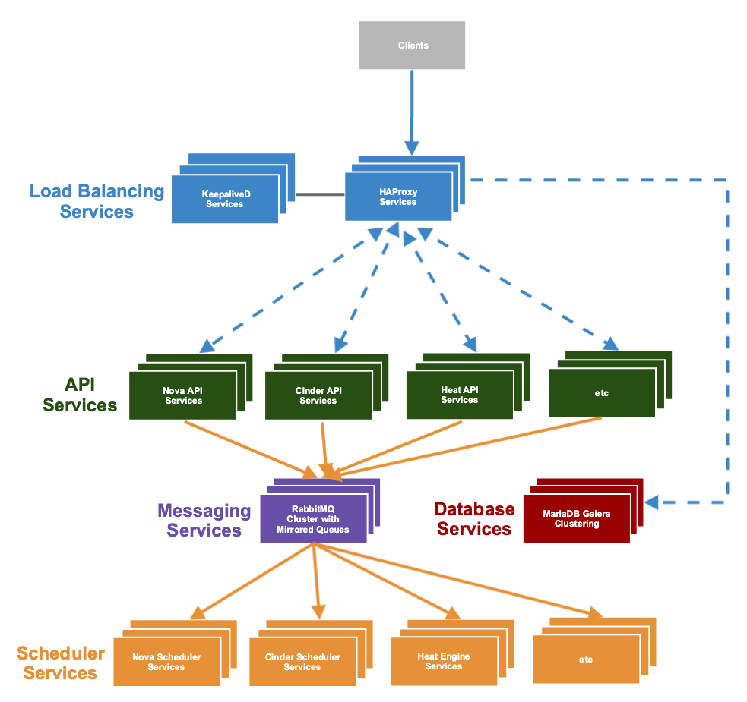
Kolla-Ansible과 OpenStack
Node/Hostname | Management/Floating IP | DISK | RAM | CPU
controller01 Also acts as Kolla-ansible deployment node | Mgt: 192.168.200.100/24 Floating: 10.100.0.100/24 | 100G | 8G | 2 cores
compute01 | Mgt: 192.168.200.120/24 Floating: 10.100.0.110/24 | 100G | 8G | 2 cores
strorage01 (provides NFS share for image storage and cinder block storage) | 192.168.200.110/24 | 250G | 8G | 2 cores
Notes:
https://namnh68.github.io/2018/10/install-openstack-aio-via-kolla-ansible/
https://kifarunix.com/deploy-multinode-openstack-using-kolla-ansible/
https://velog.io/@larshavin/Kolla-Ansible%EC%9D%84-%ED%99%9C%EC%9A%A9%ED%95%9C-OpenStack-%EC%84%A4%EC%B9%98-1
https://velog.io/@larshavin/Kolla-Ansible%EC%9D%84-%ED%99%9C%EC%9A%A9%ED%95%9C-OpenStack-%EC%84%A4%EC%B9%98-1

Slide 7
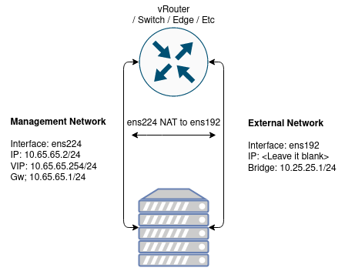
Lab: Kolla Ansible All in One Openstack
Requirement
Kali ini kami akan menggunakan spesifikasi mesin dan os seperti berikut, silakan dapat diikuti atau dapat disesuaikan dengan kebutuhan Anda:
8 CPU
8 GB RAM
100 GB Disk
Ubuntu 20.04
2 Network Interface
Ubuntu 20.04
Openstack
Notes:
https://belajarlinux.id/openstack-kolla-ansible-all-in-one-openstack-yoga/
https://docs.openstack.org/kolla-ansible/latest/user/quickstart.html
https://gbesar.com/main/baca/Instalasi%20Multi%20Node%20Openstack%20Ussuri%20dengan%20Kolla%20Ansible%20di%20Ubuntu%2018.04/all
https://www.youtube.com/watch?v=e7r2-p8Mki4

Slide 8
Lab: Kolla Ansible All in One Openstack (Cons’t)
2 NIC
Membutuhkan minimal 2 network interface yang nantinya akan digunakan sebagai:
1. Management Network
Interface: ens224 IP: 10.65.65.2/24 VIP: 10.65.65.254/24 Gw; 10.65.65.1/24
2. External Network
Interface: ens192 IP: kosongkan Bridge: 10.25.25.1/24
Management Network digunakan sebagai media komunikasi antar service yang menjalankan openstack, sedangkan External Network digunakan service neutron untuk berkomunikasi antara network internal (private) pada instances dan host (internet/publik), untuk interface ini diharuskan berstatus aktif (up) dan tidak dialokasikan IP pada interfacenya.
Konfigurasi Network
Saran…!!!!
Menggunakan ip statis pada setiap interface untuk menghindari perubahan IP address / routing pada saat host restart.
Network manager saya menggunakan netplan, berikut adalah konfigurasi interfacenya:
vi /etc/netplan/01-iface.yaml
...
# This is the network config written by 'subiquity'
network:
ethernets:
ens224:
dhcp4: false
addresses: [10.65.65.2/24]
nameservers:
addresses: [1.1.1.1,1.0.0.1]
ens192: {}
version: 2
...
netplan apply
Notes:
https://belajarlinux.id/openstack-kolla-ansible-all-in-one-openstack-yoga/

Slide 9
Lab: Kolla Ansible All in One Openstack (Cons’t)
mkdir deploy
python3 -m venv /home/panda/Deploy
source /home/panda/Deploy/bin/activate
Instalasi dependensi
Menggunakan media virtual environment yang disediakan python, adapun dependensi yang perlu diinstall adalah berikut:
root@administrator:/home/panda/Deploy#
Update paket manager:
# sudo apt update
Install dependensi python3-venv:
# sudo apt install python3-venv
Buat sebuah virtual environment lalu aktifkan untuk mulai menggunakannya:
Buat folder baru pada direktori home panda denga nama Deploy, bisa disesuaikan dengan fungsinya :)
mengaktifkan virtual environment dahulu sebelum memulai menggunakan perintah python
Upgrade versi pip
Pastikan virtual environment sudah aktif sebelum menjalankan command ini:
root@administrator:/home/panda/Deploy#
# pip install –U pip
Install paket ansible :
Kolla ansible membutuhkan paket ansible minimal versi 4 dan mendukung hingga versi 5 keatas.
Pastikan virtual environment sudah aktif sebelum menjalankan command ini:
# pip install 'ansible>=4,<6'
Notes:
https://belajarlinux.id/openstack-kolla-ansible-all-in-one-openstack-yoga/

Slide 10
Lab: Kolla Ansible All in One Openstack (Cons’t)
Buat directory /etc/kola
root@administrator:/home/panda/Deploy#
# sudo mkdir -p /etc/kolla
# sudo chown $panda:$panda /etc/kolla
Salin file global.yml dan password.yml ke directory /etc/kolla:
# cp -r /home/panda/deploy/share/kolla-ansible/etc_examples/kolla/* /etc/kolla
Salin file konfigurasi all-in-one:
# cp /path/to/venv/share/kolla-ansible/ansible/inventory/all-in-one /home/panda/
Tambahkan python interpreter pada konfigurasi all-in-one
Pastikan virtual environment sudah aktif sebelum menjalankan command ini:
# source /home/panda/deploy/bin/activate
root@administrator:/home/panda/Deploy#
Install paket docker:
Pastikan virtual environment sudah aktif sebelum menjalankan command ini:
# pip install docker
Install Kolla-ansible
Install kolla-ansible beserta dependensinya menggunakan python-pip
Pastikan virtual environment sudah aktif sebelum menjalankan command ini:
# pip install git+https://opendev.org/openstack/kolla-ansible@master
Notes:
https://belajarlinux.id/openstack-kolla-ansible-all-in-one-openstack-yoga/

Slide 11
Lab: Kolla Ansible All in One Openstack (Cons’t)
Cari lokasi binary python:
which python
/home/panda/Deploy/bin/python
Tambahkan interpreter sesuai lokasi
vi all-in-one
...
Localhost ansible_python_interpreter=/home/panda/deploy/bin/python
Install Ansible Galaxy requirements
Pastikan virtual environment sudah aktif sebelum menjalankan command ini:
# kolla-ansible install-deps
Konfigurasi Awal
Generate Password
Password yang digunakan oleh kolla ansible disimpan di direktori /etc/kolla/passwords.yml
Pastikan virtual environment sudah aktif sebelum menjalankan command ini:
# kolla-genpwd
Konfigurasi global.yml
vi /etc/kolla/global.yml
...
kolla_base_distro: "ubuntu"
openstack_release: "master"
kolla_internal_vip_address: "10.65.65.254"
network_interface: "ens224"
neutron_external_interface: "ens192"
neutron_plugin_agent: "openvswitch"
enable_neutron_provider_networks: "yes"
nova_compute_virt_type: "kvm"
Simpan konfigurasi dan lanjut ke deployment !
Notes:
https://belajarlinux.id/openstack-kolla-ansible-all-in-one-openstack-yoga/

Slide 12
Lab: Kolla Ansible All in One Openstack (Cons’t)
Deployment
Kolla Ansible sudah menyediakan playbook list yang akan menginstal semua service yang sudah di set pada konfigurasi sebelumnya.
Pastikan virtual environment sudah aktif sebelum menjalankan command ini:
@ Lakukan bootstraping pada host menggunakan dependensi kolla ansible:
# kolla-ansible -i all-in-one bootstrap-servers
@ Lakukan pre-checks konfigurasi
# kolla-ansible -i all-in-one prechecks
@ Jika dari hasil check sudah tidak ada error, selanjutnya deploy server
# kolla-ansible -i all-in-one deploy
Proses deployment akan membutuhkan waktu yang agak lama, pastikan saja kalian sudah menjalankan screen bila menggunakan remote SSH.
Jika deployment berhasil output akhirnya kurang lebih seperti berikut:
@ Lakukan bootstraping pada host menggunakan dependensi kolla ansible:
...
PLAY RECAP *****************************************************************************************************************************************************************
localhost : ok=366 changed=72 unreachable=0 **failed=0** skipped=245 rescued=0 ignored=0
Notes:
https://belajarlinux.id/openstack-kolla-ansible-all-in-one-openstack-yoga/

Slide 13
Lab: Kolla Ansible All in One Openstack (Cons’t)
List Running OpenStack Docker Containers
Untuk mengecek service docker yang berjalan silakan menggunakan command ini:
# docker ps
OpenStack Post Deployment
Pastikan virtual environment sudah aktif sebelum menjalankan command ini:
Install Openstack Client
# pip install python-openstackclient python-neutronclient python-glanceclient
Generate AdminRC
# kolla-ansible post-deploy
Gunakan AdminRC
# source /etc/kolla/admin-openrc.sh
Jalankan script untuk inisiasi awal
Secara default kolla ansible sudah menyiapkan script inisiasi awal yang digunakan untuk create network demo didalam openstack.
vim /home/panda/deploy/share/kolla-ansible/init-runonce
...
# This EXT_NET_CIDR is your public network,that you want to connect to the internet via.
ENABLE_EXT_NET=${ENABLE_EXT_NET:-1}
EXT_NET_CIDR=${EXT_NET_CIDR:-'10.25.25.0/24'}
EXT_NET_RANGE=${EXT_NET_RANGE:-'start=10.25.25.4,end=10.25.25.253'}
EXT_NET_GATEWAY=${EXT_NET_GATEWAY:-'10.25.25.1'}

Slide 14
Lab: Kolla Ansible All in One Openstack (Cons’t)
Eksekusi script
/home/panda/deploy/share/kolla-ansible/init-runonce
Aktifkan ipv4 forwarding
vi /etc/sysctl.conf
...
net.ipv4.ip_forward=1
net.ipv4.ip_nonlocal_bind=1
net.ipv6.ip_nonlocal_bind=1
net.unix.max_dgram_qlen=128
net.bridge.bridge-nf-call-iptables=1
net.bridge.bridge-nf-call-ip6tables=1
net.ipv4.neigh.default.gc_thresh1=128
net.ipv4.neigh.default.gc_thresh2=28672
net.ipv4.neigh.default.gc_thresh3=32768
net.ipv6.neigh.default.gc_thresh1=128
net.ipv6.neigh.default.gc_thresh2=28672
net.ipv6.neigh.default.gc_thresh3=32768
Sysctl
# sysctl –p
Atur interface bridge
Jalankan perintah berikut ini :
export ENABLE_EXT_NET=${ENABLE_EXT_NET:-1}
export EXT_NET_CIDR=${EXT_NET_CIDR:-'10.25.25.0/24'}
export EXT_NET_RANGE=${EXT_NET_RANGE:-'start=10.25.25.3,end=10.25.25.253'}
export EXT_NET_GATEWAY=${EXT_NET_GATEWAY:-'10.25.25.1'}
## Akses internet ke instances
sudo ifconfig br-ex $EXT_NET_GATEWAY netmask 255.255.255.0 up
sudo iptables -t nat -A POSTROUTING -s $EXT_NET_CIDR -o ens224 -j MASQUERADE
sudo iptables -A FORWARD -o ens224 -i br-ex -j ACCEPT
sudo iptables -A FORWARD -i ens224 -o br-ex -j ACCEPT
Notes:
https://belajarlinux.id/openstack-kolla-ansible-all-in-one-openstack-yoga/

Slide 15
Lab: Kolla Ansible All in One Openstack (Cons’t)
Akses dashboard dan uji konektifitas instance
Dashboard dapat diakses menggunakan Virtual IP yang sudah diset sebelumnya yaitu : http://10.65.65.254
Password dapat dilihat menggunakan command berikut ini:
# grep keystone_admin_password /etc/kolla/passwords.yml
Troubleshoot
Ketika host mengalami restart:
export EXT_NET_CIDR='10.25.25.0/24'
export EXT_NET_RANGE='start=10.25.25.3,end=10.25.25.253'
export EXT_NET_GATEWAY='10.25.25.1'
sudo ifconfig br-ex $EXT_NET_GATEWAY netmask 255.255.255.0 up
sudo iptables -t nat -A POSTROUTING -s $EXT_NET_CIDR -o ens224 -j MASQUERADE
echo 1 > /proc/sys/net/ipv4/ip_forward
sudo iptables -A FORWARD -o ens224 -i br-ex -j ACCEPT
sudo iptables -A FORWARD -i ens224 -o br-ex -j ACCEPT
Openstack.panda.id/Ddasboard/auth/login/
Notes:
https://belajarlinux.id/openstack-kolla-ansible-all-in-one-openstack-yoga/

Slide 16
Membuat Instance Melalui Horizon
Openstack: Upload Image atau ISO
Openstack: Membuat Network
Openstack: Membuat Router
Openstack: Menambahkan SSH Key
Openstack: Menambah dan Menggunakan Security Group

Slide 17
Upload Image atau ISO
Create Instance
Openstack: Upload Image atau ISO
Openstack: Membuat Network
Openstack: Membuat Router
Openstack: Menambahkan SSH Key
Openstack: Menambah dan Menggunakan Security Group

Slide 18
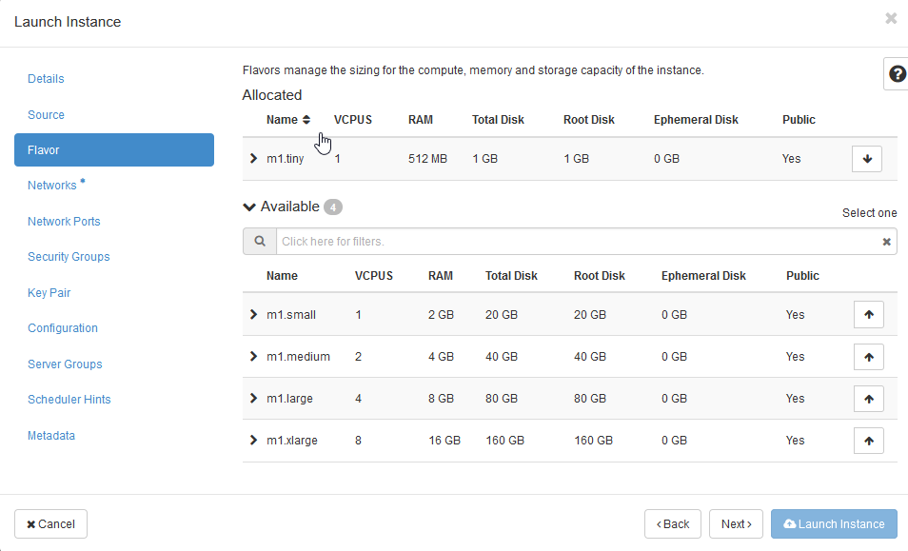
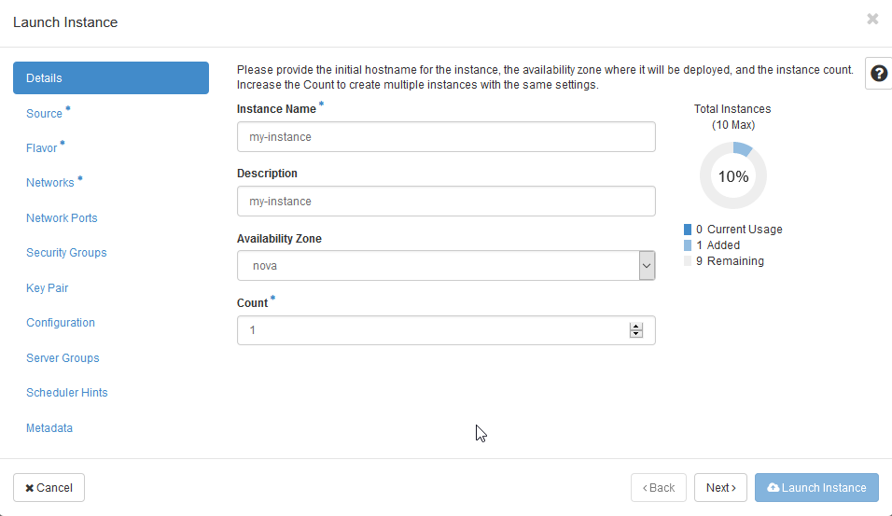
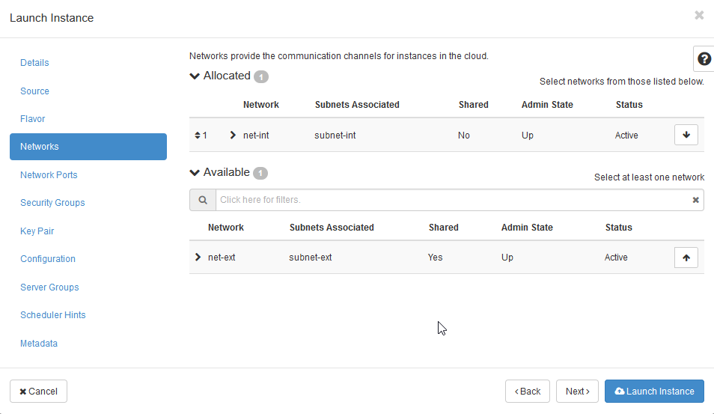
Lab: Kolla Ansible All in One Openstack (Cons’t)
Upload Image atau ISO
Create Instance
Menu Flavor silakan pilih spesifikasi instance
Upload image atau iso menggunakan cirros, silakan
Login Horizon >> Project >> Compute >> Instances >> Launch Instance
Openstack.panda.id/dashboard/project/instances
Pada menu Source silakan pilih OS atau image yang ingin Anda gunakan, disini kami contohkan OS yang kami gunakan yaitu Cirros
Menu Networks silakan pilih network internal yang telah dibuat sebelumnya.
Notes:
https://belajarlinux.id/openstack-membuat-instance-melalui-horizon/
https://belajarlinux.id/openstack-upload-image-atau-iso/
https://docs.openstack.org/kolla-ansible/latest/user/quickstart.html
https://docs.openstack.org/kolla-ansible/latest/user/virtual-environments.html
https://www.gkr.one/blg-20250424-u24-openstack?v=1bec678a0f6980689bb9000c1a51face
https://gist.github.com/gilangvperdana/82b35379eeccdad86c7e0b2143eba341

Slide 19
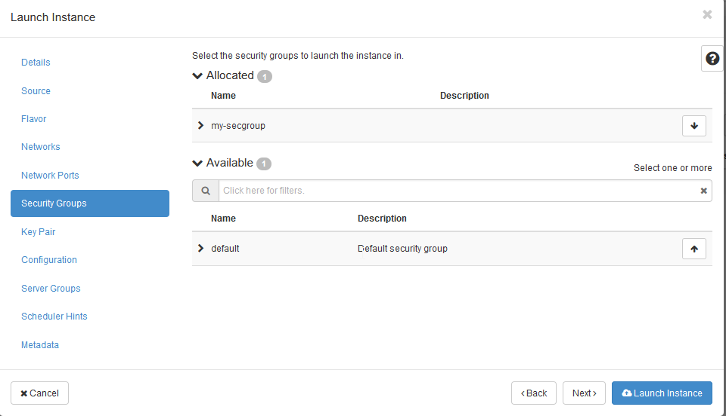
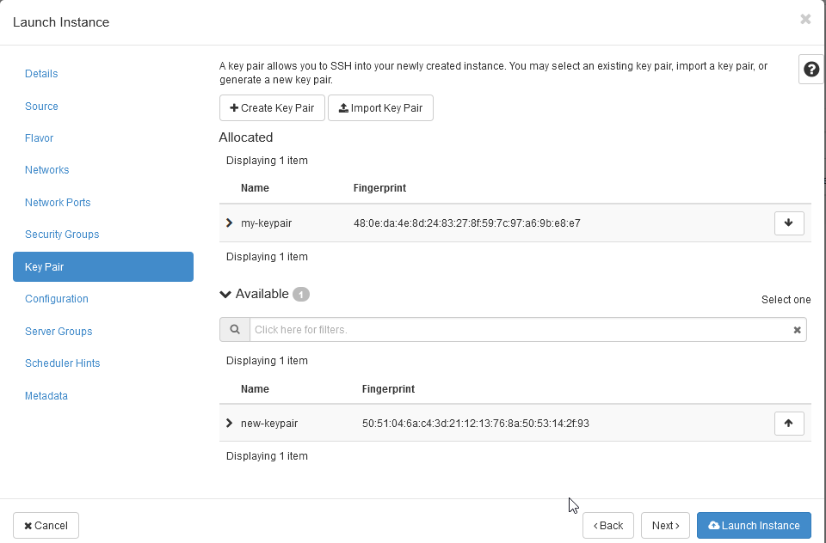
Lab: Kolla Ansible All in One Openstack (Cons’t)
Upload Image atau ISO
Create Instance
Jika sudah silakan, create Launch Instance silakan tunggu proses pembuatan Instance selesai
Menu Security Groups , silakan pilih Security Groups yang telah dibuat sebelumnya.
Openstack.panda.id/dashboard/project/instances
Saat ini instance sudah mendapatkan IP internal secara otomatis, supaya dapat diakses dari public silakan membuat floating IP pada instance silakan klik menu Associate Floating IP
Menu Key Pair silakan pilih key pair yang telah di buat juga sebelumnya
Openstack.panda.id/dashboard/project/instances
Klik tanda +
Notes:
https://belajarlinux.id/openstack-membuat-instance-melalui-horizon/
https://belajarlinux.id/openstack-upload-image-atau-iso/
https://docs.openstack.org/kolla-ansible/latest/user/quickstart.html
https://docs.openstack.org/kolla-ansible/latest/user/virtual-environments.html
https://www.gkr.one/blg-20250424-u24-openstack?v=1bec678a0f6980689bb9000c1a51face
https://gist.github.com/gilangvperdana/82b35379eeccdad86c7e0b2143eba341

Slide 20
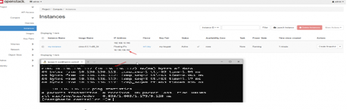
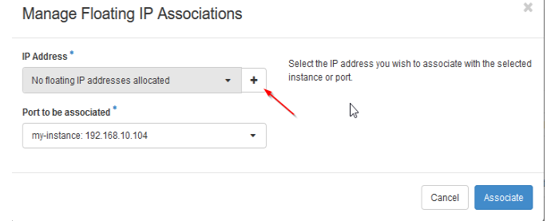
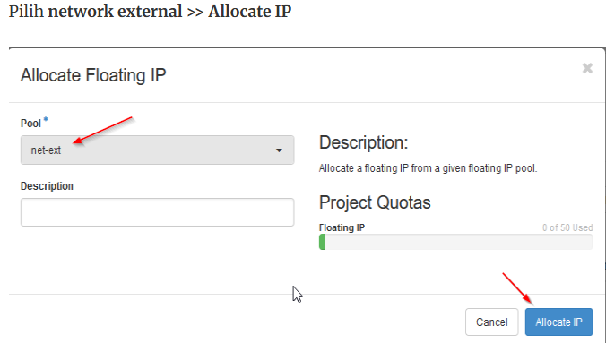
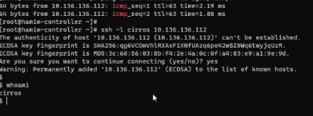
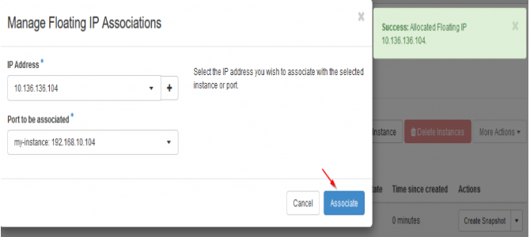
Lab: Kolla Ansible All in One Openstack (Cons’t)
Saat ini instance sudah mendapatkan dan menggunakan IP dari network internal dan external dan silakan test ping ke IP floating
Upload Image atau ISO
Create Instance
[root@controller ~]#
[root@controller ~]# ping 10.136.136.112 –c4
Manage Floating IP Associations
[root@controller ~]#
[root@controller ~]# ping 10.136.136.112 –c4
[root@controller ~]#
[root@controller ~]# ping 10.136.136.112 –c4
Pilih network external >> Allocate IP
Test login ke sisi instance
[root@controller ~]#
[root@controller ~]# ping 10.136.136.112 –c2 |grep icmp
Saat ini kita sudah mendapatkan IP nya, silakan klik Associate untuk dapat di assign ke instance Anda
[root@controller ~]#
[root@controller ~]# ping 10.136.136.112 –c2 |grep icmp
Notes:
https://belajarlinux.id/openstack-membuat-instance-melalui-horizon/
https://belajarlinux.id/openstack-upload-image-atau-iso/
https://docs.openstack.org/kolla-ansible/latest/user/quickstart.html
https://docs.openstack.org/kolla-ansible/latest/user/virtual-environments.html
https://www.gkr.one/blg-20250424-u24-openstack?v=1bec678a0f6980689bb9000c1a51face
https://gist.github.com/gilangvperdana/82b35379eeccdad86c7e0b2143eba341

Slide 21
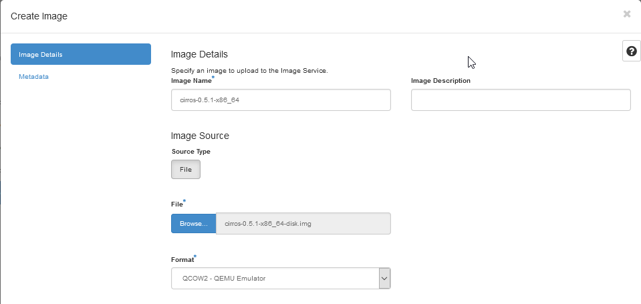
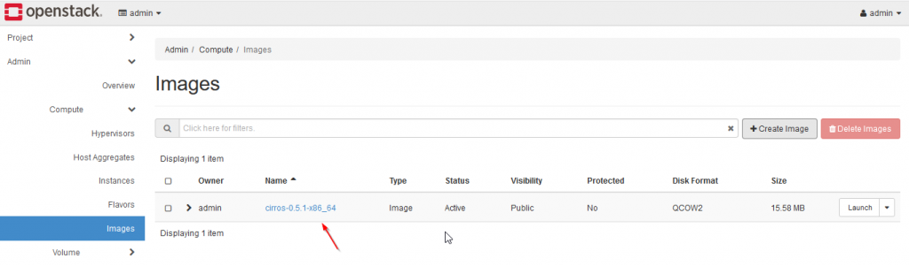
Lab: Kolla Ansible All in One Openstack (Cons’t)
Upload Image atau ISO
Create Image
Selanjutnya, isi Image Name dengan nama image yang Anda inginkan dan klik Browser >> Upload Image >> Format (QCOW2 – QEMU Emulator) >> Klik Create Image
upload image atau iso di openstack terdapat 2 cara yang dapat dilakukan yaitu melalui horizon (melalui web) atau CLI.
Upload image atau iso pastikan Anda sudah mengunguh image nya terlebih dahulu berikut link jika menggunakan Ubuntu, CentOS dan Cirros
  Ubuntu Cloud Images
  CentOS Cloud Images
  Cirros
Upload image atau iso menggunakan cirros, silakan login Horizon >> Admin >> Compute >> Images >> Create Images
Openstack.panda.id/dashboard/admin/images
Notes:
https://belajarlinux.id/openstack-upload-image-atau-iso/
https://docs.openstack.org/kolla-ansible/latest/user/quickstart.html
https://docs.openstack.org/kolla-ansible/latest/user/virtual-environments.html
https://www.gkr.one/blg-20250424-u24-openstack?v=1bec678a0f6980689bb9000c1a51face
https://gist.github.com/gilangvperdana/82b35379eeccdad86c7e0b2143eba341

Slide 22
Lab: Kolla Ansible All in One Openstack (Cons’t)
Create Instance Melalui Horizon
Selanjutnya, isi Image Name dengan nama image yang Anda inginkan dan klik Browser >> Upload Image >> Format (QCOW2 – QEMU Emulator) >> Klik Create Image
Upload image atau iso menggunakan cirros, silakan login Horizon >> Admin >> Compute >> Images >> Create Images
Openstack.panda.id/dashboard/admin/images
Notes:
https://belajarlinux.id/openstack-upload-image-atau-iso/
https://docs.openstack.org/kolla-ansible/latest/user/quickstart.html
https://docs.openstack.org/kolla-ansible/latest/user/virtual-environments.html
https://www.gkr.one/blg-20250424-u24-openstack?v=1bec678a0f6980689bb9000c1a51face
https://gist.github.com/gilangvperdana/82b35379eeccdad86c7e0b2143eba341

Slide 23
Lab: Kolla Ansible All in One Openstack (Cons’t)
Create Instance Melalui Horizon
Selanjutnya, isi Image Name dengan nama image yang Anda inginkan dan klik Browser >> Upload Image >> Format (QCOW2 – QEMU Emulator) >> Klik Create Image
Upload image atau iso menggunakan cirros, silakan login Horizon >> Admin >> Compute >> Images >> Create Images
Openstack.panda.id/dashboard/admin/images
Notes:
https://belajarlinux.id/openstack-upload-image-atau-iso/
https://docs.openstack.org/kolla-ansible/latest/user/quickstart.html
https://docs.openstack.org/kolla-ansible/latest/user/virtual-environments.html
https://www.gkr.one/blg-20250424-u24-openstack?v=1bec678a0f6980689bb9000c1a51face
https://gist.github.com/gilangvperdana/82b35379eeccdad86c7e0b2143eba341

Slide 24
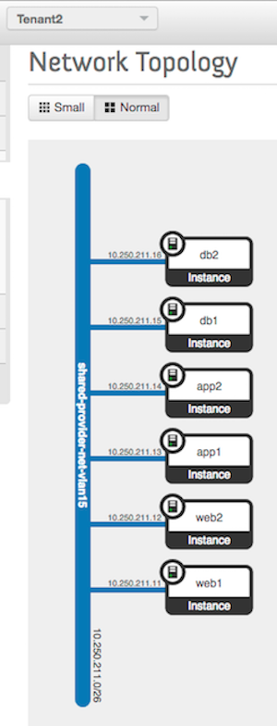
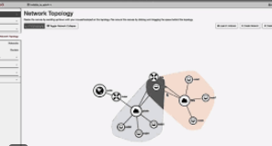
Membuat Network
Create Network
Openstack: Upload Image atau ISO
Openstack: Membuat Network
Openstack: Membuat Router
Openstack: Menambahkan SSH Key
Openstack: Menambah dan Menggunakan Security Group
Notes:
https://superuser.openinfra.org/articles/provisioning-neutron-networks-with-the-nsx-v-plugin/

Slide 25
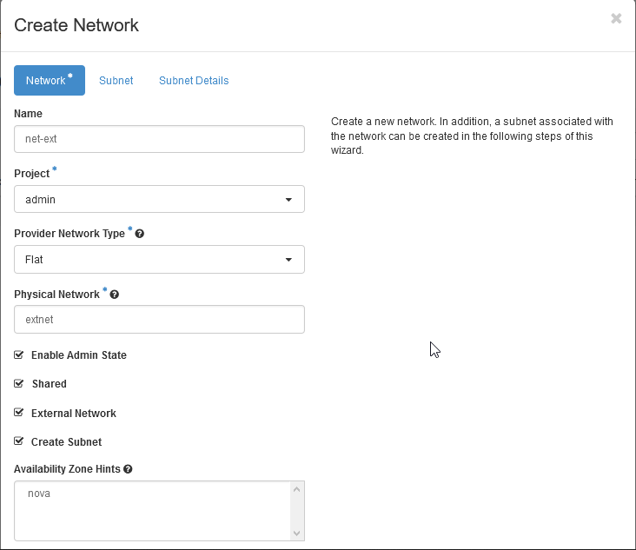
Lab: Kolla Ansible All in One Openstack (Cons’t)
Create Network
Network yaitu network external dan network internal
Menu Network
Network External: Network yang tersambung keluar (node controller dan compute).
Network internal: Network yang akan terhubung dan digunakan oleh instance/vm.
Login Horizon >> Admin >> Network >> Networks >> Create Network
Openstack.panda.id/dashboard/admin/networks/
Openstack.panda.id/dashboard/admin/networks/
Name: Name network
Project: Admin
Provider Network Type: Flat
Physical Network: extnet
Selanjutnya pindah ke menu Subnet , silakan isi nama subnet Anda, dan isi juga network untuk network net-ext
Notes:
https://belajarlinux.id/openstack-upload-image-atau-iso/
https://docs.openstack.org/kolla-ansible/latest/user/quickstart.html
https://docs.openstack.org/kolla-ansible/latest/user/virtual-environments.html
https://www.gkr.one/blg-20250424-u24-openstack?v=1bec678a0f6980689bb9000c1a51face
https://gist.github.com/gilangvperdana/82b35379eeccdad86c7e0b2143eba341

Slide 26
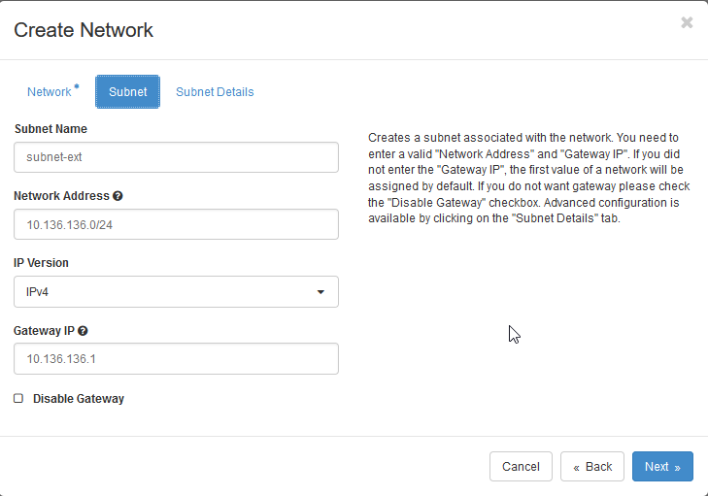
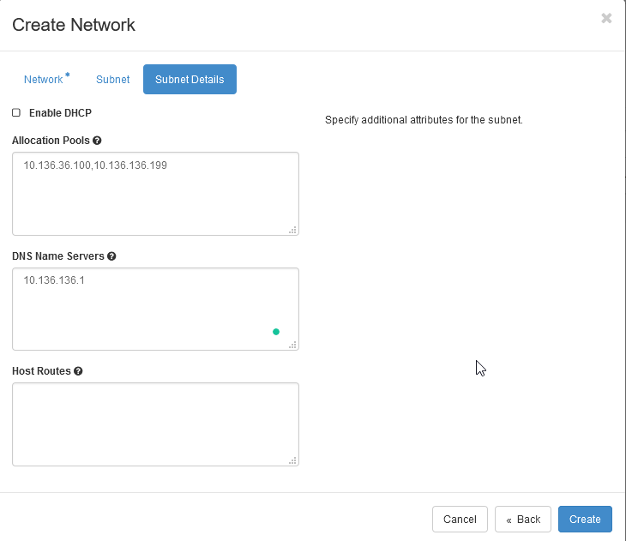
Lab: Kolla Ansible All in One Openstack (Cons’t)
Create Network
Menu _ Subnet Details _ silakan isi ip pool yang ingin Anda gunakan dari network address diatas, jika sudah silakan klik Create
Menu Subnet , silakan isi nama subnet Anda, dan isi juga network untuk network net-ext
Openstack.panda.id/dashboard/admin/networks/
Notes:
https://belajarlinux.id/openstack-upload-image-atau-iso/
https://docs.openstack.org/kolla-ansible/latest/user/quickstart.html
https://docs.openstack.org/kolla-ansible/latest/user/virtual-environments.html
https://www.gkr.one/blg-20250424-u24-openstack?v=1bec678a0f6980689bb9000c1a51face
https://gist.github.com/gilangvperdana/82b35379eeccdad86c7e0b2143eba341

Slide 27
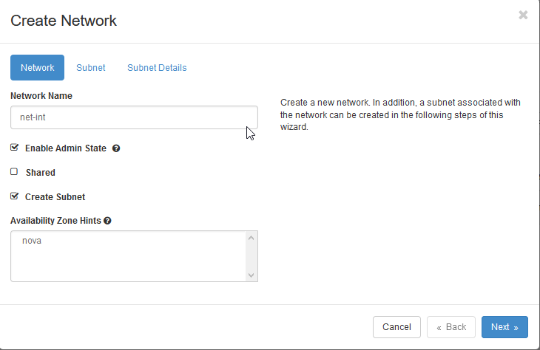
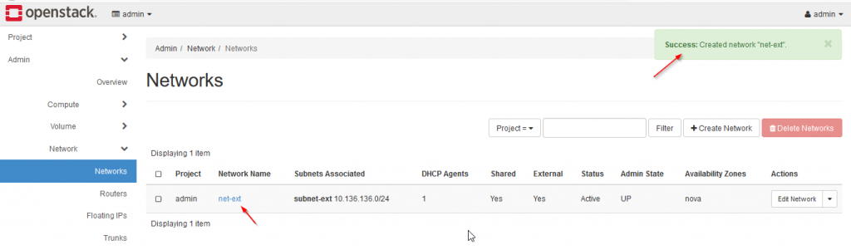
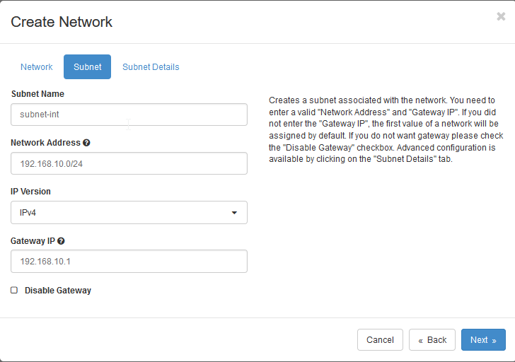
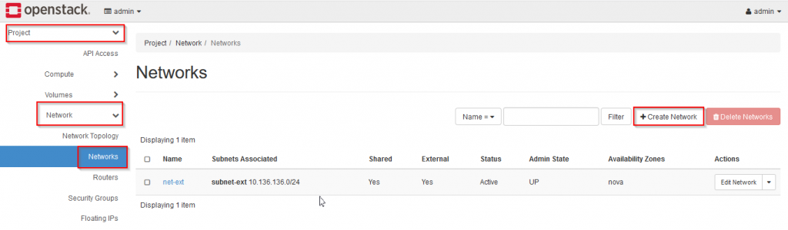
Lab: Kolla Ansible All in One Openstack (Cons’t)
Create Network
Menu Network isikan nama network
Pembuatan network selesai
Saat ini external network sudah berhasil dibuat, selanjutnya create internal network seperti berikut:
Login Horizon >> Project >> Network >> Networks >> Create Network
Openstack.panda.id/dashboard/admin/networks/Create Network
Pindah ke menu subnet untuk menentukan ip address dan subnet nya
Notes:
https://belajarlinux.id/openstack-upload-image-atau-iso/
https://docs.openstack.org/kolla-ansible/latest/user/quickstart.html
https://docs.openstack.org/kolla-ansible/latest/user/virtual-environments.html
https://www.gkr.one/blg-20250424-u24-openstack?v=1bec678a0f6980689bb9000c1a51face
https://gist.github.com/gilangvperdana/82b35379eeccdad86c7e0b2143eba341

Slide 28
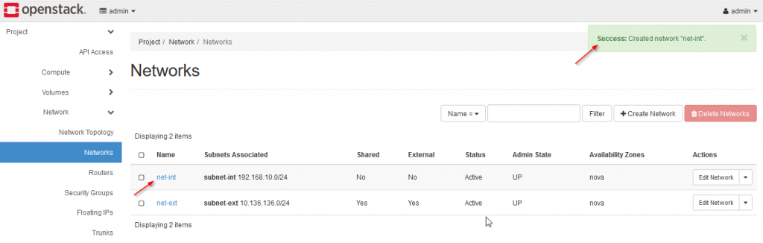
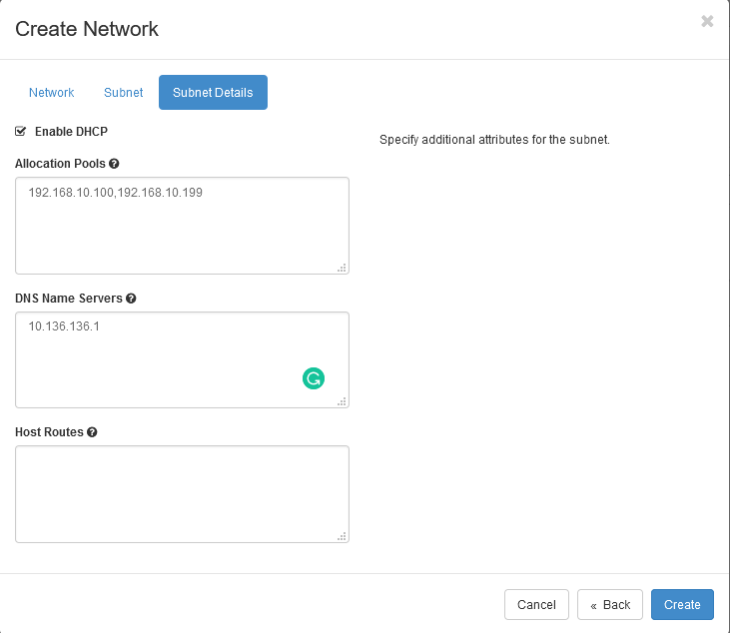
Lab: Kolla Ansible All in One Openstack (Cons’t)
Create Network
Pada menu Subnet Details, silakan isi pool network yang ingin digunakan dari range ip address diatas lalu klik _ Create _ untuk membuat network internal
Proses pembuatan network internal
Notes:
https://belajarlinux.id/openstack-upload-image-atau-iso/
https://docs.openstack.org/kolla-ansible/latest/user/quickstart.html
https://docs.openstack.org/kolla-ansible/latest/user/virtual-environments.html
https://www.gkr.one/blg-20250424-u24-openstack?v=1bec678a0f6980689bb9000c1a51face
https://gist.github.com/gilangvperdana/82b35379eeccdad86c7e0b2143eba341

Slide 29
Membuat Router
Create Router
Openstack: Upload Image atau ISO
Openstack: Membuat Network
Openstack: Membuat Router
Openstack: Menambahkan SSH Key
Openstack: Menambah dan Menggunakan Security Group
Notes:
https://belajarlinux.id/openstack-membuat-router/

Slide 30
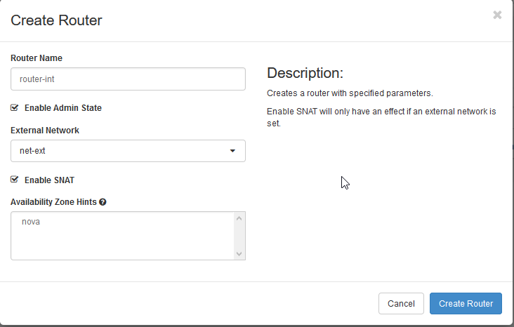
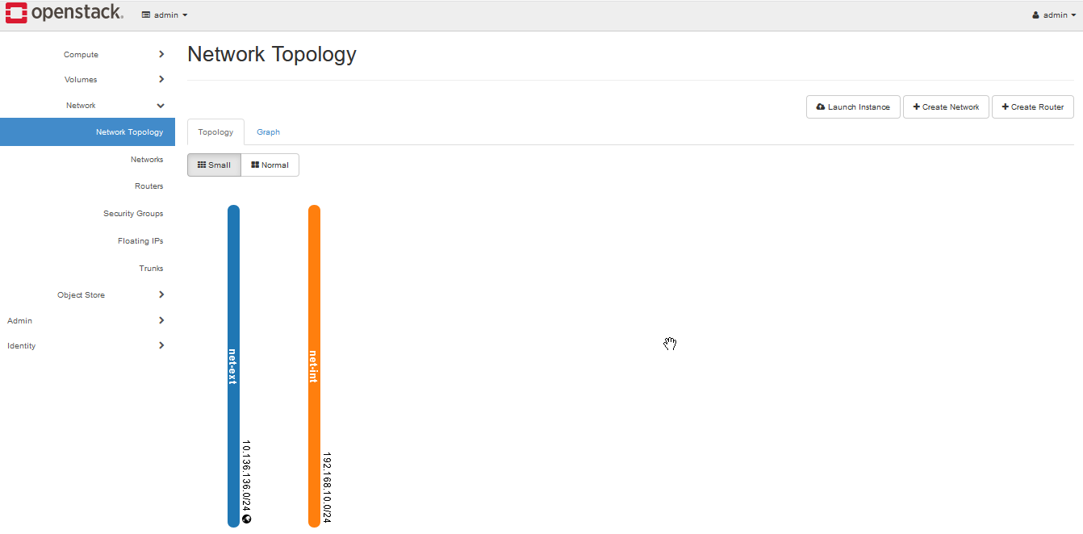
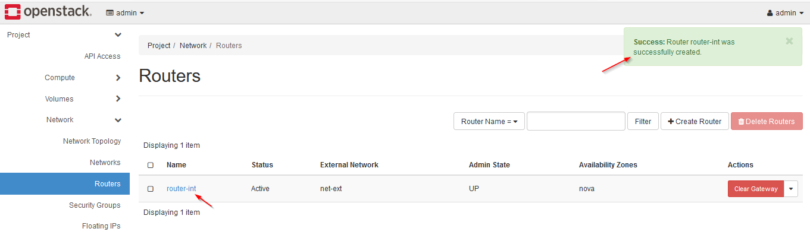
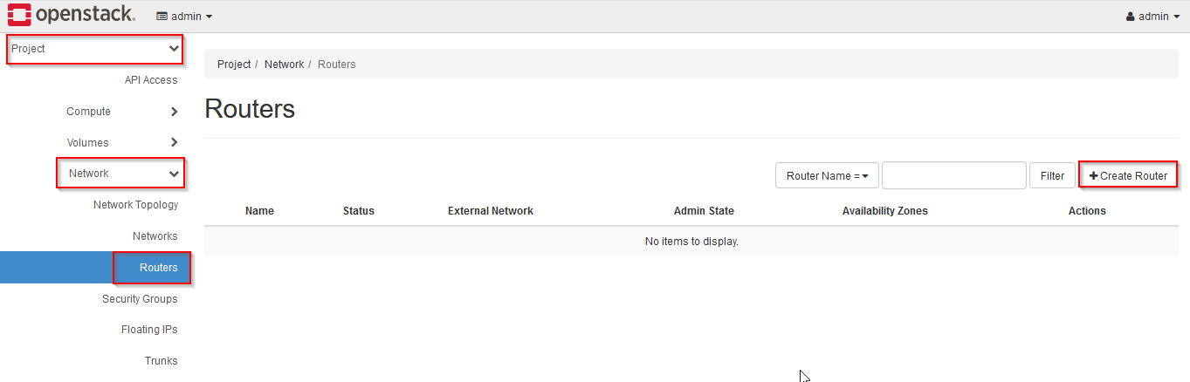
Lab: Kolla Ansible All in One Openstack (Cons’t)
Isi nama Router yang Anda inginkan contoh seperti gambar dibawah ini, klik Create Router untuk membuat router
Create Router
Membuat router melalui horizon, fungsi router sendiri untuk menghubungkan network yang telah kita buat sebelumnya, jika di lihat melalui Network topologi saat ini sudah terdapat 2 network internal dan external
Membuat router Login ke Horizon >> Network >> Router >> Create Router
Notes:
https://belajarlinux.id/openstack-membuat-router/
https://belajarlinux.id/openstack-upload-image-atau-iso/
https://docs.openstack.org/kolla-ansible/latest/user/quickstart.html
https://docs.openstack.org/kolla-ansible/latest/user/virtual-environments.html
https://www.gkr.one/blg-20250424-u24-openstack?v=1bec678a0f6980689bb9000c1a51face
https://gist.github.com/gilangvperdana/82b35379eeccdad86c7e0b2143eba341

Slide 31
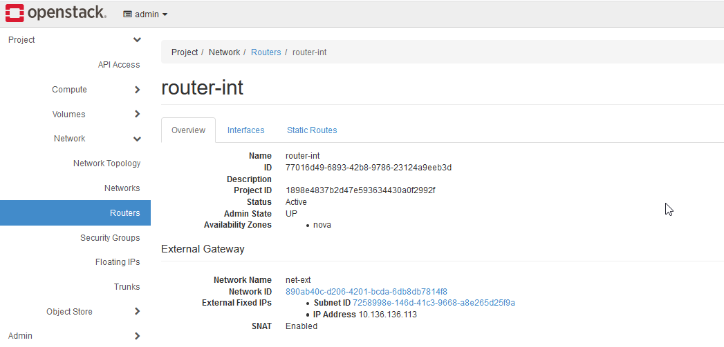
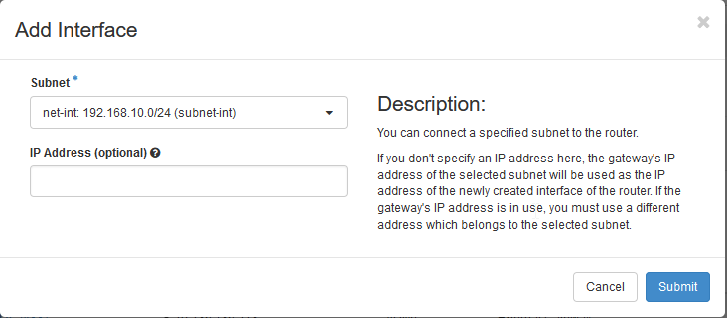
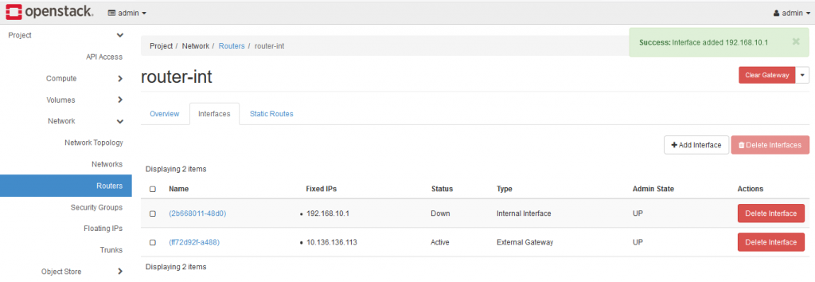
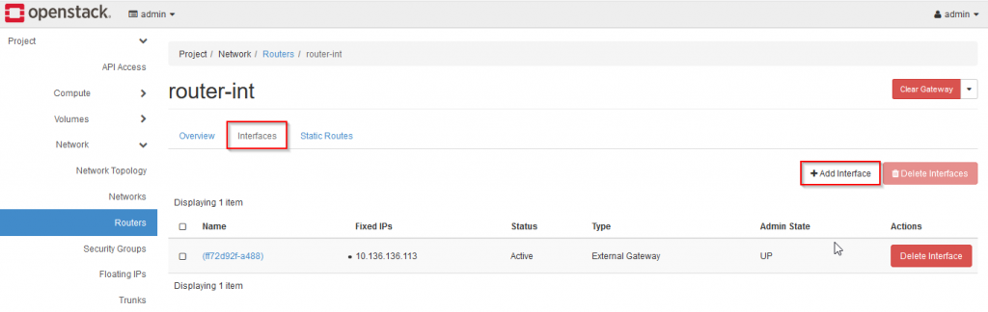
Lab: Kolla Ansible All in One Openstack (Cons’t)
Create Router
Pilih network internal yang sudah dibuat sebelumnya lalu Submit
Detail informasi dari router
Saat ini interface sudah berhasil di tambahkan
Selanjutnya pindah ke menu Interface >> Add Interface untuk menambahkan interface network yang sudah kita buat sebelumnya
Notes:
https://belajarlinux.id/openstack-upload-image-atau-iso/
https://docs.openstack.org/kolla-ansible/latest/user/quickstart.html
https://docs.openstack.org/kolla-ansible/latest/user/virtual-environments.html
https://www.gkr.one/blg-20250424-u24-openstack?v=1bec678a0f6980689bb9000c1a51face
https://gist.github.com/gilangvperdana/82b35379eeccdad86c7e0b2143eba341

Slide 32
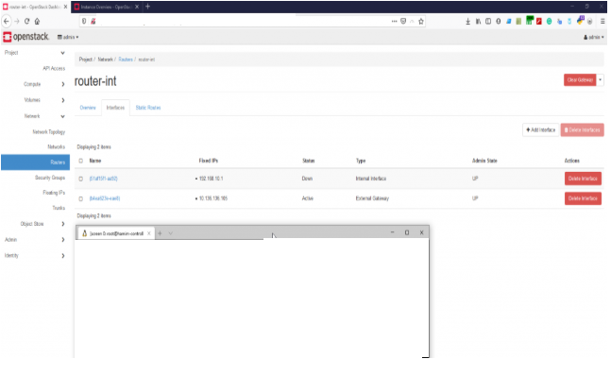
Lab: Kolla Ansible All in One Openstack (Cons’t)
Create Router
Proses pembuatan network internal
Selajutnya test ping dari controller ke IP Gateway atau IP Router yang sudah kita buat sebelumnya.
Openstack.panda.id/dashboard/project/routers/a5b00947-db9a-4934-a202-f2bd0cg1a1c/
Openstack.panda.id/dashboard/project/routers/a5b00947-db9a-4934-a202-f2bd0cg1a1c/
[root@controller ~]#
[root@controller ~]# ping 10.136.136.112 –c5
PING 10.136.136.185 (10.136.136.185) 56(84) bytes of data.
64 bytes from 10.136.136.185: icmp_seq=1 ttl=64 time=101ms TTL=0.491 ms
64 bytes from 10.136.136.185: icmp_seq=1 ttl=64 time=101ms TTL=0.491 ms
64 bytes from 10.136.136.185: icmp_seq=1 ttl=64 time=101ms TTL=0.491 ms
64 bytes from 10.136.136.185: icmp_seq=1 ttl=64 time=101ms TTL=0.491 ms
64 bytes from 10.136.136.185: icmp_seq=1 ttl=64 time=101ms TTL=0.491 ms
64 bytes from 10.136.136.185: icmp_seq=1 ttl=64 time=101ms TTL=0.491 ms
64 bytes from 10.136.136.185: icmp_seq=1 ttl=64 time=101ms TTL=0.491 ms
64 bytes from 10.136.136.185: icmp_seq=1 ttl=64 time=101ms TTL=0.491 m
[root@controller ~]#
[root@controller ~]# ping 10.136.136.112 –c5
PING 10.136.136.185 (10.136.136.185) 56(84) bytes of data.
64 bytes from 10.136.136.185: icmp_seq=1 ttl=64 time=101ms TTL=0.491 ms
64 bytes from 10.136.136.185: icmp_seq=1 ttl=64 time=101ms TTL=0.491 ms
64 bytes from 10.136.136.185: icmp_seq=1 ttl=64 time=101ms TTL=0.491 ms
64 bytes from 10.136.136.185: icmp_seq=1 ttl=64 time=101ms TTL=0.491 ms
64 bytes from 10.136.136.185: icmp_seq=1 ttl=64 time=101ms TTL=0.491 ms
Notes:
https://belajarlinux.id/openstack-upload-image-atau-iso/
https://docs.openstack.org/kolla-ansible/latest/user/quickstart.html
https://docs.openstack.org/kolla-ansible/latest/user/virtual-environments.html
https://www.gkr.one/blg-20250424-u24-openstack?v=1bec678a0f6980689bb9000c1a51face
https://gist.github.com/gilangvperdana/82b35379eeccdad86c7e0b2143eba341

Slide 33
Menambahkan SSH Key
Create SSH keys
Openstack: Upload Image atau ISO
Openstack: Membuat Network
Openstack: Membuat Router
Openstack: Menambahkan SSH Key
Openstack: Menambah dan Menggunakan Security Group
Notes:
https://belajarlinux.id/openstack-membuat-router/

Slide 34
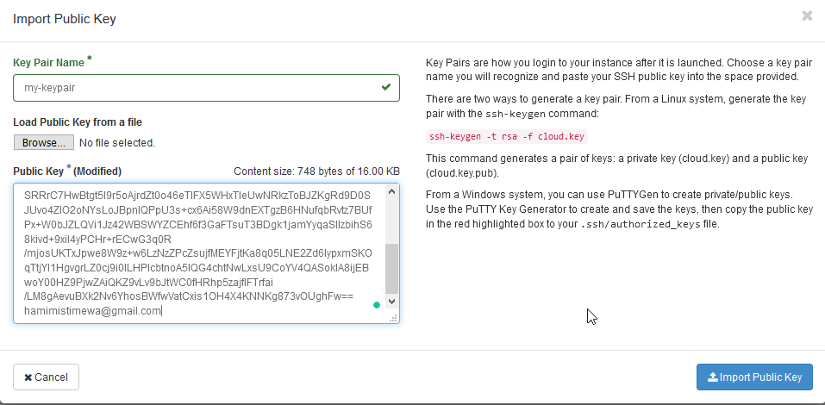
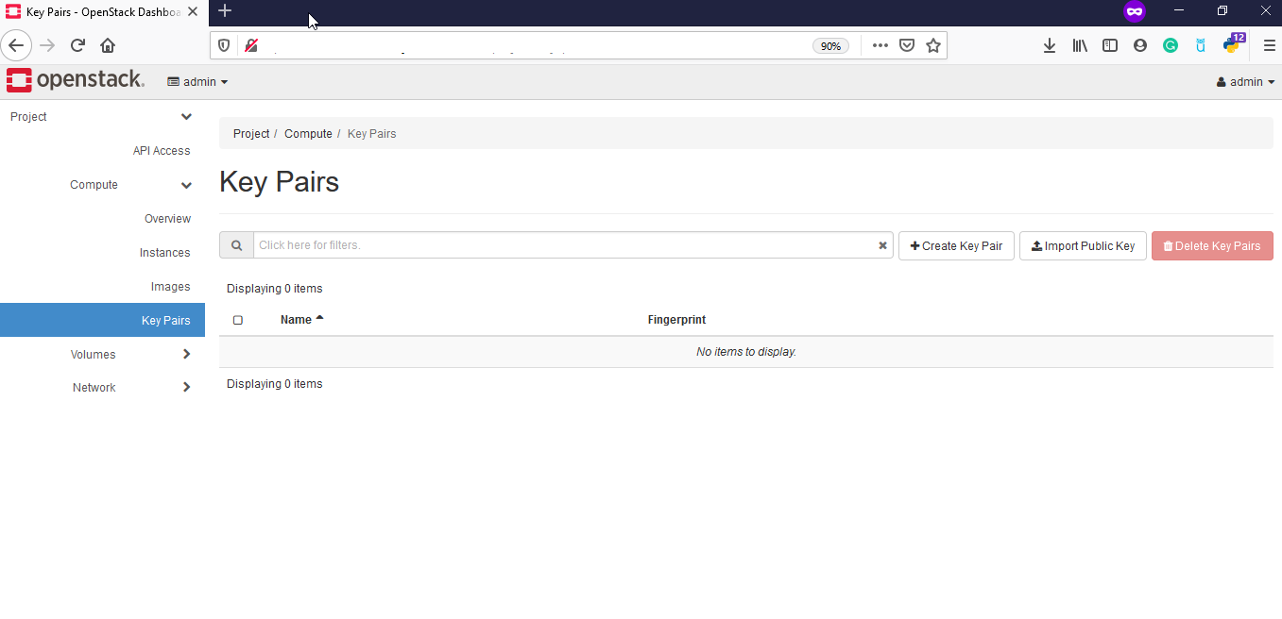
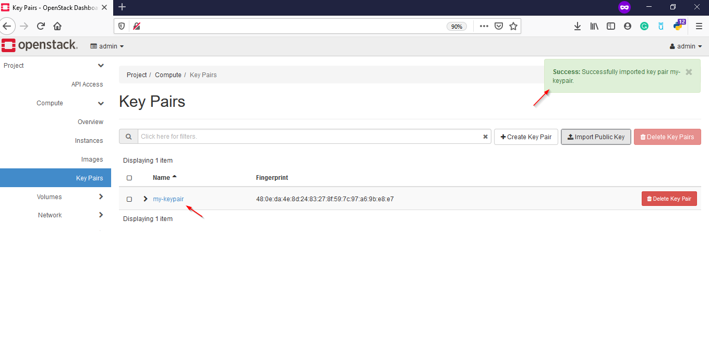
Lab: Kolla Ansible All in One Openstack (Cons’t)
Create SSH Keys
Import Public Key
Silakan klik menu Import Public Key lalu berikan nama key Anda dan isi public key Anda contoh nya seperti gambar dibawah lalu klik Import Public Key
Menambahkan SSH Key di openstack. Di openstack untuk menambahkan SSH Key dapat melalui CLI ataupun Horizon, disini kami contohkan menggunakan Horizon.
Login ke Horizon >> Compute >> Key Pairs
Openstack.panda.id/dashboard/project/key_pairs
Openstack.panda.id/dashboard/project/key_pairs
Ada 2 pemilihan terkait SSH Key diantaranya:
Import Public Key: Jika Anda sudah mempunyai public key pribadi Anda dapat upload public key nya tanpa create key baru.
Create Key Pair: Anda dapat membuat keypair baru dan keypair ini akan Anda gunakan untuk login ke instance
Berikut kami berikan contoh masing – masing pilihan diatas: Import Public Key.
Import Public Key
Silakan klik menu Import Public Key lalu berikan nama key Anda dan isi public key Anda contoh nya seperti gambar dibawah lalu klik Import Public Key
Openstack.panda.id/dashboard/project/key_pairs
Notes:
https://belajarlinux.id/openstack-upload-image-atau-iso/
https://belajarlinux.id/openstack-menambahkan-ssh-key/
https://docs.openstack.org/kolla-ansible/latest/user/quickstart.html
https://docs.openstack.org/kolla-ansible/latest/user/virtual-environments.html
https://www.gkr.one/blg-20250424-u24-openstack?v=1bec678a0f6980689bb9000c1a51face
https://gist.github.com/gilangvperdana/82b35379eeccdad86c7e0b2143eba341

Slide 35
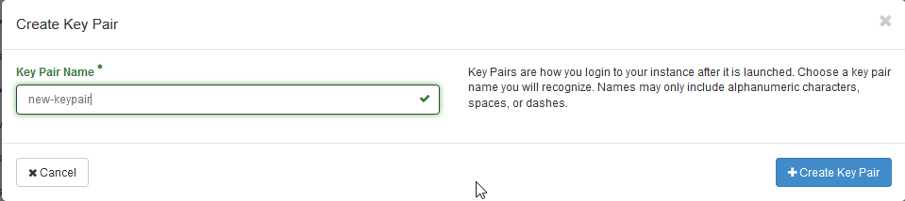
Lab: Kolla Ansible All in One Openstack (Cons’t)
Create SSH Keys
Create Key Pair
Silakan Klik pada Create Key Pair lalu isi nama keypair
silakan klik Create Key Pair, setelah nya akan muncul pop seperti Anda, silakan download key pair nya.
Openstack.panda.id/dashboard/project/key_pairs
Openstack.panda.id/dashboard/project/key_pairs
Notes:
https://belajarlinux.id/openstack-upload-image-atau-iso/
https://docs.openstack.org/kolla-ansible/latest/user/quickstart.html
https://docs.openstack.org/kolla-ansible/latest/user/virtual-environments.html
https://www.gkr.one/blg-20250424-u24-openstack?v=1bec678a0f6980689bb9000c1a51face
https://gist.github.com/gilangvperdana/82b35379eeccdad86c7e0b2143eba341

Slide 36
Menambah Security
Create Security Group
Openstack: Upload Image atau ISO
Openstack: Membuat Network
Openstack: Membuat Router
Openstack: Menambahkan SSH Key
Openstack: Menambah dan Menggunakan Security Group
Notes:
https://belajarlinux.id/openstack-membuat-router/

Slide 37
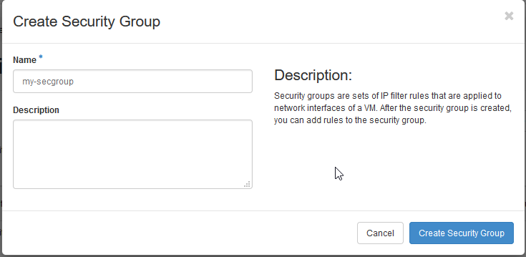
Lab: Kolla Ansible All in One Openstack (Cons’t)
Create Security Group
Isi nama security group Anda lalu klik Create Security Group
Membuat dan menggunakan security group dapat melalui horizon atau via CLI. Disini kami akan menggunakan horizon untuk menambahkan security group, berikut tahapannya:
Login Horizon >> Project >> Network >> Security Group >> +Create Security Group
Openstack.panda.id/dashboard/project/security_groups/
Openstack.panda.id/dashboard/project/security_groups/
Saat ini security grouup sudah berhasil
Openstack.panda.id/dashboard/project/security_groups/
Notes:
https://belajarlinux.id/openstack-upload-image-atau-iso/
https://docs.openstack.org/kolla-ansible/latest/user/quickstart.html
https://docs.openstack.org/kolla-ansible/latest/user/virtual-environments.html
https://www.gkr.one/blg-20250424-u24-openstack?v=1bec678a0f6980689bb9000c1a51face
https://gist.github.com/gilangvperdana/82b35379eeccdad86c7e0b2143eba341

Slide 38
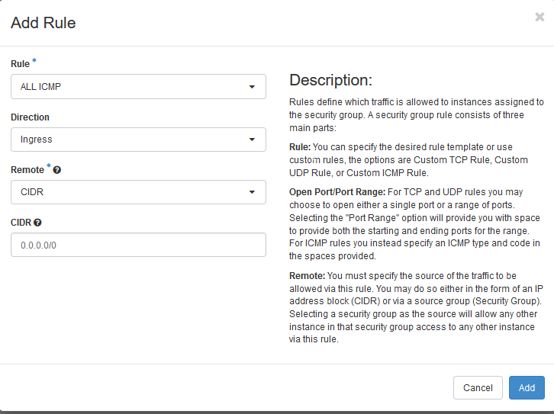
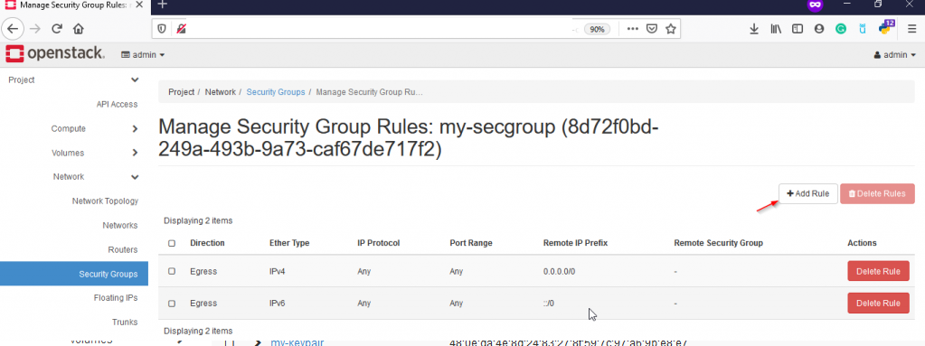
Lab: Kolla Ansible All in One Openstack (Cons’t)
Create Security Group
Klik + Add Rule untuk menambahkan rule atau port yang ingin Anda gunakan, misalnya disini kami ingin allow port atau protokol IMCP, lalu klik Add
Terdapat 2 security group (default) dan security group yang sudah dibuat sebelumnya.
Untuk yang default sebenarnya dapat Anda gunakan juga. Untuk menambahkan port atau menggunakan security group silakan klik menu Manage Rules pada security group Anda
Openstack.panda.id/dashboard/project/security_groups/8d72f0bd-249a-493b-9a73-caf67de717f2/
Openstack.panda.id/dashboard/project/security_groups/8d72f0bd-249a-493b-9a73-caf67de717f2/
Notes:
https://belajarlinux.id/openstack-upload-image-atau-iso/
https://docs.openstack.org/kolla-ansible/latest/user/quickstart.html
https://docs.openstack.org/kolla-ansible/latest/user/virtual-environments.html
https://www.gkr.one/blg-20250424-u24-openstack?v=1bec678a0f6980689bb9000c1a51face
https://gist.github.com/gilangvperdana/82b35379eeccdad86c7e0b2143eba341

Slide 39
Lab: Kolla Ansible All in One Openstack (Cons’t)
Create SSH Keys
Saat ini rule ICMP sudah dibuat
Openstack.panda.id/dashboard/project/security_groups/8d72f0bd-249a-493b-9a73-caf67de717f2/
Openstack.panda.id/dashboard/project/security_groups/8d72f0bd-249a-493b-9a73-caf67de717f2/
Dapat menambahkan rule atau port – port yang Anda inginkan misalnya port ssh, imap, http dan yang lainnya melalui security group
Notes:
https://belajarlinux.id/openstack-upload-image-atau-iso/
https://docs.openstack.org/kolla-ansible/latest/user/quickstart.html
https://docs.openstack.org/kolla-ansible/latest/user/virtual-environments.html
https://www.gkr.one/blg-20250424-u24-openstack?v=1bec678a0f6980689bb9000c1a51face
https://gist.github.com/gilangvperdana/82b35379eeccdad86c7e0b2143eba341

Slide 40
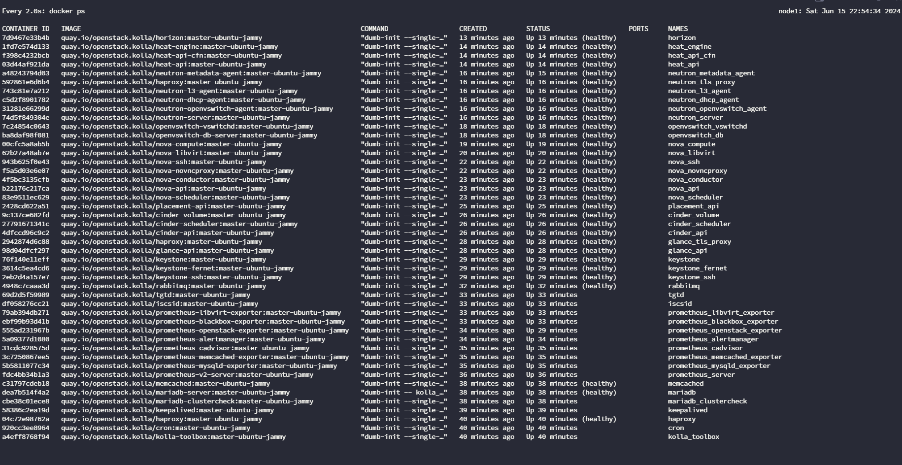
Lab: Kolla Ansible All in One Openstack (Cons’t)
All Service running on Docker
Horizon
http://Openstack.panda.id/Deploy/
Notes:
https://gist.github.com/gilangvperdana/82b35379eeccdad86c7e0b2143eba341
https://belajarlinux.id/openstack-upload-image-atau-iso/
https://docs.openstack.org/kolla-ansible/latest/user/quickstart.html
https://docs.openstack.org/kolla-ansible/latest/user/virtual-environments.html
https://www.gkr.one/blg-20250424-u24-openstack?v=1bec678a0f6980689bb9000c1a51face

Slide 41


Lab: Kolla Ansible All in One Openstack (Cons’t)
Network Agent
Compute Service

Slide 42

Lab: Kolla Ansible All in One Openstack (Cons’t)
Volume Service
Compute Service
Notes:
Reference
https://docs.openstack.org/kolla-ansible/latest/user/quickstart.html
https://quay.io/organization/openstack.kolla
https://github.com/openstack/kolla-ansible/blob/master/etc/kolla/globals.yml
https://achchusnulchikam.medium.com/deploy-production-ready-openstack-using-kolla-ansible-9cd1d1f210f1

Slide 43
Deploy All-in-One OpenStack with Kolla-Ansible on Ubuntu 22.04
Openstack.panda.id/dashboard/admin/images
Openstack.panda.id/Deploy/
Notes:
https://vikipranata.is-a.dev/posts/openstack-kolla-ansible-2024.2/
https://superuser.openinfra.org/articles/kolla-ansible-openstack-installation-ubuntu-24-04/
https://docs.openstack.org/kolla-ansible/latest/user/quickstart.html
https://www.youtube.com/watch?v=Mc70SjV72ck
https://www.scribd.com/document/822144481/openstack-kolla-Ansible-AIO-Multinode-Documentation
Kolla Ansible OpenStack Installation (Ubuntu 24.04) (Rev.: 20250523-0)
https://www.gkr.one/blg-20250424-u24-openstack
Deploy Multinode OpenStack using Kolla-Ansible
Multinode Deployment of Kolla https://docs.openstack.org/kolla-ansible/latest/user/multinode.html
Deploy Multinode OpenStack using Kolla-Ansible
https://kifarunix.com/deploy-multinode-openstack-using-kolla-ansible/
https://superuser.openinfra.org/articles/how-to-implement-an-openstack-based-private-cloud-with-kolla-ansible-part-2/

Slide 44





OpenStack Menggunakan Kolla Ansible
hybrid system of bare metal and virtualised nodes is managed and provisioned by Kayobe
$ openstack service list
+-------------------------------------------------------+----------------------+-----------------------+
| ID | Name | Type |
+-------------------------------------------------------+----------------------+-----------------------+
| 10cb2de52c404662aa6ca3ccdb8f2cf7 | cinderv2 | volumev2 |
| 250a6a7cf4d44f0c9cdd2a39f8203ccc | cinderv3 | volumev3 |
| 2d99d37fc498465591faa9f44580d991 | placement | placement |
| 4001de18bf5c45f5a1467a31ea5a2afd | heat-cfn | cloudformation |
| 505333b0b90b4962a37d55c44bc940f9 | keystone | identity |
| 612c645a37e848d49af9f6f53dc6e8ac | nova_legacy | compute_legacy |
| 87c2edd540c84c8296251ea284a14398 | neutron | network |
| 94e54356818d43af8ed7f4e1a6da28f1 | nova | compute |
| a9f6eb791ec740c183ecff67dc7c7b08 | glance | image |
| eaf1f96955244acfbf5124e42c32f4e6 | heat | orchestration |
+------------------------------------------------------+----------------------+-----------------------+
An example of a 3 rack system managed and provisioned using Kayobe with a high-availability control plane
Notes:
https://btech.id/en/news/cara-menginstall-openstack-menggunakan-kolla-ansible/
https://kifarunix.com/deploy-all-in-one-openstack-with-kolla-ansible-on-ubuntu-22-04/
https://superuser.openinfra.org/articles/how-to-implement-an-openstack-based-private-cloud-with-kolla-ansible-part-1/
https://www.stackhpc.com/pages/kayobe.html

Slide 45





OpenStack Series #2 — Install openstack menggunakan Kolla Ansible (Multi-nodes)
Prasyarat
Bare-metal / Virtual Machine (Minimal 1 node untuk metode All In One dan minimal 2 node untuk metode Multinode)
Minimal 2 NIC per VM dengan 1 interface yang tidak diberikan ip
Disk tambahan untuk backend storage (At Least 50gb)
Ram minimal 8gb
Koneksi ke Internet
Mempunyai akses root maupun user sudoer
Notes:
https://medium.com/btech-engineering/openstack-series-2-install-openstack-menggunakan-kolla-ansible-multi-nodes-df4f07aae73e
https://medium.com/btech-engineering/openstack-series-2-install-openstack-menggunakan-kolla-ansible-multi-nodes-df4f07aae73e

Slide 46
Openstack 2024.2 with Kolla Ansible
Openstack.panda.id/dashboard/admin/images
Openstack.panda.id/Deploy/
Notes:
https://vikipranata.is-a.dev/posts/openstack-kolla-ansible-2024.2/

Slide 47
Openstack 2024.2 with Kolla Ansible (Cons’t)
Node Hostname | Node Role | vCPU | Memory | RootDisk | ManagementNet | StorageNet
Deploy01adm01 | Ansible | 2 Core | 2GB | 20GB | 10.78.78.199 | -
Deploy01con01 | Controller | 16 Core | 16GB | 40GB | 10.78.78.201 | 10.79.79.201
Deploy01con02 | Controller | 16 Core | 16GB | 40GB | 10.78.78.202 | 10.79.79.202
Deploy01con03 | Controller | 16 Core | 16GB | 40GB | 10.78.78.203 | 10.79.79.203
Deploy01hpv01 | Hypervisor | 32 Core | 32GB | 40GB | 10.78.78.204 | 10.79.79.204
Deploy01hpv02 | Hypervisor | 32 Core | 32GB | 40GB | 10.78.78.205 | 10.79.79.205
Notes:
https://vikipranata.is-a.dev/posts/openstack-kolla-ansible-2024.2/

Slide 48
Openstack 2024.2 with Kolla Ansible (Cons’t)
network:
version: 2
ethernets:
eth0:
match:
macaddress: "BC:24:11:D3:02:2F"
set-name: "eth0"
critical: true
eth1:
match:
macaddress: "BC:24:11:77:6F:A2"
set-name: "eth1"
addresses:
- "10.78.78.201/24"
nameservers:
addresses:
- 10.78.78.103
- 10.78.78.104
search:
- Deploy.is-a.dev
routes:
- to: "default"
via: "10.78.78.254"
critical: true
eth2:
match:
macaddress: "BC:24:11:D6:06:52"
set-name: "eth2"
addresses:
- "10.79.79.201/24"
critical: true
mtu: 9000
eth3:
match:
macaddress: "BC:24:11:EF:59:FD"
set-name: "eth3"
addresses:
- "10.79.80.201/24"
critical: true
mtu: 9000
Interface mapping:
eth0 for Public Network
eth1 for Management Network
eth2 for Storage Network with Jumbo frames
eth4 for Tunnel/Self Service/Guest Network with Jumbo frames
We can review network configuration in sample-netplan.yaml
Notes:
https://raw.githubusercontent.com/vikipranata/vikipranata/refs/heads/hugo/content/posts/openstack-kolla-ansible-2024.2/uploads/sample-netplan.yaml

Slide 49
Openstack 2024.2 with Kolla Ansible (Cons’t)
Installing NFS Server for Glance Service in Deploy01adm01 node
Install packages and dependencies
sudo apt install -y git gcc libssl-dev libffi-dev \
python3-venv python3-dev python3-selinux python3-setuptools \
python3-pip python3-docker nfs-common
sudo apt update
sudo apt install nfs-kernel-server
sudo mkdir -p /data
sudo chown nobody:nogroup /data
echo "/data *(rw,sync,no_subtree_check)" >> /etc/exports
sudo systemctl restart nfs-kernel-server
sudo exportfs -v
Mount nfs volume for all node
sudo mkdir /data cat <<EOF | sudo tee -a /etc/fstab 10.78.78.199:/data /data nfs defaults,_netdev 0 0 EOF
sudo mount /data
Create virtual environment for kolla-ansible
python3 -m venv kolla-venv
cd kolla-venv
source bin/activate
pwd
Execute in all nodes
Mapping static hostname in /etc/hosts
cat <<EOF | tee -a /etc/hosts
10.78.78.199 Deploy01adm01 Deploy01adm01.Deploy.is-a.dev
10.78.78.201 Deploy01con01 Deploy01con01.Deploy.is-a.dev
10.78.78.202 Deploy01con02 Deploy01con02.Deploy.is-a.dev
10.78.78.203 Deploy01con02 Deploy01con03.Deploy.is-a.dev
10.78.78.204 Deploy01hpv01 Deploy01hpv01.Deploy.is-a.dev
10.78.78.205 Deploy01hpv02 Deploy01hpv02.Deploy.is-a.dev
10.78.78.200 os-int
10.78.78.100 os-ext
EOF
panda@Deploy01adm01: ~ cd kolla-venv
panda@Deploy01adm01: ~ /kolla-venv$ source bin/activate
(kola-venv) panda@Deploy01adm01: ~ /kolla-venv $ pwd
/home/panda/ kolla-venv
(kola-venv) panda@Deploy01adm01: ~ /kolla-venv $
Update pip and install ansible
pip install -U pip pip install 'ansible>=8,<9'

Slide 50







All in one Multi Node cloud infrastructure (compute, Network, Storage)
Apache Cloudstack
Cloud Stack
CloudStack Basic Networking
Small-Scale Deployment
Notes:
Apache Cloudstack
https://docs.cloudstack.apache.org/en/4.16.0.0/conceptsandterminology/choosing_deployment_architecture.html
OK https://docs.huihoo.com/apache/cloudstack/4.1.0/en-US/Apache_CloudStack/4.1.0/html-single/Installation_Guide/index.html
OK https://galaxy.ai/youtube-summarizer/step-by-step-guide-to-setting-up-a-private-cloud-with-apache-cloudstack-cxYpOT9CXdI
Small-Scale Deployment
OK https://docs.cloudstack.apache.org/en/4.16.0.0/conceptsandterminology/choosing_deployment_architecture.html
Cloud Stack
https://technologyrss.com/private-cloud-setup-step-by-step/amp/
CloudStack Basic Networking
https://cloudierthanthou.wordpress.com/2015/04/08/cloudstack-basic-networking-the-missing-owners-manual/
Deploy OpenStack using Kolla-Ansible
https://hackmd.io/@yujungcheng/ByXxq-_Vj
https://belajarlinux.id/mengenal-apa-itu-kolla-ansible/
https://releases.openstack.org/
Deploy All-in-One OpenStack with Kolla-Ansible on Ubuntu 22.04
https://www.scribd.com/document/822144481/openstack-kolla-Ansible-AIO-Multinode-Documentation
Deploy All-in-One OpenStack with Kolla-Ansible on Ubuntu 22.04
https://kifarunix.com/deploy-all-in-one-openstack-with-kolla-ansible-on-ubuntu-22-04/#google_vignette
Automated Multinode OpenStack Deployment with Kolla-Ansible
Updated on July 29, 2025 by Lauren Morley
https://openmetal.io/resources/blog/automated-multinode-openstack-deployment-with-kolla-ansible/
https://gist.github.com/gilangvperdana/356296c8f4c6726859da290321087e71
https://serverfault.com/questions/1130614/kolla-ansible-deployment-fails-on-ubuntu-22-04-while-waiting-for-nova-compute-s

Slide 51



Build Private Cloud with OpenStack Kolla-ansible Step by Step Guide 1.0 -Part 1 Preparation
root@openstack-controller01:~# cat /etc/hosts
127.0.0.1 localhost
192.168.0.1 openstack-controller01
192.168.0.2 openstack-controller02
192.168.0.3 openstack-controller03
192.168.0.4 openstack-ceph01
192.168.0.5 openstack-ceph02
192.168.0.6 openstack-ceph03
192.168.0.7 openstack-compute01
192.168.0.8 openstack-compute02
192.168.0.9 openstack-staging
192.168.0.254 openstack-int.your-domain.com ##<< make sure this match with global.yml file VIP FQDN.
10.196.24.221 openstack-vip.your-domain.com
Index
Part 1 Preparation
Part 2 OS Preparation
Part 3 Prepare Docker Registry
Part 4-Install Ceph Cluster
Part 5-Ceph Cluster Troubleshooting
Part 6-Deploy Openstack with Kolla-ansible
Part 7-Openstack Cluster Post Installation
Part 8-Openstack Upload Image
Part 9-Openstack Create Network
Part 10-Openstack Create VM
Version
OS: Ubuntu 20.04
Openstack: Wallaby
Ceph: Qunicy
Notes:
https://kevin-wang-xin.medium.com/build-private-cloud-with-openstack-kolla-ansible-step-by-step-guide-1-0-part-1-preparation-24dc005712d0
https://github.com/openstack/kolla-ansible

Slide 52























Build Private Cloud with OpenStack Kolla-ansible Step by Step Guide 1.0 -Part 1 Preparation
Index
Part 1 Preparation
Part 2 OS Preparation
Part 3 Prepare Docker Registry
Part 4-Install Ceph Cluster
Part 5-Ceph Cluster Troubleshooting
Part 6-Deploy Openstack with Kolla-ansible
Part 7-Openstack Cluster Post Installation
Part 8-Openstack Upload Image
Part 9-Openstack Create Network
Part 10-Openstack Create VM
Version
OS: Ubuntu 20.04
Openstack: Wallaby
Ceph: Qunicy
Create private network in project
Create Intance
Now we have two networks
GUI
Assign Floating IP to VM
Create Router
Add interface into Router
Notes:
https://kevin-wang-xin.medium.com/build-private-cloud-with-openstack-kolla-ansible-step-by-step-guide-1-0-part-1-preparation-24dc005712d0
https://github.com/openstack/kolla-ansible

Slide 53





Openstack Train (kolla-ansible)
Notes:
https://www.cnblogs.com/liujitao79/p/15330702.html
https://docs.openstack.org/project-deploy-guide/kolla-ansible/train/
https://elatov.github.io/2018/01/openstack-ansible-and-kolla-on-ubuntu-1604/
https://satishdotpatel.github.io/openstack-ansible-add-sriov-compute-node/

Slide 54




Notes:
https://www.cnblogs.com/liujitao79/p/15330702.html
https://docs.openstack.org/project-deploy-guide/kolla-ansible/train/
https://elatov.github.io/2018/01/openstack-ansible-and-kolla-on-ubuntu-1604/
https://satishdotpatel.github.io/openstack-ansible-add-sriov-compute-node/
Deploy Production Ready OpenStack Using Kolla Ansible
https://achchusnulchikam.medium.com/deploy-production-ready-openstack-using-kolla-ansible-9cd1d1f210f1

Slide 55








Deploy Production Ready OpenStack Using Kolla Ansible
Prerequisites:
5 Servers (3 controller+storage, 2 compute+storage)
Linux servers running Ubuntu 22.04
6 Subnets (internal net, self-service net, ceph public net, ceph cluster net, public net, provider net)
Internet Connection
Certain ports are open on the server
Ceph version Reef
OpenStack version Bobcat
Notes:
https://achchusnulchikam.medium.com/deploy-production-ready-openstack-using-kolla-ansible-9cd1d1f210f1

Slide 56
Deploy OpenStack using Kolla-Ansible (Cons’t)
Lab Environment
Hosts
Configure host network interface. For example on GPU111
Add user to /etc/sudoers for no password sudo
Hostname | Role and Spec.
------------------------------------------------------------------------------------------------------
GPU10 | deploy (Ubuntu 22.04)
GPU111 | controller (Ubuntu 20.04, 4CPU, 32G RAM, 192.168.1.23)
GPU71 | compute (Ubuntu 20.04, 2CPU, 16G RAM, 192.168.1.24)
GPU72 | compute (Ubuntu 20.04, 2CPU, 16G RAM, 192.168.1.25)
GPU73 | compute (Ubuntu 20.04, 2CPU, 16G RAM, 192.168.1.26)
ubuntu@GPU111:~$ cat /etc/netplan/00-installer-config.yaml
# This is the network config written by 'subiquity'
network:
ethernets:
eno1:
dhcp4: false
link-local: []
addresses:
- 192.168.1.23/24
gateway4: 192.168.1.1
nameservers:
addresses:
- 8.8.8.8
- 8.8.4.4
eno2:
dhcp4: false
link-local: []
match:
macaddress: f8:e4:3b:87:00:1f
set-name: eno2
version: 2
ubuntu ALL=(ALL) NOPASSWD:ALL
NOTE: Refer "Use local docker registry to deploy" section for using local registry
Hosts
eno1: internal (192.168.1.0/24)
eno2: External
NOTE: The eno2 interface is a "USB" NIC, rename it to eno2 base on mac address on each host.
Account username: "ubuntu"
Prerequest
Add hosts to /etc/hosts in all hosts
ubuntu@GPU111:~$ sudo netplan try
ubuntu@GPU111:~$ sudo netplan apply
amel@GPU10:~$ ssh-keygen
amel@GPU10:~$ ssh-copy-id GPU111
amel@GPU10:~$ ssh-copy-id GPU71
amel@GPU10:~$ ssh-copy-id GPU72
amel@GPU10:~$ ssh-copy-id GPU73
NOTE: Do not configure IP address on eno2 interface.
GPU == GPU
Build Multinode Kolla-Ansible Openstack LAB using LXD
Notes:
https://hackmd.io/@yujungcheng/ByXxq-_Vj
OpenStack pada Satu Node dengan Kolla-Ansible — Panduan Lengkap untuk Penggunaan Seperti Produksi https://www.youtube.com/watch?v=Mc70SjV72ck
https://hackmd.io/@yujungcheng/ByXxq-_Vj#2-Setup-NFS-server-on-controller-for-cinder-backend
https://hackmd.io/@yujungcheng/ByXxq-_Vj#4-Access-OpenStack
https://belajarlinux.id/openstack-kolla-ansible-all-in-one-openstack-yoga/
https://gist.github.com/gilangvperdana/82b35379eeccdad86c7e0b2143eba341
Prerequisites
3 NIC
NIC 1 -> NAT (enp0s3)
NIC 2 -> Host Only Adapter (enp0s8)
NIC 3 -> Bridge Mode (enp0s9)
50 GB for /dev/sda
50 GB for /dev/sdb
4 VCPU
8GB RAM
Ubuntu Jammy (22.04 LTS)
Set /etc/hosts
192.168.56.2 osint.gbesar.link 192.168.56.3 os.gbesar.link

Slide 57
Deploy OpenStack using Kolla-Ansible (Cons’t)
1. Setup kolla ansible on deploy node
Install dependency packages on
(kolla-ansible-venv) amel@GPU10:~$ cp -r ~/Data/kolla-ansible-venv/share/kolla-ansible/etc_examples//kolla/* /etc/kolla/
(kolla-ansible-venv) amel@GPU10:~$ cp ~/Data/kolla-ansible-venv/share/kolla-ansible/ansible/inventory/multinode /etc/kolla/
amel@GPU10:~$ sudo apt update -y
amel@GPU10:~$ sudo apt install python3-dev libffi-dev gcc libssl-dev -y
NOTE: for all-in-one deploy, use ~/Data/kolla-ansible-venv/share/kolla-ansible/ansible/inventory/all-in-one
Install python virtual environment for kolla-ansible
Install Ansible Galaxy requirements
amel@GPU10:~$ sudo apt install python3-venv –y
amel@GPU10:~$ python3 -m venv ~/Data/kolla-ansible-venv
amel@GPU10:~$ source ~/Data/kolla-ansible-venv/bin/activate (kolla-ansible-venv) amel@GPU10:~$
(kolla-ansible-venv) amel@GPU10:~$ pip install -U pip
(kolla-ansible-venv) amel@GPU10:~$ pip install 'ansible>=4,<6‘
(kolla-ansible-venv) amel@GPU10:~$ kolla-ansible install-deps
Installing Ansible Galaxy dependencies
Starting galaxy collection install process
Process install dependency map
Cloning into '/home/amel/.ansible/tmp/ansible-local-111805_n2pn0om/tmp5syatw1g/ansible-collection-kolla9pniyzg2'...
remote: Enumerating objects: 150, done.
remote: Counting objects: 100% (150/150), done.
remote: Compressing objects: 100% (97/97), done.
remote: Total 409 (delta 120), reused 53 (delta 53), pack-reused 259
Receiving objects: 100% (409/409), 79.20 KiB | 477.00 KiB/s, done.
Resolving deltas: 100% (159/159), done.
Already on 'master'
Your branch is up to date with 'origin/master'.
Starting collection install process
Installing 'openstack.kolla:1.0.0' to '/home/amel/.ansible/collections/ansible_collections/openstack/kolla'
Created collection for openstack.kolla:1.0.0 at /home/amel/.ansible/collections/ansible_collections/openstack/kolla
openstack.kolla:1.0.0 was installed successfully
(kolla-ansible-venv) amel@GPU10:~$
Install Kolla-ansible
(kolla-ansible-venv) amel@GPU10:~$ pip install git+https://opendev.org/openstack/kolla-ansible@master
(kolla-ansible-venv) amel@GPU10:~$ sudo mkdir -p /etc/
kolla(kolla-ansible-venv) amel@GPU10:~$ sudo chown $USER:$USER /etc/kolla/
(kolla-ansible-venv) amel@GPU10:~$ ls -ld /etc/kolla/
drwxr-xr-x 2 amel amel 4096 Nov 5 16:01 /etc/kolla/
Notes:
OpenStack pada Satu Node dengan Kolla-Ansible — Panduan Lengkap untuk Penggunaan Seperti Produksi https://www.youtube.com/watch?v=Mc70SjV72ck
https://hackmd.io/@yujungcheng/ByXxq-_Vj#2-Setup-NFS-server-on-controller-for-cinder-backend
https://hackmd.io/@yujungcheng/ByXxq-_Vj#4-Access-OpenStack
https://belajarlinux.id/openstack-kolla-ansible-all-in-one-openstack-yoga/
https://gist.github.com/gilangvperdana/82b35379eeccdad86c7e0b2143eba341
Prerequisites
3 NIC
NIC 1 -> NAT (enp0s3)
NIC 2 -> Host Only Adapter (enp0s8)
NIC 3 -> Bridge Mode (enp0s9)
50 GB for /dev/sda
50 GB for /dev/sdb
4 VCPU
8GB RAM
Ubuntu Jammy (22.04 LTS)
Set /etc/hosts
192.168.56.2 osint.gbesar.link 192.168.56.3 os.gbesar.link

Slide 58
Deploy OpenStack using Kolla-Ansible (Cons’t)
Configure Ansible
Edit multinode inventory file
(kolla-ansible-venv) amel@GPU10:~$ cat /etc/ansible/ansible.cfg
[default]
deprecation_warnings=False
host_key_checking=False
pipelining=True
forks=100
1 # These initial groups are the only groups required to be modified. The
2 # additional groups are for more control of the environment.
3 [control]
4 # These hostname must be resolvable from your deployment host
5 GPU111
6
7 # The above can also be specified as follows:
8 #control[01:03] ansible_user=kolla
9
10 # The network nodes are where your l3-agent and loadbalancers will run
11 # This can be the same as a host in the control group
12 [network:children]
13 control
14
15 [compute]
16 GPU7[1:3]
17
18 [monitoring:children]
19 control
20
21 # When compute nodes and control nodes use different interfaces,
22 # you need to comment out "api_interface" and other interfaces from the globals.yml
23 # and specify like below:
24 #compute01 neutron_external_interface=eth0 api_interface=em1 tunnel_interface=em1
25
26 [storage:children]
27 control
Prepare initial configuration
(kolla-ansible-venv) amel@GPU10:~$ cd /etc/kolla/
(kolla-ansible-venv) amel@GPU10:/etc/kolla$ ls -l
total 52
-rw-rw-r-- 1 amel amel 32632 Nov 5 16:07 globals.yml
-rw-rw-r-- 1 amel amel 9490 Nov 5 16:25 multinode
-rw-rw-r-- 1 amel amel 5163 Nov 5 16:07 passwords.yml
NOTE: I use "network:children", "storage:children" and "monitoring:children" to add "control" as children group. Use hostname if you do not want to use children groups.

Slide 59
Deploy OpenStack using Kolla-Ansible (Cons’t)
Set Kolla passwords
Check inventory
(kolla-ansible-venv) amel@GPU10:/etc/kolla$ ansible -i multinode all -m ping
[WARNING]: Invalid characters were found in group names but not replaced, use -vvvv to see details
localhost | SUCCESS => {
"ansible_facts": {
"discovered_interpreter_python": "/usr/bin/python3"
},
"changed": false,
"ping": "pong"
}
GPU111 | SUCCESS => {
"ansible_facts": {
"discovered_interpreter_python": "/usr/bin/python3"
},
"changed": false,
"ping": "pong"
}
GPU72 | SUCCESS => {
"ansible_facts": {
"discovered_interpreter_python": "/usr/bin/python3"
},
"changed": false,
"ping": "pong"
}
GPU73 | SUCCESS => {
"ansible_facts": {
"discovered_interpreter_python": "/usr/bin/python3"
},
"changed": false,
"ping": "pong"
}
GPU71 | SUCCESS => {
"ansible_facts": {
"discovered_interpreter_python": "/usr/bin/python3"
},
"changed": false,
"ping": "pong"
}
(kolla-ansible-venv) amel@GPU10:/etc/kolla$ kolla-genpwd
Edit global.yml file as below
48 # This should be a VIP, an unused IP on your network that will float between
49 # the hosts running keepalived for high-availability. If you want to run an
50 # All-In-One without haproxy and keepalived, you can set enable_haproxy to no
51 # in "OpenStack options" section, and set this value to the IP of your
52 # 'network_interface' as set in the Networking section below.
53 #kolla_internal_vip_address: "10.10.10.254"
54 kolla_internal_vip_address: "192.168.1.250"
111 ##############################
112 # Neutron - Networking Options
113 ##############################
114 # This interface is what all your api services will be bound to by default.
115 # Additionally, all vxlan/tunnel and storage network traffic will go over this
116 # interface by default. This interface must contain an IP address.
117 # It is possible for hosts to have non-matching names of interfaces - these can
118 # be set in an inventory file per host or per group or stored separately, see
119 # http://docs.ansible.com/ansible/intro_inventory.html
120 # Yet another way to workaround the naming problem is to create a bond for the
121 # interface on all hosts and give the bond name here. Similar strategy can be
122 # followed for other types of interfaces.
123 #network_interface: "eth0"
124 network_interface: "eno1"
149 # This is the raw interface given to neutron as its external network port. Even
150 # though an IP address can exist on this interface, it will be unusable in most
151 # configurations. It is recommended this interface not be configured with any IP
152 # addresses for that reason.
153 #neutron_external_interface: "eth1"
154 neutron_external_interface: "eno2"
302 # OpenStack services can be enabled or disabled with these options
303 #enable_aodh: "no"
304 #enable_barbican: "no"
305 #enable_blazar: "no"
306 #enable_ceilometer: "no"
307 #enable_ceilometer_ipmi: "no"
308 #enable_cells: "no"
309 #enable_central_logging: "no"
310 #enable_ceph_rgw: "no"
311 #enable_ceph_rgw_loadbalancer: "{{ enable_ceph_rgw | bool }}"
312 #enable_cinder: "no"
313 enable_cinder: "yes"
314 #enable_cinder_backup: "yes"
315 enable_cinder_backup: "yes"
316 #enable_cinder_backend_hnas_nfs: "no"
317 #enable_cinder_backend_iscsi: "{{ enable_cinder_backend_lvm | bool }}"
318 #enable_cinder_backend_lvm: "no"
319 #enable_cinder_backend_nfs: "no"
320 enable_cinder_backend_nfs: "yes"
544 # Valid options are [ nfs, swift, ceph ]
545 #cinder_backup_driver: "ceph"
546 #cinder_backup_share: ""
547 #cinder_backup_mount_options_nfs: ""
548 cinder_backup_driver: "nfs"
549 cinder_backup_share: "GPU111:/kolla_nfs"
550 cinder_backup_mount_options_nfs: ""

Slide 60
Deploy OpenStack using Kolla-Ansible (Cons’t)
Create "nfs_shares" file with nfs configuration
3. Deployment
Bootstrap servers with kolla deploy dependencies
amel@GPU10:/etc/kolla$ mkdir config
amel@GPU10:/etc/kolla$ cat config/nfs_shares
GPU111:/kolla_nfs
(kolla-ansible-venv) amel@GPU10:/etc/kolla$ kolla-ansible -i ./multinode bootstrap-servers
... output omit
PLAY RECAP *****************************************************************************
localhost : ok=2 changed=0 unreachable=0 failed=0 skipped=0 rescued=0 ignored=0
GPU111 : ok=31 changed=15 unreachable=0 failed=0 skipped=21 rescued=0 ignored=0
GPU71 : ok=30 changed=14 unreachable=0 failed=0 skipped=22 rescued=0 ignored=0
GPU72 : ok=30 changed=14 unreachable=0 failed=0 skipped=22 rescued=0 ignored=0
GPU73 : ok=30 changed=14 unreachable=0 failed=0 skipped=22 rescued=0 ignored=0
2. Setup NFS server on controller for cinder backend
root@GPU111:~# apt install nfs-kernel-server -y
root@GPU111:~# cat /etc/exports
/kolla_nfs 192.168.1.0/24(rw,sync,no_root_squash)
root@GPU111:~# mkdir /kolla_nfs
root@GPU111:~# systemctl start nfs-kernel-server
NOTE: if bootstrap-servers playbook failed with error. Failed to update apt cache: W:Updating from such a repository can't be done securely, and is therefore disabled by default, re-run the playbook.
root@GPU111:~# systemctl status nfs-kernel-server
● nfs-server.service - NFS server and services
Loaded: loaded (/lib/systemd/system/nfs-server.service; enabled; vendor preset: enabled)
Drop-In: /run/systemd/generator/nfs-server.service.d
└─order-with-mounts.conf
Active: active (exited) since Sat 2025-18-05 11:51:21 UTC; 24min ago
Process: 67275 ExecStartPre=/usr/sbin/exportfs -r (code=exited, status=0/SUCCESS)
Process: 67276 ExecStart=/usr/sbin/rpc.nfsd $RPCNFSDARGS (code=exited, status=0/SUCCESS)
Main PID: 67276 (code=exited, status=0/SUCCESS)
Nov 05 11:51:19 GPU111 systemd[1]: Starting NFS server and services...
Nov 05 11:51:19 GPU111 exportfs[67275]: exportfs: /etc/exports [1]: Neither 'subtree_check' or 'no_subtree_check' specified for export "192.168.1.0/24:/kolla_nfs".
Nov 05 11:51:19 GPU111 exportfs[67275]: Assuming default behaviour ('no_subtree_check').
Do pre-deployment checks for hosts
(kolla-ansible-venv) amel@GPU10:/etc/kolla$ kolla-ansible -i ./multinode prechecks
... output omit
PLAY RECAP *****************************************************************************
localhost : ok=11 changed=0 unreachable=0 failed=0 skipped=14 rescued=0 ignored=0
GPU111 : ok=93 changed=0 unreachable=0 failed=0 skipped=159 rescued=0 ignored=0
GPU71 : ok=29 changed=0 unreachable=0 failed=0 skipped=30 rescued=0 ignored=0
GPU72 : ok=28 changed=0 unreachable=0 failed=0 skipped=27 rescued=0 ignored=0
GPU73 : ok=28 changed=0 unreachable=0 failed=0 skipped=27 rescued=0 ignored=0

Slide 61
Deploy OpenStack using Kolla-Ansible (Cons’t)
Run actual deployment
Access method 1: source admin-openrc.sh
(kolla-ansible-venv) amel@GPU10:/etc/kolla$ kolla-ansible -i ./multinode deploy
... output omit
PLAY RECAP *******************************************************************************
localhost : ok=4 changed=0 unreachable=0 failed=0 skipped=0 rescued=0 ignored=0
GPU111 : ok=287 changed=122 unreachable=0 failed=0 skipped=220 rescued=0 ignored=0
GPU71 : ok=59 changed=33 unreachable=0 failed=0 skipped=45 rescued=0 ignored=0
GPU72 : ok=54 changed=33 unreachable=0 failed=0 skipped=45 rescued=0 ignored=0
GPU73 : ok=54 changed=33 unreachable=0 failed=0 skipped=46 rescued=0 ignored=0
(kolla-ansible-venv) amel@GPU10:/etc/kolla$ source admin-openrc.sh
(kolla-ansible-venv) amel@GPU10:/etc/kolla$ openstack catalog list
+-----------+----------------+---------------------------------------------------------------------------+
| Name | Type | Endpoints |
+-----------+----------------+---------------------------------------------------------------------------+
| nova | compute | RegionOne |
| | | public: http://192.168.1.250:8774/v2.1 |
| | | RegionOne |
| | | internal: http://192.168.1.250:8774/v2.1 |
| | | |
| cinderv3 | volumev3 | RegionOne |
| | | public: http://192.168.1.250:8776/v3/496d5b465e684f20a8217fa408728ac2 |
| | | RegionOne |
| | | internal: http://192.168.1.250:8776/v3/496d5b465e684f20a8217fa408728ac2 |
| | | |
| placement | placement | RegionOne |
| | | internal: http://192.168.1.250:8780 |
| | | RegionOne |
| | | public: http://192.168.1.250:8780 |
| | | |
| glance | image | RegionOne |
| | | internal: http://192.168.1.250:9292 |
| | | RegionOne |
| | | public: http://192.168.1.250:9292 |
| | | |
| keystone | identity | RegionOne |
| | | public: http://192.168.1.250:5000 |
| | | RegionOne |
| | | internal: http://192.168.1.250:5000 |
| | | |
| neutron | network | RegionOne |
| | | public: http://192.168.1.250:9696 |
| | | RegionOne |
| | | internal: http://192.168.1.250:9696 |
| | | |
| heat-cfn | cloudformation | RegionOne |
| | | internal: http://192.168.1.250:8000/v1 |
| | | RegionOne |
| | | public: http://192.168.1.250:8000/v1 |
| | | |
| heat | orchestration | RegionOne |
| | | public: http://192.168.1.250:8004/v1/496d5b465e684f20a8217fa408728ac2 |
| | | RegionOne |
| | | internal: http://192.168.1.250:8004/v1/496d5b465e684f20a8217fa408728ac2 |
| | | |
+-----------+----------------+---------------------------------------------------------------------------+
(kolla-ansible-venv) amel@GPU10:/etc/kolla$ openstack compute service list
+--------------------------------------+----------------+--------+----------+---------+-------+----------------------------+
| ID | Binary | Host | Zone | Status | State | Updated At |
+--------------------------------------+----------------+--------+----------+---------+-------+----------------------------+
| 9cb2e662-0446-417d-9ecb-d0ef5679459e | nova-scheduler | GPU111 | internal | enabled | up | 2025-18-05T12:41:51.000000 |
| 19dc19a4-4d78-4909-95a4-60fda0e62839 | nova-conductor | GPU111 | internal | enabled | up | 2025-18-05T12:41:48.000000 |
| 795eefbd-9461-4462-8a68-125e77027a5b | nova-compute | GPU71 | nova | enabled | up | 2025-18-05T12:41:51.000000 |
| b1734c47-918c-4aee-9fc0-78326b4dde8e | nova-compute | GPU73 | nova | enabled | up | 2025-18-05T12:41:51.000000 |
| feb93682-0dab-4dc0-95cc-872d4196339d | nova-compute | GPU72 | nova | enabled | up | 2025-18-05T12:41:51.000000 |
+--------------------------------------+----------------+--------+----------+---------+-------+----------------------------+
4. Access OpenStack
Install openstack client
(kolla-ansible-venv) amel@GPU10:/etc/kolla$ pip install python-openstackclient -c https://releases.openstack.org/constraints/upper/master
Generate admin openrc and clouds.yaml
(kolla-ansible-venv) amel@GPU10:/etc/kolla$ ls -l
total 96
-rw------- 1 amel amel 565 Nov 5 23:38 admin-openrc.sh
-rw------- 1 amel amel 573 Nov 5 23:38 clouds.yaml
drwxrwxr-x 2 amel amel 4096 Nov 5 22:54 config
-rw-rw-r-- 1 amel amel 32846 Nov 5 22:27 globals.yml
-rw-rw-r-- 1 amel amel 9475 Nov 5 16:59 multinode
-rw-rw-r-- 1 amel amel 34047 Nov 5 17:10 passwords.yml

Slide 62

Deploy OpenStack using Kolla-Ansible (Cons’t)
Access method 2: use clouds.yaml
openstack command with "–os-cloud" option to choose cloud
(kolla-ansible-venv) amel@GPU10:/etc/kolla$ cat clouds.yaml
clouds:
kolla-admin:
auth:
auth_url: http://192.168.1.250:5000
project_domain_name: Default
user_domain_name: Default
project_name: admin
username: admin
password: Lo6CMreQQAwHmp3sCjR0NqaqDm0fCoX7I0OBVY1c
region_name: RegionOne
kolla-admin-internal:
auth:
auth_url: http://192.168.1.250:5000
project_domain_name: Default
user_domain_name: Default
project_name: admin
username: admin
password: Lo6CMreQQAwHmp3sCjR0NqaqDm0fCoX7I0OBVY1c
interface: internal
region_name: RegionOne
(kolla-ansible-venv) amel@GPU10:~$ openstack --os-cloud kolla-admin compute service list
+--------------------------------------------------------+---------------------+-------------+---------------+--------------+----------------+----------------------------------------+
| ID | Binary | Host | Zone | Status | State | Updated At |
+--------------------------------------------------------+---------------------+-------------+---------------+--------------+----------------+----------------------------------------+
| 9cb2e662-0446-417d-9ecb-d0ef5679459e | nova-scheduler | GPU111 | internal | enabled | up | 2025-18-05T13:05:22.000000 |
| 19dc19a4-4d78-4909-95a4-60fda0e62839 | nova-conductor | GPU111 | internal | enabled | up | 2025-18-05T13:05:18.000000 |
| 795eefbd-9461-4462-8a68-125e77027a5b | nova-compute | GPU71 | nova | enabled | up | 2025-18-05T13:05:21.000000 |
| b1734c47-918c-4aee-9fc0-78326b4dde8e | nova-compute | GPU73 | nova | enabled | up | 2025-18-05T13:05:21.000000 |
| feb93682-0dab-4dc0-95cc-872d4196339d | nova-compute | GPU72 | nova | enabled | up | 2025-18-05T13:05:21.000000 |
+--------------------------------------------------------+---------------------+-------------+---------------+--------------+----------------+----------------------------------------+
5. Access Web GUI (Horizon)
Get admin password from admin-open.rc or clouds.yaml
(kolla-ansible-venv) amel@GPU10:/etc/kolla$ cp ./clouds.yaml /etc/openstack/
OR
(kolla-ansible-venv) amel@GPU10:/etc/kolla$ mkdir ~/.config/openstack
(kolla-ansible-venv) amel@GPU10:/etc/kolla$ cp ./clouds.yaml ~/.config/openstack
OR
(kolla-ansible-venv) amel@GPU10:/etc/kolla$ export OS_CLIENT_CONFIG_FILE=/etc/kolla/clouds.yaml

Slide 63

Deploy OpenStack using Kolla-Ansible (Cons’t)
System Information

Slide 64
Deploy OpenStack using Kolla-Ansible (Cons’t)
Extra: create examples for demo
NOTE: copy "clouds.yaml" in controller node to /etc/kolla/ first.
(kolla-ansible-venv) amel@GPU10:/etc/kolla$ ~/Data/kolla-ansible-venv/share/kolla-ansible/init-runonce
Checking for locally available cirros image.
None found, downloading cirros image.
% Total % Received % Xferd Average Speed Time Time Time Current
Dload Upload Total Spent Left Speed
0 0 0 0 0 0 0 0 --:--:-- --:--:-- --:--:-- 0
100 20.1M 100 20.1M 0 0 2928k 0 0:00:07 0:00:07 --:--:-- 4371k
Creating glance image.
+------------------+-------------------------------------------------------------------------------------------------------------------------------------------------------------+
| Field | Value |
+------------------+-------------------------------------------------------------------------------------------------------------------------------------------------------------+
| container_format | bare |
| created_at | 2025-18-06T01:03:54Z |
| disk_format | qcow2 |
| file | /v2/images/1fa43af3-ac22-4dba-85e9-04b21807c5d4/file |
| id | 1fa43af3-ac22-4dba-85e9-04b21807c5d4 |
| min_disk | 0 |
| min_ram | 0 |
| name | cirros |
| owner | 496d5b465e684f20a8217fa408728ac2 |
| properties | os_hidden='False', os_type='linux', owner_specified.openstack.md5='', owner_specified.openstack.object='images/cirros', owner_specified.openstack.sha256='' |
| protected | False |
| schema | /v2/schemas/image |
| status | queued |
| tags | |
| updated_at | 2025-18-06T01:03:54Z |
| visibility | public |
+------------------+-------------------------------------------------------------------------------------------------------------------------------------------------------------+
Configuring neutron.
+-------------------------+--------------------------------------+
| Field | Value |
+-------------------------+--------------------------------------+
| admin_state_up | UP |
| availability_zone_hints | |
| availability_zones | |
| created_at | 2025-18-06T01:03:56Z |
| description | |
| distributed | False |
| enable_ndp_proxy | None |
| external_gateway_info | null |
| flavor_id | None |
| ha | False |
| id | d8adf379-d03a-4c58-80cb-9cf7003524a6 |
| name | demo-router |
| project_id | 496d5b465e684f20a8217fa408728ac2 |
| revision_number | 1 |
| routes | |
| status | ACTIVE |
| tags | |
| tenant_id | 496d5b465e684f20a8217fa408728ac2 |
| updated_at | 2025-18-06T01:03:56Z |
+-------------------------+--------------------------------------+
+---------------------------+--------------------------------------+
| Field | Value |
+---------------------------+--------------------------------------+
| admin_state_up | UP |
| availability_zone_hints | |
| availability_zones | |
| created_at | 2025-18-06T01:03:57Z |
| description | |
| dns_domain | None |
| id | 67e89302-e5c7-4a17-ad1c-675b664874c1 |
| ipv4_address_scope | None |
| ipv6_address_scope | None |
| is_default | False |
| is_vlan_transparent | None |
| mtu | 1450 |
| name | demo-net |
| port_security_enabled | True |
| project_id | 496d5b465e684f20a8217fa408728ac2 |
| provider:network_type | vxlan |
| provider:physical_network | None |
| provider:segmentation_id | 472 |
| qos_policy_id | None |
| revision_number | 1 |
| router:external | Internal |
| segments | None |
| shared | False |
| status | ACTIVE |
| subnets | |
| tags | |
| tenant_id | 496d5b465e684f20a8217fa408728ac2 |
| updated_at | 2025-18-06T01:03:57Z |
+---------------------------+--------------------------------------+
+----------------------+--------------------------------------+
| Field | Value |
+----------------------+--------------------------------------+
| allocation_pools | 10.0.0.2-10.0.0.254 |
| cidr | 10.0.0.0/24 |
| created_at | 2025-18-06T01:03:59Z |
| description | |
| dns_nameservers | 8.8.8.8 |
| dns_publish_fixed_ip | None |
| enable_dhcp | True |
| gateway_ip | 10.0.0.1 |
| host_routes | |
| id | 312eff74-d80c-4281-a51a-9b4bed5132c4 |
| ip_version | 4 |
| ipv6_address_mode | None |
| ipv6_ra_mode | None |
| name | demo-subnet |
| network_id | 67e89302-e5c7-4a17-ad1c-675b664874c1 |
| project_id | 496d5b465e684f20a8217fa408728ac2 |
| revision_number | 0 |
| segment_id | None |
| service_types | |
| subnetpool_id | None |
| tags | |
| updated_at | 2025-18-06T01:03:59Z |
+----------------------+--------------------------------------+
+---------------------------+--------------------------------------+
| Field | Value |
+---------------------------+--------------------------------------+
| admin_state_up | UP |
| availability_zone_hints | |
| availability_zones | |
| created_at | 2025-18-06T01:04:03Z |
| description | |
| dns_domain | None |
| id | 17cb537a-88ac-42ed-9eb2-29177cb7490e |
| ipv4_address_scope | None |
| ipv6_address_scope | None |
| is_default | False |
| is_vlan_transparent | None |
| mtu | 1500 |
| name | public1 |
| port_security_enabled | True |
| project_id | 496d5b465e684f20a8217fa408728ac2 |
| provider:network_type | flat |
| provider:physical_network | physnet1 |
| provider:segmentation_id | None |
| qos_policy_id | None |
| revision_number | 1 |
| router:external | External |
| segments | None |
| shared | False |
| status | ACTIVE |
| subnets | |
| tags | |
| tenant_id | 496d5b465e684f20a8217fa408728ac2 |
| updated_at | 2025-18-06T01:04:03Z |
+---------------------------+--------------------------------------+
+----------------------+--------------------------------------+
| Field | Value |
+----------------------+--------------------------------------+
| allocation_pools | 10.0.2.150-10.0.2.199 |
| cidr | 10.0.2.0/24 |
| created_at | 2025-18-06T01:04:04Z |
| description | |
| dns_nameservers | |
| dns_publish_fixed_ip | None |
| enable_dhcp | False |
| gateway_ip | 10.0.2.1 |
| host_routes | |
| id | 142f17ca-c06d-4c07-abdc-dc935b1b83a3 |
| ip_version | 4 |
| ipv6_address_mode | None |
| ipv6_ra_mode | None |
| name | public1-subnet |
| network_id | 17cb537a-88ac-42ed-9eb2-29177cb7490e |
| project_id | 496d5b465e684f20a8217fa408728ac2 |
| revision_number | 0 |
| segment_id | None |
| service_types | |
| subnetpool_id | None |
| tags | |
| updated_at | 2025-18-06T01:04:04Z |
+----------------------+--------------------------------------+
+-------------------------+--------------------------------------+
| Field | Value |
+-------------------------+--------------------------------------+
| created_at | 2025-18-06T01:04:11Z |
| description | |
| direction | ingress |
| ether_type | IPv4 |
| id | b485970a-d7ee-43d2-a1ea-1e440be2dd12 |
| name | None |
| normalized_cidr | 0.0.0.0/0 |
| port_range_max | None |
| port_range_min | None |
| project_id | 496d5b465e684f20a8217fa408728ac2 |
| protocol | icmp |
| remote_address_group_id | None |
| remote_group_id | None |
| remote_ip_prefix | 0.0.0.0/0 |
| revision_number | 0 |
| security_group_id | ab6be57e-a748-4b92-bbe0-3d26bab3d60b |
| tags | [] |
| updated_at | 2025-18-06T01:04:11Z |
+-------------------------+--------------------------------------+
+-------------------------+--------------------------------------+
| Field | Value |
+-------------------------+--------------------------------------+
| created_at | 2025-18-06T01:04:12Z |
| description | |
| direction | ingress |
| ether_type | IPv4 |
| id | caec3c73-02cd-4f31-8c6c-c27370599559 |
| name | None |
| normalized_cidr | 0.0.0.0/0 |
| port_range_max | 22 |
| port_range_min | 22 |
| project_id | 496d5b465e684f20a8217fa408728ac2 |
| protocol | tcp |
| remote_address_group_id | None |
| remote_group_id | None |
| remote_ip_prefix | 0.0.0.0/0 |
| revision_number | 0 |
| security_group_id | ab6be57e-a748-4b92-bbe0-3d26bab3d60b |
| tags | [] |
| updated_at | 2025-18-06T01:04:12Z |
+-------------------------+--------------------------------------+
+-------------------------+--------------------------------------+
| Field | Value |
+-------------------------+--------------------------------------+
| created_at | 2025-18-06T01:04:13Z |
| description | |
| direction | ingress |
| ether_type | IPv4 |
| id | 1b7a08bc-cdf3-4ced-a402-113302e5bd6a |
| name | None |
| normalized_cidr | 0.0.0.0/0 |
| port_range_max | 8000 |
| port_range_min | 8000 |
| project_id | 496d5b465e684f20a8217fa408728ac2 |
| protocol | tcp |
| remote_address_group_id | None |
| remote_group_id | None |
| remote_ip_prefix | 0.0.0.0/0 |
| revision_number | 0 |
| security_group_id | ab6be57e-a748-4b92-bbe0-3d26bab3d60b |
| tags | [] |
| updated_at | 2025-18-06T01:04:13Z |
+-------------------------+--------------------------------------+
+-------------------------+--------------------------------------+
| Field | Value |
+-------------------------+--------------------------------------+
| created_at | 2025-18-06T01:04:14Z |
| description | |
| direction | ingress |
| ether_type | IPv4 |
| id | 05ed928f-07b9-4af1-abf5-589a0493e206 |
| name | None |
| normalized_cidr | 0.0.0.0/0 |
| port_range_max | 8080 |
| port_range_min | 8080 |
| project_id | 496d5b465e684f20a8217fa408728ac2 |
| protocol | tcp |
| remote_address_group_id | None |
| remote_group_id | None |
| remote_ip_prefix | 0.0.0.0/0 |
| revision_number | 0 |
| security_group_id | ab6be57e-a748-4b92-bbe0-3d26bab3d60b |
| tags | [] |
| updated_at | 2025-18-06T01:04:14Z |
+-------------------------+--------------------------------------+
Generating ssh key.
Generating public/private ecdsa key pair.
Your identification has been saved in /home/amel/.ssh/id_ecdsa
Your public key has been saved in /home/amel/.ssh/id_ecdsa.pub
The key fingerprint is:
SHA256:61Ij/vwAIbuaC7nT6W1LwCGCfJwNqhoJhq4+dia4Dao amel@GPU10
The key's randomart image is:
+---[ECDSA 256]---+
| . |
|+ o + |
|*+.+... |
|*+.. o . |
|+.o . . S |
|oo . ...o. |
|B. .o. oo. |
|=OoB. oo . |
|E=@oo. o+.. |
+----[SHA256]-----+
Configuring nova public key and quotas.
+-------------+-------------------------------------------------+
| Field | Value |
+-------------+-------------------------------------------------+
| created_at | None |
| fingerprint | 4e:2d:29:67:6d:2e:af:24:b1:40:22:0a:79:d0:6e:35 |
| id | mykey |
| is_deleted | None |
| name | mykey |
| type | ssh |
| user_id | 6714a667d1e3406fab0c7add7d71d412 |
+-------------+-------------------------------------------------+
+----------------------------+---------+
| Field | Value |
+----------------------------+---------+
| OS-FLV-DISABLED:disabled | False |
| OS-FLV-EXT-DATA:ephemeral | 0 |
| description | None |
| disk | 1 |
| id | 1 |
| name | m1.tiny |
| os-flavor-access:is_public | True |
| properties | |
| ram | 512 |
| rxtx_factor | 1.0 |
| swap | |
| vcpus | 1 |
+----------------------------+---------+
+----------------------------+----------+
| Field | Value |
+----------------------------+----------+
| OS-FLV-DISABLED:disabled | False |
| OS-FLV-EXT-DATA:ephemeral | 0 |
| description | None |
| disk | 20 |
| id | 2 |
| name | m1.small |
| os-flavor-access:is_public | True |
| properties | |
| ram | 2048 |
| rxtx_factor | 1.0 |
| swap | |
| vcpus | 1 |
+----------------------------+----------+
+----------------------------+-----------+
| Field | Value |
+----------------------------+-----------+
| OS-FLV-DISABLED:disabled | False |
| OS-FLV-EXT-DATA:ephemeral | 0 |
| description | None |
| disk | 40 |
| id | 3 |
| name | m1.medium |
| os-flavor-access:is_public | True |
| properties | |
| ram | 4096 |
| rxtx_factor | 1.0 |
| swap | |
| vcpus | 2 |
+----------------------------+-----------+
+----------------------------+----------+
| Field | Value |
+----------------------------+----------+
| OS-FLV-DISABLED:disabled | False |
| OS-FLV-EXT-DATA:ephemeral | 0 |
| description | None |
| disk | 80 |
| id | 4 |
| name | m1.large |
| os-flavor-access:is_public | True |
| properties | |
| ram | 8192 |
| rxtx_factor | 1.0 |
| swap | |
| vcpus | 4 |
+----------------------------+----------+
+----------------------------+-----------+
| Field | Value |
+----------------------------+-----------+
| OS-FLV-DISABLED:disabled | False |
| OS-FLV-EXT-DATA:ephemeral | 0 |
| description | None |
| disk | 160 |
| id | 5 |
| name | m1.xlarge |
| os-flavor-access:is_public | True |
| properties | |
| ram | 16384 |
| rxtx_factor | 1.0 |
| swap | |
| vcpus | 8 |
+----------------------------+-----------+
Done.
To deploy a demo instance, run:
openstack --os-cloud=kolla-admin server create \
--image cirros \
--flavor m1.tiny \
--key-name mykey \
--network demo-net \
demo1
(kolla-ansible-venv) amel@GPU10:~/Data/kolla-ansible-venv/share/kolla-ansible$
(kolla-ansible-venv) amel@GPU10:/etc/kolla$ openstack --os-cloud=kolla-admin server create \
--image cirros \
--flavor m1.tiny \
--key-name mykey \
--network demo-net \
demo1
+-------------------------------------+-----------------------------------------------+
| Field | Value |
+-------------------------------------+-----------------------------------------------+
| OS-DCF:diskConfig | MANUAL |
| OS-EXT-AZ:availability_zone | |
| OS-EXT-SRV-ATTR:host | None |
| OS-EXT-SRV-ATTR:hypervisor_hostname | None |
| OS-EXT-SRV-ATTR:instance_name | |
| OS-EXT-STS:power_state | NOSTATE |
| OS-EXT-STS:task_state | scheduling |
| OS-EXT-STS:vm_state | building |
| OS-SRV-USG:launched_at | None |
| OS-SRV-USG:terminated_at | None |
| accessIPv4 | |
| accessIPv6 | |
| addresses | |
| adminPass | 6Fa52DZ6AXEy |
| config_drive | |
| created | 2025-18-06T01:08:01Z |
| flavor | m1.tiny (1) |
| hostId | |
| id | b942a0c6-7541-4380-91a4-19a16d875860 |
| image | cirros (1fa43af3-ac22-4dba-85e9-04b21807c5d4) |
| key_name | mykey |
| name | demo1 |
| progress | 0 |
| project_id | 496d5b465e684f20a8217fa408728ac2 |
| properties | |
| security_groups | name='default' |
| status | BUILD |
| updated | 2025-18-06T01:08:02Z |
| user_id | 6714a667d1e3406fab0c7add7d71d412 |
| volumes_attached | |
+-------------------------------------+-----------------------------------------------+
NOTE: configuration are located in /etc/kolla in all cluster nodes.
Notes:
https://hackmd.io/@yujungcheng/ByXxq-_Vj#4-Access-OpenStack
Extra: Add Ceph storage as an Cinder backend
NOTE: Refer to https://hackmd.io/8tkrVJP7QU-MjO-0_W13jQ for setup a Ceph storage.
This section provides steps to add a Ceph storage into Cinder volume as backend; and set Nova to use the Ceph storage for running instance.
Reference:
https://docs.ceph.com/en/latest/rbd/rbd-openstack/
https://docs.openstack.org/kolla-ansible/latest/reference/storage/external-ceph-guide.html
Create pool for volume
root@GPU111:~# ceph osd pool create volumes pool 'volumes' created root@GPU111:~# ceph osd pool create vms pool 'vms' created root@GPU111:~# ceph osd pool create backups pool 'backups' created
root@GPU111:~# rbd pool init volumes root@GPU111:~# rbd pool init vms root@GPU111:~# rbd pool init backups
Note: we still create "backups" pool because "Kolla-Ansible" playbook still add Ceph keyring for cinder-backup no matter "nfs" is configured to cinder_backup_driver. I think its kinda of bug. Fail message if no keyring for "cinder-backup" configured.
TASK [cinder : Copy over Ceph keyring files for cinder-backup] *************************************************** An exception occurred during task execution. To see the full traceback, use -vvv. The error was: If you are using a module and expect the file to exist on the remote, see the remote_src option failed: [GPU111] (item=cinder-backup/ceph.client.cinder.keyring) => {"ansible_loop_var": "item", "changed": false, "item": "cinder-backup/ceph.client.cinder.keyring", "msg": "Could not find or access '/etc/kolla/config/cinder/cinder-backup/ceph.client.cinder.keyring' on the Ansible Controller.\nIf you are using a module and expect the file to exist on the remote, see the remote_src option"} An exception occurred during task execution. To see the full traceback, use -vvv. The error was: If you are using a module and expect the file to exist on the remote, see the remote_src option failed: [GPU111] (item=cinder-backup/ceph.client.cinder-backup.keyring) => {"ansible_loop_var": "item", "changed": false, "item": "cinder-backup/ceph.client.cinder-backup.keyring", "msg": "Could not find or access '/etc/kolla/config/cinder/cinder-backup/ceph.client.cinder-backup.keyring' on the Ansible Controller.\nIf you are using a module and expect the file to exist on the remote, see the remote_src option"}
Setup Ceph client authentication to create cinder user for accessing volumes and vms pool.
root@GPU111:~# ceph auth get-or-create client.cinder mon 'profile rbd' osd 'profile rbd pool=volumes, profile rbd pool=vms' mgr 'profile rbd pool=volumes, profile rbd pool=vms' [client.cinder] key = AQAC5nBjU4CrCRAAi3kUAheIpOz5dvWZKg9pNw==

Slide 65
Deploy OpenStack using Kolla-Ansible (Cons’t)
root@GPU111:/etc/kolla# ls -l
total 140
drwxrwx--- 2 root root 4096 Nov 5 11:44 cinder-api
drwxrwx--- 2 root root 4096 Nov 7 13:11 cinder-backup
drwxrwx--- 2 root root 4096 Nov 5 11:44 cinder-scheduler
drwxrwx--- 2 root root 4096 Nov 5 12:03 cinder-volume
drwxrwx--- 2 root root 4096 Nov 5 11:29 cron
drwxrwx--- 2 root root 4096 Nov 5 11:29 fluentd
drwxrwx--- 2 root root 4096 Nov 5 11:42 glance-api
drwxrwx--- 3 root root 4096 Nov 5 11:36 haproxy
drwxrwx--- 2 root root 4096 Nov 5 12:24 heat-api
drwxrwx--- 2 root root 4096 Nov 5 12:24 heat-api-cfn
drwxrwx--- 2 root root 4096 Nov 5 12:24 heat-engine
drwxrwx--- 2 root root 4096 Nov 5 12:25 horizon
drwxrwx--- 3 root root 4096 Nov 5 11:36 keepalived
drwxrwx--- 2 root root 4096 Nov 5 11:39 keystone
drwxrwx--- 2 root root 4096 Nov 5 11:39 keystone-fernet
drwxrwx--- 2 root root 4096 Nov 5 11:39 keystone-ssh
drwxrwx--- 2 root root 4096 Nov 5 11:29 kolla-toolbox
drwxrwx--- 2 root root 4096 Nov 5 11:37 mariadb
drwxrwx--- 2 root root 4096 Nov 5 11:37 mariadb-clustercheck
drwxrwx--- 2 root root 4096 Nov 5 11:38 memcached
drwxrwx--- 2 root root 4096 Nov 5 12:20 neutron-dhcp-agent
drwxrwx--- 2 root root 4096 Nov 5 12:21 neutron-l3-agent
drwxrwx--- 2 root root 4096 Nov 5 12:21 neutron-metadata-agent
drwxrwx--- 2 root root 4096 Nov 5 12:20 neutron-openvswitch-agent
drwxrwx--- 2 root root 4096 Nov 5 12:20 neutron-server
drwxrwx--- 2 root root 4096 Nov 5 12:07 nova-api
drwxrwx--- 2 root root 4096 Nov 5 12:05 nova-api-bootstrap
drwxrwx--- 2 root root 4096 Nov 5 12:06 nova-cell-bootstrap
drwxrwx--- 2 root root 4096 Nov 5 12:07 nova-conductor
drwxrwx--- 2 root root 4096 Nov 5 12:07 nova-novncproxy
drwxrwx--- 2 root root 4096 Nov 5 12:07 nova-scheduler
drwxrwx--- 2 root root 4096 Nov 5 12:18 openvswitch-db-server
drwxrwx--- 2 root root 4096 Nov 5 12:18 openvswitch-vswitchd
drwxrwx--- 2 root root 4096 Nov 5 12:05 placement-api
drwxrwx--- 2 root root 4096 Nov 5 11:39 rabbitmq
ubuntu@GPU71:~$ ls -al /etc/kolla/
total 44
drwxr-xr-x 11 root root 4096 Nov 5 12:20 .
drwxr-xr-x 107 root root 4096 Nov 5 12:07 ..
drwxrwx--- 2 root root 4096 Nov 5 11:29 cron
drwxrwx--- 2 root root 4096 Nov 5 11:29 fluentd
drwxrwx--- 2 root root 4096 Nov 5 11:29 kolla-toolbox
drwxrwx--- 2 root root 4096 Nov 5 12:20 neutron-openvswitch-agent
drwxrwx--- 2 root root 4096 Nov 5 12:08 nova-compute
drwxrwx--- 2 root root 4096 Nov 5 12:08 nova-libvirt
drwxrwx--- 2 root root 4096 Nov 5 12:08 nova-ssh
drwxrwx--- 2 root root 4096 Nov 5 12:18 openvswitch-db-server
drwxrwx--- 2 root root 4096 Nov 5 12:18 openvswitch-vswitchd
Extra: Add Ceph storage as an Cinder backend
NOTE: Refer to https://verdysgn.io/8tkrVJP7QU-MjO-0_W13jQ for setup a Ceph storage.
This section provides steps to add a Ceph storage into Cinder volume as backend; and set Nova to use the Ceph storage for running instance.
Notes:
https://hackmd.io/8tkrVJP7QU-MjO-0_W13jQ

Slide 66
Deploy OpenStack using Kolla-Ansible (Cons’t)
Setup Ceph storage via cephadm
Steps
Create cephadmin user and set to sudoer
tags: ceph
Example of Ceph storage cluster setup via cephadm.
I setup Ceph storage for OpenStack to use as "shared" storage which allow "live-migration" of instance.
OpenStack setup: https://verdysgn.io/v2HFpS2AS8CVXiv_I2svZg (kolla-ansible)
root@GPU111:~# useradd -m -s /bin/bash cephadmin
root@GPU111:~# passwd cephadmin
New password:
Retype new password:
passwd: password updated successfully
root@GPU111:~# echo "cephadmin ALL=(ALL:ALL) NOPASSWD:ALL" >> /etc/sudoers.d/cephadmin
root@GPU111:~# ls /etc/sudoers.d/
cephadmin README
root@GPU111:~# chmod 0440 /etc/sudoers.d/cephadmin
Install cephadm tool
Environment
root@GPU111:~# apt install cephadm
Reading package lists... Done
Building dependency tree
Reading state information... Done
The following packages were automatically installed and are no longer required:
libfwupdplugin1 libisns0
Use 'apt autoremove' to remove them.
Recommended packages:
docker.io
The following NEW packages will be installed:
cephadm
0 upgraded, 1 newly installed, 0 to remove and 11 not upgraded.
Need to get 58.5 kB of archives.
After this operation, 307 kB of additional disk space will be used.
Get:1 http://au.archive.ubuntu.com/ubuntu focal-updates/universe amd64 cephadm amd64 15.2.16-0ubuntu0.20.04.1 [58.5 kB]
Fetched 58.5 kB in 0s (665 kB/s)
Selecting previously unselected package cephadm.
(Reading database ... 130835 files and directories currently installed.)
Preparing to unpack .../cephadm_15.2.16-0ubuntu0.20.04.1_amd64.deb ...
Unpacking cephadm (15.2.16-0ubuntu0.20.04.1) ...
Setting up cephadm (15.2.16-0ubuntu0.20.04.1) ...
Adding system user cephadm....done
IP Address hostname Ceph Node
-----------------------------------------
192.168.1.23 GPU111 deploy & mon
192.168.1.24 GPU71 osd
192.168.1.25 GPU72 osd
192.168.1.26 GPU73 osd
The GPU111 will be deploy node, and initial ceph monitor host. (cephadm will auto add 2 addtional monitors automatically base on cluster size)The GPU71, GPU72 and GPU73 are OSD hosts, they have additional disk /dev/sdb (usb 3.0 drive) for OSD drive.
NOTE: or install via curl to fetch most recent version. For example

Slide 67
Deploy OpenStack using Kolla-Ansible (Cons’t)
NOTE: add --skip-monitoring-stack option to skip monitoring stack (Prometheus, Grafana, etc…) deploy.
NOTE: add --cluster-network to use cluster network. (for example, 192.168.122.0/24) (for newer cephadm version??) https://github.com/ceph/ceph/pull/38911
root@node1:~# curl --silent --remote-name --location https://github.com/ceph/ceph/raw/quincy/src/cephadm/cephadm
root@node1:~# chmod +x ./cephadm
Switch to cephadmin user
root@GPU111:~# su cephadmin -
cephadmin@GPU111:/root$
When login dashbaoard first time, you will be asked to update password. Here I simply update the password.
Bootstrap a new cluster
cephadmin@GPU111:~$ sudo cephadm bootstrap --mon-ip 192.168.1.23
Creating directory /etc/ceph for ceph.conf
Verifying podman|docker is present...
Verifying lvm2 is present...
Verifying time synchronization is in place...
Unit chrony.service is enabled and running
Repeating the final host check...
podman|docker (/usr/bin/docker) is present
systemctl is present
lvcreate is present
Unit chrony.service is enabled and running
Host looks OK
Cluster fsid: 16e21856-6030-11ed-8a24-db02e0e54b22
Verifying IP 192.168.1.23 port 3300 ...
Verifying IP 192.168.1.23 port 6789 ...
Mon IP 192.168.1.23 is in CIDR network 192.168.1.0/24
Pulling container image quay.io/ceph/ceph:v15...
Extracting ceph user uid/gid from container image...
Creating initial keys...
Creating initial monmap...
Creating mon...
Waiting for mon to start...
Waiting for mon...
mon is available
Assimilating anything we can from ceph.conf...
Generating new minimal ceph.conf...
Restarting the monitor...
Setting mon public_network...
Creating mgr...
Verifying port 9283 ...
Wrote keyring to /etc/ceph/ceph.client.admin.keyring
Wrote config to /etc/ceph/ceph.conf
Waiting for mgr to start...
Waiting for mgr...
mgr not available, waiting (1/10)...
mgr not available, waiting (2/10)...
mgr not available, waiting (3/10)...
mgr not available, waiting (4/10)...
mgr not available, waiting (5/10)...
mgr is available
Enabling cephadm module...
Waiting for the mgr to restart...
Waiting for Mgr epoch 5...
Mgr epoch 5 is available
Setting orchestrator backend to cephadm...
Generating ssh key...
Wrote public SSH key to to /etc/ceph/ceph.pub
Adding key to root@localhost's authorized_keys...
Adding host GPU111...
Deploying mon service with default placement...
Deploying mgr service with default placement...
Deploying crash service with default placement...
Enabling mgr prometheus module...
Deploying prometheus service with default placement...
Deploying grafana service with default placement...
Deploying node-exporter service with default placement...
Deploying alertmanager service with default placement...
Enabling the dashboard module...
Waiting for the mgr to restart...
Waiting for Mgr epoch 13...
Mgr epoch 13 is available
Generating a dashboard self-signed certificate...
Creating initial admin user...
Fetching dashboard port number...
Ceph Dashboard is now available at:
URL: https://GPU11ATKC41:8443/
User: admin
Password: plur7o63uu
You can access the Ceph CLI with:
sudo /usr/sbin/cephadm shell --fsid 16e21856-6030-11ed-8a24-db02e0e54b22 -c /etc/ceph/ceph.conf -k /etc/ceph/ceph.client.admin.keyring
Please consider enabling telemetry to help improve Ceph:
ceph telemetry on
For more information see:
https://docs.ceph.com/docs/master/mgr/telemetry/
Bootstrap complete.
username/password: admin/cephadmin
Check Ceph containers
cephadmin@GPU111:~$ sudo docker ps
CONTAINER ID IMAGE COMMAND CREATED STATUS PORTS NAMES
15225fbe7d8a quay.io/prometheus/alertmanager:v0.20.0 "/bin/alertmanager -…" 3 minutes ago Up 3 minutes ceph-16e21856-6030-11ed-8a24-db02e0e54b22-alertmanager.GPU111
23d37d214780 quay.io/ceph/ceph-grafana:6.7.4 "/bin/sh -c 'grafana…" 3 minutes ago Up 3 minutes ceph-16e21856-6030-11ed-8a24-db02e0e54b22-grafana.GPU111
a506c9016de5 quay.io/prometheus/prometheus:v2.18.1 "/bin/prometheus --c…" 4 minutes ago Up 4 minutes ceph-16e21856-6030-11ed-8a24-db02e0e54b22-prometheus.GPU111
795ec188ff2a quay.io/prometheus/node-exporter:v0.18.1 "/bin/node_exporter …" 4 minutes ago Up 4 minutes ceph-16e21856-6030-11ed-8a24-db02e0e54b22-node-exporter.GPU111
a497030e7c57 quay.io/ceph/ceph:v15 "/usr/bin/ceph-crash…" 5 minutes ago Up 5 minutes ceph-16e21856-6030-11ed-8a24-db02e0e54b22-crash.GPU111
19e955a4dadc quay.io/ceph/ceph:v15 "/usr/bin/ceph-mgr -…" 6 minutes ago Up 6 minutes ceph-16e21856-6030-11ed-8a24-db02e0e54b22-mgr.GPU111.oezajx
6120dd3bf195 quay.io/ceph/ceph:v15 "/usr/bin/ceph-mon -…" 6 minutes ago Up 6 minutes ceph-16e21856-6030-11ed-8a24-db02e0e54b22-mon.GPU111
Notes:
https://hackmd.io/8tkrVJP7QU-MjO-0_W13jQ

Slide 68
Deploy OpenStack using Kolla-Ansible (Cons’t)
Check Ceph status
cephadmin@GPU111:~$ sudo /usr/sbin/cephadm shell --fsid 16e21856-6030-11ed-8a24-db02e0e54b22 -c /etc/ceph/ceph.conf -k /etc/ceph/ceph.client.admin.keyring
Using recent ceph image quay.io/ceph/ceph@sha256:c08064dde4bba4e72a1f55d90ca32df9ef5aafab82efe2e0a0722444a5aaacca
root@GPU111:/# sudo ceph -s
cluster:
id: 16e21856-6030-11ed-8a24-db02e0e54b22
health: HEALTH_WARN
OSD count 0 < osd_pool_default_size 3
services:
mon: 1 daemons, quorum GPU111 (age 8m)
mgr: GPU111.oezajx(active, since 7m)
osd: 0 osds: 0 up, 0 in
data:
pools: 0 pools, 0 pgs
objects: 0 objects, 0 B
usage: 0 B used, 0 B / 0 B avail
pgs:
cephadmin@GPU111:~$ sudo ceph -s
cluster:
id: 16e21856-6030-11ed-8a24-db02e0e54b22
health: HEALTH_WARN
OSD count 0 < osd_pool_default_size 3
services:
mon: 1 daemons, quorum GPU111 (age 12m)
mgr: GPU111.oezajx(active, since 12m)
osd: 0 osds: 0 up, 0 in
data:
pools: 0 pools, 0 pgs
objects: 0 objects, 0 B
usage: 0 B used, 0 B / 0 B avail
pgs:
Add host label to GPU111
cephadmin@GPU111:~$ sudo ceph orch host ls
HOST ADDR LABELS STATUS
GPU111 GPU111
cephadmin@GPU111:~$ sudo ceph orch host label add GPU111 _admin
Added label _admin to host GPU111
cephadmin@GPU111:~$ sudo ceph orch host ls
HOST ADDR LABELS STATUS
GPU111 GPU111 _admin
Install Ceph-common package so we can use ceph command to check cluster directly
cephadmin@GPU111:~$ sudo cephadm version
Using recent ceph image quay.io/ceph/ceph@sha256:c08064dde4bba4e72a1f55d90ca32df9ef5aafab82efe2e0a0722444a5aaacca
ceph version 15.2.17 (8a82819d84cf884bd39c17e3236e0632ac146dc4) octopus (stable)
cephadmin@GPU111:~$ sudo cephadm add-repo --release octopus
Installing repo GPG key from https://download.ceph.com/keys/release.asc...
Installing repo file at /etc/apt/sources.list.d/ceph.list...
cephadmin@GPU111:~$ sudo cephadm install ceph-common
Installing packages ['ceph-common']...

Slide 69
Deploy OpenStack using Kolla-Ansible (Cons’t)
Copy public key of Ceph to OSD hosts
Add OSD host to cluster and set label
cephadmin@GPU111:~$ ssh-copy-id -f -i /etc/ceph/ceph.pub root@GPU71
/usr/bin/ssh-copy-id: INFO: Source of key(s) to be installed: "/etc/ceph/ceph.pub"
The authenticity of host 'GPU71 (192.168.1.24)' can't be established.
ECDSA key fingerprint is SHA256:jwfxrwrwnLwLblfkfLJC3Yr894+FGQznY8+ylYTNXR8.
Are you sure you want to continue connecting (yes/no/[fingerprint])? yes
root@GPU71's password:
Number of key(s) added: 1
Now try logging into the machine, with: "ssh 'root@GPU71'"
and check to make sure that only the key(s) you wanted were added.
cephadmin@GPU111:~$ ssh-copy-id -f -i /etc/ceph/ceph.pub root@GPU72
/usr/bin/ssh-copy-id: INFO: Source of key(s) to be installed: "/etc/ceph/ceph.pub"
The authenticity of host 'GPU72 (192.168.1.25)' can't be established.
ECDSA key fingerprint is SHA256:9gXSkvu9mZsfNu56cQgMcSYnfEr33h5haoYs8CVxh6E.
Are you sure you want to continue connecting (yes/no/[fingerprint])? yes
root@GPU72's password:
Number of key(s) added: 1
Now try logging into the machine, with: "ssh 'root@GPU72'"
and check to make sure that only the key(s) you wanted were added.
cephadmin@GPU111:~$ ssh-copy-id -f -i /etc/ceph/ceph.pub root@GPU73
/usr/bin/ssh-copy-id: INFO: Source of key(s) to be installed: "/etc/ceph/ceph.pub"
The authenticity of host 'GPU73 (192.168.1.26)' can't be established.
ECDSA key fingerprint is SHA256:4GMMsd+hO9Zh71ZrI/cHneRFoPO3kBuV/f5K7JeMVhY.
Are you sure you want to continue connecting (yes/no/[fingerprint])? yes
root@GPU73's password:
Number of key(s) added: 1
Now try logging into the machine, with: "ssh 'root@GPU73'"
and check to make sure that only the key(s) you wanted were added.
cephadmin@GPU111:~$ sudo ceph orch host add GPU71
Added host 'GPU71'
cephadmin@GPU111:~$ sudo ceph orch host add GPU72
Added host 'GPU72'
cephadmin@GPU111:~$ sudo ceph orch host add GPU73
Added host 'GPU73'
cephadmin@GPU111:~$ sudo ceph orch host ls
HOST ADDR LABELS STATUS
GPU111 GPU111 _admin mon
GPU71 GPU71
GPU72 GPU72
GPU73 GPU73
cephadmin@GPU111:~$ sudo ceph orch host label add GPU71 osd
Added label osd to host GPU71
cephadmin@GPU111:~$ sudo ceph orch host label add GPU72 osd
Added label osd to host GPU72
cephadmin@GPU111:~$ sudo ceph orch host label add GPU73 osd
Added label osd to host GPU73
cephadmin@GPU111:~$ sudo ceph orch host ls
HOST ADDR LABELS STATUS
GPU111 GPU111 _admin mon
GPU71 GPU71 osd
GPU72 GPU72 osd
GPU73 GPU73 osd
NOTE: you could tell cephadm to deploy daemons base on label. For example, to limit monitors run on host with "mon" label.

Slide 70

Deploy OpenStack using Kolla-Ansible (Cons’t)
Dasboard
$ sudo ceph orch apply mon --placement="label:mon"
Add storage to cluster
cephadmin@GPU111:~$ sudo ceph orch daemon add osd GPU71:/dev/sdb
Created osd(s) 0 on host 'GPU71'
cephadmin@GPU111:~$ sudo ceph orch daemon add osd GPU72:/dev/sdb
Created osd(s) 1 on host 'GPU72'
cephadmin@GPU111:~$ sudo ceph orch daemon add osd GPU73:/dev/sdb
Created osd(s) 2 on host 'GPU73'
Check cluster status
cephadmin@GPU111:~$ sudo ceph -s
cluster:
id: 16e21856-6030-11ed-8a24-db02e0e54b22
health: HEALTH_OK
services:
mon: 3 daemons, quorum GPU111,GPU71,GPU72 (age 119s)
mgr: GPU111.oezajx(active, since 36m), standbys: GPU71.pmlfuu
osd: 3 osds: 3 up (since 24s), 3 in (since 24s)
data:
pools: 1 pools, 1 pgs
objects: 0 objects, 0 B
usage: 3.0 GiB used, 692 GiB / 695 GiB avail
pgs: 1 active+clean
Notes:
https://hackmd.io/8tkrVJP7QU-MjO-0_W13jQ
https://github.com/ceph/ceph/pull/38911

Slide 71
Deploy OpenStack using Kolla-Ansible (Cons’t)
Purging cluster
root@GPU111:~# ceph mgr module disable cephadm
root@GPU111:~# ceph fsid
16e21856-6030-11ed-8a24-db02e0e54b22
cephadm rm-cluster --force --zap-osds --fsid 16e21856-6030-11ed-8a24-db02e0e54b22
To disable/remove the Prometheus rleated services (TBC)
$ ceph mgr module disable prometheus
$ ceph orch rm node-exporter
Notes:
addtional monitors automatically base on cluster size)
The GPU71, GPU72 and GPU73 are OSD hosts, they have additional disk /dev/sdb (usb 3.0 drive) for OSD drive.
Steps
Create cephadmin user and set to sudoer
root@GPU111:~# useradd -m -s /bin/bash cephadmin root@GPU111:~# passwd cephadmin New password: Retype new password: passwd: password updated successfully root@GPU111:~# echo "cephadmin ALL=(ALL:ALL) NOPASSWD:ALL" >> /etc/sudoers.d/cephadmin root@GPU111:~# ls /etc/sudoers.d/ cephadmin README root@GPU111:~# chmod 0440 /etc/sudoers.d/cephadmin
Install cephadm tool
root@GPU111:~# apt install cephadm Reading package lists... Done Building dependency tree Reading state information... Done The following packages were automatically installed and are no longer required: libfwupdplugin1 libisns0 Use 'apt autoremove' to remove them. Recommended packages: docker.io The following NEW packages will be installed: cephadm 0 upgraded, 1 newly installed, 0 to remove and 11 not upgraded. Need to get 58.5 kB of archives. After this operation, 307 kB of additional disk space will be used. Get:1 http://au.archive.ubuntu.com/ubuntu focal-updates/universe amd64 cephadm amd64 15.2.16-0ubuntu0.20.04.1 [58.5 kB] Fetched 58.5 kB in 0s (665 kB/s) Selecting previously unselected package cephadm. (Reading database ... 130835 files and directories currently installed.) Preparing to unpack .../cephadm_15.2.16-0ubuntu0.20.04.1_amd64.deb ... Unpacking cephadm (15.2.16-0ubuntu0.20.04.1) ... Setting up cephadm (15.2.16-0ubuntu0.20.04.1) ... Adding system user cephadm....done
NOTE: or install via curl to fetch most recent version. For example
root@node1:~# curl --silent --remote-name --location https://github.com/ceph/ceph/raw/quincy/src/cephadm/cephadm root@node1:~# chmod +x ./cephadm
Switch to cephadmin user
root@GPU111:~# su cephadmin - cephadmin@GPU111:/root$
Bootstrap a new cluster
cephadmin@GPU111:~$ sudo cephadm bootstrap --mon-ip 192.168.1.23 Creating directory /etc/ceph for ceph.conf Verifying podman|docker is present... Verifying lvm2 is present... Verifying time synchronization is in place... Unit chrony.service is enabled and running Repeating the final host check... podman|docker (/usr/bin/docker) is present systemctl is present lvcreate is present Unit chrony.service is enabled and running Host looks OK Cluster fsid: 16e21856-6030-11ed-8a24-db02e0e54b22 Verifying IP 192.168.1.23 port 3300 ... Verifying IP 192.168.1.23 port 6789 ... Mon IP 192.168.1.23 is in CIDR network 192.168.1.0/24 Pulling container image quay.io/ceph/ceph:v15... Extracting ceph user uid/gid from container image... Creating initial keys... Creating initial monmap... Creating mon... Waiting for mon to start... Waiting for mon... mon is available Assimilating anything we can from ceph.conf... Generating new minimal ceph.conf... Restarting the monitor... Setting mon public_network... Creating mgr... Verifying port 9283 ... Wrote keyring to /etc/ceph/ceph.client.admin.keyring Wrote config to /etc/ceph/ceph.conf Waiting for mgr to start... Waiting for mgr... mgr not available, waiting (1/10)... mgr not available, waiting (2/10)... mgr not available, waiting (3/10)... mgr not available, waiting (4/10)... mgr not available, waiting (5/10)... mgr is available Enabling cephadm module... Waiting for the mgr to restart... Waiting for Mgr epoch 5... Mgr epoch 5 is available Setting orchestrator backend to cephadm... Generating ssh key... Wrote public SSH key to to /etc/ceph/ceph.pub Adding key to root@localhost's authorized_keys... Adding host GPU111... Deploying mon service with default placement... Deploying mgr service with default placement... Deploying crash service with default placement... Enabling mgr prometheus module... Deploying prometheus service with default placement... Deploying grafana service with default placement... Deploying node-exporter service with default placement... Deploying alertmanager service with default placement... Enabling the dashboard module... Waiting for the mgr to restart... Waiting for Mgr epoch 13... Mgr epoch 13 is available Generating a dashboard self-signed certificate... Creating initial admin user... Fetching dashboard port number... Ceph Dashboard is now available at: URL: https://GPU11ATKC41:8443/ User: admin Password: plur7o63uu You can access the Ceph CLI with: sudo /usr/sbin/cephadm shell --fsid 16e21856-6030-11ed-8a24-db02e0e54b22 -c /etc/ceph/ceph.conf -k /etc/ceph/ceph.client.admin.keyring Please consider enabling telemetry to help improve Ceph: ceph telemetry on For more information see: https://docs.ceph.com/docs/master/mgr/telemetry/ Bootstrap complete.
NOTE: add --skip-monitoring-stack option to skip monitoring stack (Prometheus, Grafana, etc…) deploy.
NOTE: add --cluster-network to use cluster network. (for example, 192.168.122.0/24) (for newer cephadm version??) https://github.com/ceph/ceph/pull/38911
When login dashbaoard first time, you will be asked to update password. Here I simply update the password.
username/password: admin/cephadmin
Check Ceph containers
cephadmin@GPU111:~$ sudo docker ps CONTAINER ID IMAGE COMMAND CREATED STATUS PORTS NAMES 15225fbe7d8a quay.io/prometheus/alertmanager:v0.20.0 "/bin/alertmanager -…" 3 minutes ago Up 3 minutes ceph-16e21856-6030-11ed-8a24-db02e0e54b22-alertmanager.GPU111 23d37d214780 quay.io/ceph/ceph-grafana:6.7.4 "/bin/sh -c 'grafana…" 3 minutes ago Up 3 minutes ceph-16e21856-6030-11ed-8a24-db02e0e54b22-grafana.GPU111 a506c9016de5 quay.io/prometheus/prometheus:v2.18.1 "/bin/prometheus --c…" 4 minutes ago Up 4 minutes ceph-16e21856-6030-11ed-8a24-db02e0e54b22-prometheus.GPU111 795ec188ff2a quay.io/prometheus/node-exporter:v0.18.1 "/bin/node_exporter …" 4 minutes ago Up 4 minutes ceph-16e21856-6030-11ed-8a24-db02e0e54b22-node-exporter.GPU111 a497030e7c57 quay.io/ceph/ceph:v15 "/usr/bin/ceph-crash…" 5 minutes ago Up 5 minutes ceph-16e21856-6030-11ed-8a24-db02e0e54b22-crash.GPU111 19e955a4dadc quay.io/ceph/ceph:v15 "/usr/bin/ceph-mgr -…" 6 minutes ago Up 6 minutes ceph-16e21856-6030-11ed-8a24-db02e0e54b22-mgr.GPU111.oezajx 6120dd3bf195 quay.io/ceph/ceph:v15 "/usr/bin/ceph-mon -…" 6 minutes ago Up 6 minutes ceph-16e21856-6030-11ed-8a24-db02e0e54b22-mon.GPU111
Check Ceph status
cephadmin@GPU111:~$ sudo /usr/sbin/cephadm shell --fsid 16e21856-6030-11ed-8a24-db02e0e54b22 -c /etc/ceph/ceph.conf -k /etc/ceph/ceph.client.admin.keyring Using recent ceph image quay.io/ceph/ceph@sha256:c08064dde4bba4e72a1f55d90ca32df9ef5aafab82efe2e0a0722444a5aaacca root@GPU111:/# sudo ceph -s cluster: id: 16e21856-6030-11ed-8a24-db02e0e54b22 health: HEALTH_WARN OSD count 0 < osd_pool_default_size 3 services: mon: 1 daemons, quorum GPU111 (age 8m) mgr: GPU111.oezajx(active, since 7m) osd: 0 osds: 0 up, 0 in data: pools: 0 pools, 0 pgs objects: 0 objects, 0 B usage: 0 B used, 0 B / 0 B avail pgs:
Install Ceph-common package so we can use ceph command to check cluster directly
cephadmin@GPU111:~$ sudo cephadm version Using recent ceph image quay.io/ceph/ceph@sha256:c08064dde4bba4e72a1f55d90ca32df9ef5aafab82efe2e0a0722444a5aaacca ceph version 15.2.17 (8a82819d84cf884bd39c17e3236e0632ac146dc4) octopus (stable) cephadmin@GPU111:~$ sudo cephadm add-repo --release octopus Installing repo GPG key from https://download.ceph.com/keys/release.asc... Installing repo file at /etc/apt/sources.list.d/ceph.list... cephadmin@GPU111:~$ sudo cephadm install ceph-common Installing packages ['ceph-common']...
cephadmin@GPU111:~$ sudo ceph -s cluster: id: 16e21856-6030-11ed-8a24-db02e0e54b22 health: HEALTH_WARN OSD count 0 < osd_pool_default_size 3 services: mon: 1 daemons, quorum GPU111 (age 12m) mgr: GPU111.oezajx(active, since 12m) osd: 0 osds: 0 up, 0 in data: pools: 0 pools, 0 pgs objects: 0 objects, 0 B usage: 0 B used, 0 B / 0 B avail pgs:
Add host label to GPU111
cephadmin@GPU111:~$ sudo ceph orch host ls HOST ADDR LABELS STATUS GPU111 GPU111 cephadmin@GPU111:~$ sudo ceph orch host label add GPU111 _admin Added label _admin to host GPU111 cephadmin@GPU111:~$ sudo ceph orch host ls HOST ADDR LABELS STATUS GPU111 GPU111 _admin
Copy public key of Ceph to OSD hosts
cephadmin@GPU111:~$ ssh-copy-id -f -i /etc/ceph/ceph.pub root@GPU71 /usr/bin/ssh-copy-id: INFO: Source of key(s) to be installed: "/etc/ceph/ceph.pub" The authenticity of host 'GPU71 (192.168.1.24)' can't be established. ECDSA key fingerprint is SHA256:jwfxrwrwnLwLblfkfLJC3Yr894+FGQznY8+ylYTNXR8. Are you sure you want to continue connecting (yes/no/[fingerprint])? yes root@GPU71's password: Number of key(s) added: 1 Now try logging into the machine, with: "ssh 'root@GPU71'" and check to make sure that only the key(s) you wanted were added. cephadmin@GPU111:~$ ssh-copy-id -f -i /etc/ceph/ceph.pub root@GPU72 /usr/bin/ssh-copy-id: INFO: Source of key(s) to be installed: "/etc/ceph/ceph.pub" The authenticity of host 'GPU72 (192.168.1.25)' can't be established. ECDSA key fingerprint is SHA256:9gXSkvu9mZsfNu56cQgMcSYnfEr33h5haoYs8CVxh6E. Are you sure you want to continue connecting (yes/no/[fingerprint])? yes root@GPU72's password: Number of key(s) added: 1 Now try logging into the machine, with: "ssh 'root@GPU72'" and check to make sure that only the key(s) you wanted were added. cephadmin@GPU111:~$ ssh-copy-id -f -i /etc/ceph/ceph.pub root@GPU73 /usr/bin/ssh-copy-id: INFO: Source of key(s) to be installed: "/etc/ceph/ceph.pub" The authenticity of host 'GPU73 (192.168.1.26)' can't be established. ECDSA key fingerprint is SHA256:4GMMsd+hO9Zh71ZrI/cHneRFoPO3kBuV/f5K7JeMVhY. Are you sure you want to continue connecting (yes/no/[fingerprint])? yes root@GPU73's password: Number of key(s) added: 1 Now try logging into the machine, with: "ssh 'root@GPU73'" and check to make sure that only the key(s) you wanted were added.
Add OSD host to cluster and set label
cephadmin@GPU111:~$ sudo ceph orch host add GPU71 Added host 'GPU71' cephadmin@GPU111:~$ sudo ceph orch host add GPU72 Added host 'GPU72' cephadmin@GPU111:~$ sudo ceph orch host add GPU73 Added host 'GPU73' cephadmin@GPU111:~$ sudo ceph orch host ls HOST ADDR LABELS STATUS GPU111 GPU111 _admin mon GPU71 GPU71 GPU72 GPU72 GPU73 GPU73 cephadmin@GPU111:~$ sudo ceph orch host label add GPU71 osd Added label osd to host GPU71 cephadmin@GPU111:~$ sudo ceph orch host label add GPU72 osd Added label osd to host GPU72 cephadmin@GPU111:~$ sudo ceph orch host label add GPU73 osd Added label osd to host GPU73 cephadmin@GPU111:~$ sudo ceph orch host ls HOST ADDR LABELS STATUS GPU111 GPU111 _admin mon GPU71 GPU71 osd GPU72 GPU72 osd GPU73 GPU73 osd
NOTE: you could tell cephadm to deploy daemons base on label. For example, to limit monitors run on host with "mon" label.
$ sudo ceph orch apply mon --placement="label:mon"
Add storage to cluster
cephadmin@GPU111:~$ sudo ceph orch daemon add osd GPU71:/dev/sdb Created osd(s) 0 on host 'GPU71' cephadmin@GPU111:~$ sudo ceph orch daemon add osd GPU72:/dev/sdb Created osd(s) 1 on host 'GPU72' cephadmin@GPU111:~$ sudo ceph orch daemon add osd GPU73:/dev/sdb Created osd(s) 2 on host 'GPU73'
Check cluster status
cephadmin@GPU111:~$ sudo ceph -s cluster: id: 16e21856-6030-11ed-8a24-db02e0e54b22 health: HEALTH_OK services: mon: 3 daemons, quorum GPU111,GPU71,GPU72 (age 119s) mgr: GPU111.oezajx(active, since 36m), standbys: GPU71.pmlfuu osd: 3 osds: 3 up (since 24s), 3 in (since 24s) data: pools: 1 pools, 1 pgs objects: 0 objects, 0 B usage: 3.0 GiB used, 692 GiB / 695 GiB avail pgs: 1 active+clean
Dashboard
Purging cluster
root@GPU111:~# ceph mgr module disable cephadm root@GPU111:~# ceph fsid 16e21856-6030-11ed-8a24-db02e0e54b22 cephadm rm-cluster --force --zap-osds --fsid 16e21856-6030-11ed-8a24-db02e0e54b22
https://hackmd.io/8tkrVJP7QU-MjO-0_W13jQ
Ref.:
https://docs.ceph.com/en/quincy/cephadm/operations/#purging-a-cluster
https://www.flamingbytes.com/posts/uninstall-ceph/

Slide 72
Deploy OpenStack using Kolla-Ansible (Cons’t)
Extra: create examples for demo
NOTE: copy "clouds.yaml" in controller node to /etc/kolla/ first.
Setup Ceph client authentication to create cinder user for accessing volumes and vms pool.
Create pool for volume
root@GPU111:~# ceph auth get-or-create client.cinder mon 'profile rbd' osd 'profile rbd pool=volumes, profile rbd pool=vms' mgr 'profile rbd pool=volumes, profile rbd pool=vms'
[client.cinder]
key = AQAC5nBjU4CrCRAAi3kUAheIpOz5dvWZKg9pNw==
root@GPU111:~# ceph osd pool create volumes
pool 'volumes' created
root@GPU111:~# ceph osd pool create vms
pool 'vms' created
root@GPU111:~# ceph osd pool create backups
pool 'backups' created
Also for cinder-backup. (We still use NFS for cinder-backup anyway)
root@GPU111:~# rbd pool init volumes
root@GPU111:~# rbd pool init vms
root@GPU111:~# rbd pool init backups
root@GPU111:/etc/kolla# ceph auth get-or-create client.cinder-backup mon 'profile rbd' osd 'profile rbd pool=backups' mgr 'profile rbd pool=backups'
[client.cinder-backup]
key = AQB++HBjbprHIBAAai68wc04/vfhYJGmNgTQoQ==
NOTE: we still create "backups" pool because "Kolla-Ansible" playbook still add Ceph keyring for cinder-backup no matter "nfs" is configured to cinder_backup_driver. I think its kinda of bug. Fail message if no keyring for "cinder-backup" configured.
Copy the key to deploy node for cinder
TASK [cinder : Copy over Ceph keyring files for cinder-backup] ***************************************************
An exception occurred during task execution. To see the full traceback, use -vvv. The error was: If you are using a module and expect the file to exist on the remote, see the remote_src option
failed: [GPU111] (item=cinder-backup/ceph.client.cinder.keyring) => {"ansible_loop_var": "item", "changed": false, "item": "cinder-backup/ceph.client.cinder.keyring", "msg": "Could not find or access '/etc/kolla/config/cinder/cinder-backup/ceph.client.cinder.keyring' on the Ansible Controller.\nIf you are using a module and expect the file to exist on the remote, see the remote_src option"}
An exception occurred during task execution. To see the full traceback, use -vvv. The error was: If you are using a module and expect the file to exist on the remote, see the remote_src option
failed: [GPU111] (item=cinder-backup/ceph.client.cinder-backup.keyring) => {"ansible_loop_var": "item", "changed": false, "item": "cinder-backup/ceph.client.cinder-backup.keyring", "msg": "Could not find or access '/etc/kolla/config/cinder/cinder-backup/ceph.client.cinder-backup.keyring' on the Ansible Controller.\nIf you are using a module and expect the file to exist on the remote, see the remote_src option"}
(kolla-ansible-venv) amel@GPU10:/etc/kolla$ mkdir -p ./config/cinder/cinder-volume/
(kolla-ansible-venv) amel@GPU10:/etc/kolla$ cat ./config/cinder/cinder-volume/ceph.client.cinder.keyring
[client.cinder]
key = AQAC5nBjU4CrCRAAi3kUAheIpOz5dvWZKg9pNw==
Notes:
https://hackmd.io/@yujungcheng/ByXxq-_Vj#4-Access-OpenStack
Extra: Add Ceph storage as an Cinder backend
NOTE: Refer to https://hackmd.io/8tkrVJP7QU-MjO-0_W13jQ for setup a Ceph storage.
This section provides steps to add a Ceph storage into Cinder volume as backend; and set Nova to use the Ceph storage for running instance.
Reference:
https://docs.ceph.com/en/latest/rbd/rbd-openstack/
https://docs.openstack.org/kolla-ansible/latest/reference/storage/external-ceph-guide.html
Create pool for volume
root@GPU111:~# ceph osd pool create volumes pool 'volumes' created root@GPU111:~# ceph osd pool create vms pool 'vms' created root@GPU111:~# ceph osd pool create backups pool 'backups' created
root@GPU111:~# rbd pool init volumes root@GPU111:~# rbd pool init vms root@GPU111:~# rbd pool init backups
Note: we still create "backups" pool because "Kolla-Ansible" playbook still add Ceph keyring for cinder-backup no matter "nfs" is configured to cinder_backup_driver. I think its kinda of bug. Fail message if no keyring for "cinder-backup" configured.
TASK [cinder : Copy over Ceph keyring files for cinder-backup] *************************************************** An exception occurred during task execution. To see the full traceback, use -vvv. The error was: If you are using a module and expect the file to exist on the remote, see the remote_src option failed: [GPU111] (item=cinder-backup/ceph.client.cinder.keyring) => {"ansible_loop_var": "item", "changed": false, "item": "cinder-backup/ceph.client.cinder.keyring", "msg": "Could not find or access '/etc/kolla/config/cinder/cinder-backup/ceph.client.cinder.keyring' on the Ansible Controller.\nIf you are using a module and expect the file to exist on the remote, see the remote_src option"} An exception occurred during task execution. To see the full traceback, use -vvv. The error was: If you are using a module and expect the file to exist on the remote, see the remote_src option failed: [GPU111] (item=cinder-backup/ceph.client.cinder-backup.keyring) => {"ansible_loop_var": "item", "changed": false, "item": "cinder-backup/ceph.client.cinder-backup.keyring", "msg": "Could not find or access '/etc/kolla/config/cinder/cinder-backup/ceph.client.cinder-backup.keyring' on the Ansible Controller.\nIf you are using a module and expect the file to exist on the remote, see the remote_src option"}
Setup Ceph client authentication to create cinder user for accessing volumes and vms pool.
root@GPU111:~# ceph auth get-or-create client.cinder mon 'profile rbd' osd 'profile rbd pool=volumes, profile rbd pool=vms' mgr 'profile rbd pool=volumes, profile rbd pool=vms' [client.cinder] key = AQAC5nBjU4CrCRAAi3kUAheIpOz5dvWZKg9pNw==

Slide 73
Deploy OpenStack using Kolla-Ansible (Cons’t)
(kolla-ansible-venv) amel@GPU10:/etc/kolla$ mkdir -p ./config/cinder/cinder-backup/
(kolla-ansible-venv) amel@GPU10:/etc/kolla$ cp ./config/cinder/cinder-volume/ceph.client.cinder.keyring ./config/cinder/cinder-backup/
(kolla-ansible-venv) amel@GPU10:/etc/kolla$ cat ./config/cinder/cinder-backup/ceph.client.cinder-backup.keyring
[client.cinder-backup]
key = AQB++HBjbprHIBAAai68wc04/vfhYJGmNgTQoQ==
Copy ceph.conf and cinder keyring for Nova
(kolla-ansible-venv) amel@GPU10:/etc/kolla$ mkdir -p ./config/nova
(kolla-ansible-venv) amel@GPU10:/etc/kolla$ cp ./config/cinder/ceph.conf ./config/nova/
(kolla-ansible-venv) amel@GPU10:/etc/kolla$ cp ./config/cinder/cinder-volume/ceph.client.cinder.keyring ./config/nova/
Check Ceph config files for kolla
NOTE: cinder-backup needs cinder and cinder-backup keys.
Copy ceph.conf to deploy node
(kolla-ansible-venv) amel@GPU10:/etc/kolla$ tree ./config/
./config/
├── cinder
│ ├── ceph.conf
│ ├── cinder-backup
│ │ ├── ceph.client.cinder-backup.keyring
│ │ └── ceph.client.cinder.keyring
│ └── cinder-volume
│ └── ceph.client.cinder.keyring
├── nfs_shares
└── nova
├── ceph.client.cinder.keyring
└── ceph.conf
(kolla-ansible-venv) amel@GPU10:/etc/kolla$ cat ./config/cinder/ceph.conf
# minimal ceph.conf for 16e21856-6030-11ed-8a24-db02e0e54b22
[global]
fsid = 16e21856-6030-11ed-8a24-db02e0e54b22
mon_host = [v2:192.168.1.23:3300/0,v1:192.168.1.23:6789/0]
NOTE: remove the "tab" in the ceph.conf. Otherwise kolla-ansible would fail with error.
TASK [cinder : Copying over ceph.conf for Cinder]
An exception occurred during task execution. To see the full traceback, use -vvv. The error was: oslo_config.iniparser.ParseError: at line 3, Unexpected continuation line: '\tfsid = 16e21856-6030-11ed-8a24-db02e0e54b22'
fatal: [GPU111]: FAILED! => {"msg": "Unexpected failure during module execution.", "stdout": ""}
Config globals.yml
cinder_backend_ceph: "yes"
nova_backend_ceph: "yes"
ceph_cinder_keyring: "ceph.client.cinder.keyring"
ceph_cinder_user: "cinder"
ceph_cinder_pool_name: "volumes"
ceph_cinder_backup_keyring: "ceph.client.cinder-backup.keyring"
ceph_cinder_backup_user: "cinder-backup"
ceph_cinder_backup_pool_name: "backups"
ceph_nova_keyring: "{{ ceph_cinder_keyring }}"
ceph_nova_user: "{{ ceph_cinder_user }}"
ceph_nova_pool_name: "vms"
[global]
fsid =
mon_host =

Slide 74
Deploy OpenStack using Kolla-Ansible (Cons’t)
Apply configuration
[rbd-1]
volume_driver = cinder.volume.drivers.rbd.RBDDriver
volume_backend_name = rbd-1
rbd_pool = volumes
rbd_ceph_conf = /etc/ceph/ceph.conf
rados_connect_timeout = 5
rbd_user = cinder
rbd_secret_uuid = a8c5fb21-a2da-46a3-9275-2c3365bc3a12
report_discard_supported = True
[nfs-1]
volume_driver = cinder.volume.drivers.nfs.NfsDriver
volume_backend_name = nfs-1
nfs_shares_config = /etc/cinder/nfs_shares
nfs_snapshot_support = True
nas_secure_file_permissions = False
nas_secure_file_operations = False
(kolla-ansible-venv) amel@GPU10:/etc/kolla$ kolla-ansible -i multinode deploy
Check cinder volume service status
root@GPU111:~# openstack volume service list
+------------------+--------------+------+---------+-------+----------------------------+
| Binary | Host | Zone | Status | State | Updated At |
+------------------+--------------+------+---------+-------+----------------------------+
| cinder-scheduler | GPU111 | nova | enabled | up | 2025-18-13T14:36:43.000000 |
| cinder-volume | GPU111@nfs-1 | nova | enabled | up | 2025-18-13T14:36:44.000000 |
| cinder-backup | GPU111 | nova | enabled | up | 2025-18-13T14:36:48.000000 |
| cinder-volume | GPU111@rbd-1 | nova | enabled | up | 2025-18-13T14:36:47.000000 |
+------------------+--------------+------+---------+-------+----------------------------+
The cinder-backup use NFS backup driver
root@GPU111:/etc/kolla/cinder-backup# cat cinder.conf | grep backup
backup_driver = cinder.backup.drivers.nfs.NFSBackupDriver
backup_mount_options =
backup_mount_point_base = /var/lib/cinder/backup
backup_share = GPU111:/kolla_nfs
backup_file_size = 327680000
Create volume types
root@GPU111:/etc/kolla/cinder-volume# openstack volume type create ceph
+-------------+--------------------------------------+
| Field | Value |
+-------------+--------------------------------------+
| description | None |
| id | f2c1ce62-d33f-4045-b94b-fce501961679 |
| is_public | True |
| name | ceph |
+-------------+--------------------------------------+
root@GPU111:/etc/kolla/cinder-volume# openstack volume type set ceph --property volume_backend_name=rbd-1
Cinder volume has two backends enabled
root@GPU111:/etc/kolla/cinder-volume# cat cinder.conf | grep enabled_backends
enabled_backends = rbd-1,nfs-1

Slide 75
Deploy OpenStack using Kolla-Ansible (Cons’t)
Create a VM with "ephemeral" disk.
root@GPU111:/etc/kolla/cinder-volume# openstack volume type list --long
+--------------------------------------+-------------+-----------+---------------------+-----------------------------+
| ID | Name | Is Public | Description | Properties |
+--------------------------------------+-------------+-----------+---------------------+-----------------------------+
| f2c1ce62-d33f-4045-b94b-fce501961679 | ceph | True | None | volume_backend_name='rbd-1' |
| f9782ab2-931d-430b-92dd-b6810677c0e0 | __DEFAULT__ | True | Default Volume Type | |
+--------------------------------------+-------------+-----------+---------------------+-----------------------------+
root@GPU111:~# openstack server create --flavor 1c2r4d --image ubuntu22.04 --key-name key-pair1 --network demo-net ubuntu_vm
+-------------------------------------+----------------------------------------------------+
| Field | Value |
+-------------------------------------+----------------------------------------------------+
| OS-DCF:diskConfig | MANUAL |
| OS-EXT-AZ:availability_zone | |
| OS-EXT-SRV-ATTR:host | None |
| OS-EXT-SRV-ATTR:hypervisor_hostname | None |
| OS-EXT-SRV-ATTR:instance_name | |
| OS-EXT-STS:power_state | NOSTATE |
| OS-EXT-STS:task_state | scheduling |
| OS-EXT-STS:vm_state | building |
| OS-SRV-USG:launched_at | None |
| OS-SRV-USG:terminated_at | None |
| accessIPv4 | |
| accessIPv6 | |
| addresses | |
| adminPass | s5vdJaDqsBh7 |
| config_drive | |
| created | 2025-18-14T11:58:01Z |
| flavor | 1c2r4d (8f99ab4a-e2de-493d-9940-37de21dfd623) |
| hostId | |
| id | 1adcbf1f-0dd9-4086-a67f-ccf73d8b94e6 |
| image | ubuntu22.04 (40cbae5f-79ab-4c4f-ba97-fc97c6cd65f4) |
| key_name | key-pair1 |
| name | ubuntu_vm |
| progress | 0 |
| project_id | 496d5b465e684f20a8217fa408728ac2 |
| properties | |
| security_groups | name='default' |
| status | BUILD |
| updated | 2025-18-14T11:58:01Z |
| user_id | 6714a667d1e3406fab0c7add7d71d412 |
| volumes_attached | |
+-------------------------------------+----------------------------------------------------+
root@GPU111:~# openstack server show ubuntu_vm
+-------------------------------------+----------------------------------------------------------+
| Field | Value |
+-------------------------------------+----------------------------------------------------------+
| OS-DCF:diskConfig | MANUAL |
| OS-EXT-AZ:availability_zone | nova |
| OS-EXT-SRV-ATTR:host | GPU72 |
| OS-EXT-SRV-ATTR:hypervisor_hostname | GPU7CJYHN2 |
| OS-EXT-SRV-ATTR:instance_name | instance-00000007 |
| OS-EXT-STS:power_state | Running |
| OS-EXT-STS:task_state | None |
| OS-EXT-STS:vm_state | active |
| OS-SRV-USG:launched_at | 2025-18-14T11:59:04.000000 |
| OS-SRV-USG:terminated_at | None |
| accessIPv4 | |
| accessIPv6 | |
| addresses | demo-net=10.0.0.142 |
| config_drive | |
| created | 2025-18-14T11:58:01Z |
| flavor | 1c2r4d (8f99ab4a-e2de-493d-9940-37de21dfd623) |
| hostId | 6a619bdab198165b54faafe85d858871dff1042234d57e47742b0720 |
| id | 1adcbf1f-0dd9-4086-a67f-ccf73d8b94e6 |
| image | ubuntu22.04 (40cbae5f-79ab-4c4f-ba97-fc97c6cd65f4) |
| key_name | key-pair1 |
| name | ubuntu_vm |
| progress | 0 |
| project_id | 496d5b465e684f20a8217fa408728ac2 |
| properties | |
| security_groups | name='default' |
| status | ACTIVE |
| updated | 2025-18-14T11:59:04Z |
| user_id | 6714a667d1e3406fab0c7add7d71d412 |
| volumes_attached | |
+-------------------------------------+----------------------------------------------------------+
root@GPU111:~# rbd ls -l vms
NAME SIZE PARENT FMT PROT LOCK
1adcbf1f-0dd9-4086-a67f-ccf73d8b94e6_disk 2.2 GiB 2 excl
Test VM creation with ceph volume type
root@GPU111:/etc/kolla/cinder-volume# openstack flavor list
+--------------------------------------+-----------+-------+------+-----------+-------+-----------+
| ID | Name | RAM | Disk | Ephemeral | VCPUs | Is Public |
+--------------------------------------+-----------+-------+------+-----------+-------+-----------+
| 1 | m1.tiny | 512 | 1 | 0 | 1 | True |
| 2 | m1.small | 2048 | 20 | 0 | 1 | True |
| 3 | m1.medium | 4096 | 40 | 0 | 2 | True |
| 4 | m1.large | 8192 | 80 | 0 | 4 | True |
| 5 | m1.xlarge | 16384 | 160 | 0 | 8 | True |
| 8f99ab4a-e2de-493d-9940-37de21dfd623 | 1c2r4d | 2048 | 4 | 0 | 1 | False |
+--------------------------------------+-----------+-------+------+-----------+-------+-----------+
root@GPU111:/etc/kolla/cinder-volume# openstack keypair list
+-----------+-------------------------------------------------+
| Name | Fingerprint |
+-----------+-------------------------------------------------+
| key-pair1 | 31:a1:03:89:15:fb:5b:46:e7:b8:5a:94:8d:39:82:12 |
+-----------+-------------------------------------------------+
root@GPU111:/etc/kolla/cinder-volume# openstack image list
+--------------------------------------+-------------+--------+
| ID | Name | Status |
+--------------------------------------+-------------+--------+
| 1fa43af3-ac22-4dba-85e9-04b21807c5d4 | cirros | active |
| 40cbae5f-79ab-4c4f-ba97-fc97c6cd65f4 | ubuntu22.04 | active |
+--------------------------------------+-------------+--------+
root@GPU111:/etc/kolla/cinder-volume# openstack network list
+--------------------------------------+----------+--------------------------------------+
| ID | Name | Subnets |
+--------------------------------------+----------+--------------------------------------+
| 17cb537a-88ac-42ed-9eb2-29177cb7490e | public1 | 142f17ca-c06d-4c07-abdc-dc935b1b83a3 |
| 67e89302-e5c7-4a17-ad1c-675b664874c1 | demo-net | 312eff74-d80c-4281-a51a-9b4bed5132c4 |
+--------------------------------------+----------+--------------------------------------+

Slide 76
Deploy OpenStack using Kolla-Ansible (Cons’t)
Test live migration
Create cinder volume on ceph
root@GPU111:~# openstack server migrate --live-migration ubuntu_vm
root@GPU111:~# openstack server show ubuntu_vm
+-------------------------------------+----------------------------------------------------------+
| Field | Value |
+-------------------------------------+----------------------------------------------------------+
| OS-DCF:diskConfig | MANUAL |
| OS-EXT-AZ:availability_zone | nova |
| OS-EXT-SRV-ATTR:host | GPU71 |
| OS-EXT-SRV-ATTR:hypervisor_hostname | GPU7CJYHN1 |
| OS-EXT-SRV-ATTR:instance_name | instance-00000007 |
| OS-EXT-STS:power_state | Running |
| OS-EXT-STS:task_state | None |
| OS-EXT-STS:vm_state | active |
| OS-SRV-USG:launched_at | 2025-18-14T11:59:04.000000 |
| OS-SRV-USG:terminated_at | None |
| accessIPv4 | |
| accessIPv6 | |
| addresses | demo-net=10.0.0.142 |
| config_drive | |
| created | 2025-18-14T11:58:01Z |
| flavor | 1c2r4d (8f99ab4a-e2de-493d-9940-37de21dfd623) |
| hostId | c7db1b2553c921575d60036b5d792993c9a242db70405cb52bc0bfea |
| id | 1adcbf1f-0dd9-4086-a67f-ccf73d8b94e6 |
| image | ubuntu22.04 (40cbae5f-79ab-4c4f-ba97-fc97c6cd65f4) |
| key_name | key-pair1 |
| name | ubuntu_vm |
| progress | 0 |
| project_id | 496d5b465e684f20a8217fa408728ac2 |
| properties | |
| security_groups | name='default' |
| status | ACTIVE |
| updated | 2025-18-14T12:33:46Z |
| user_id | 6714a667d1e3406fab0c7add7d71d412 |
| volumes_attached | |
+-------------------------------------+----------------------------------------------------------+
root@GPU111:~# openstack volume create --bootable --image ubuntu22.04 --type ceph --size 3 ubuntu22.04_boot_image
+---------------------+--------------------------------------+
| Field | Value |
+---------------------+--------------------------------------+
| attachments | [] |
| availability_zone | nova |
| bootable | false |
| consistencygroup_id | None |
| created_at | 2025-18-14T12:37:31.146975 |
| description | None |
| encrypted | False |
| id | 6c4f5912-4480-46cd-a960-f0a59a3f5d98 |
| migration_status | None |
| multiattach | False |
| name | ubuntu22.04_boot_image |
| properties | |
| replication_status | None |
| size | 3 |
| snapshot_id | None |
| source_volid | None |
| status | creating |
| type | ceph |
| updated_at | None |
| user_id | 6714a667d1e3406fab0c7add7d71d412 |
+---------------------+--------------------------------------+
root@GPU111:~# openstack volume list --long
+--------------------------------------+------------------------+-----------+------+------+----------+-------------+------------+
| ID | Name | Status | Size | Type | Bootable | Attached to | Properties |
+--------------------------------------+------------------------+-----------+------+------+----------+-------------+------------+
| 6c4f5912-4480-46cd-a960-f0a59a3f5d98 | ubuntu22.04_boot_image | available | 3 | ceph | true | | |
+--------------------------------------+------------------------+-----------+------+------+----------+-------------+------------+
root@GPU111:~# rbd ls -l volumes
NAME SIZE PARENT FMT PROT LOCK
volume-6c4f5912-4480-46cd-a960-f0a59a3f5d98 3 GiB 2

Slide 77
Deploy OpenStack using Kolla-Ansible (Cons’t)
Create VM with the volume
Extra: Use local docker registry to deploy (Not Work)
Create a local docker registry on host GPU10 for Kolla-Ansible
NOTE: This does not work because kolla-ansible use "quay.io" to pull images and under "openstack.kolla" organization. However the docker registry https://registry-1.docker.io does not have "openstack.kolla". This results image pull failure.
root@GPU111:~# openstack server create --volume ubuntu22.04_boot_image --flavor 1c2r4d --key-name key-pair1 --network demo-net ubuntu22.04_ceph_volume_vm
+-------------------------------------+-----------------------------------------------+
| Field | Value |
+-------------------------------------+-----------------------------------------------+
| OS-DCF:diskConfig | MANUAL |
| OS-EXT-AZ:availability_zone | |
| OS-EXT-SRV-ATTR:host | None |
| OS-EXT-SRV-ATTR:hypervisor_hostname | None |
| OS-EXT-SRV-ATTR:instance_name | |
| OS-EXT-STS:power_state | NOSTATE |
| OS-EXT-STS:task_state | scheduling |
| OS-EXT-STS:vm_state | building |
| OS-SRV-USG:launched_at | None |
| OS-SRV-USG:terminated_at | None |
| accessIPv4 | |
| accessIPv6 | |
| addresses | |
| adminPass | vTNp7WWrhuFi |
| config_drive | |
| created | 2025-18-14T12:41:40Z |
| flavor | 1c2r4d (8f99ab4a-e2de-493d-9940-37de21dfd623) |
| hostId | |
| id | b7143bbd-f23e-42f9-9125-0b61592602f0 |
| image | |
| key_name | key-pair1 |
| name | ubuntu22.04_ceph_volume_vm |
| progress | 0 |
| project_id | 496d5b465e684f20a8217fa408728ac2 |
| properties | |
| security_groups | name='default' |
| status | BUILD |
| updated | 2025-18-14T12:41:40Z |
| user_id | 6714a667d1e3406fab0c7add7d71d412 |
| volumes_attached | |
+-------------------------------------+-----------------------------------------------+
root@GPU111:~# openstack server list
+--------------------------------------+----------------------------+--------+---------------------+-------------+--------+
| ID | Name | Status | Networks | Image | Flavor |
+--------------------------------------+----------------------------+--------+---------------------+-------------+--------+
| b7143bbd-f23e-42f9-9125-0b61592602f0 | ubuntu22.04_ceph_volume_vm | ACTIVE | demo-net=10.0.0.182 | | 1c2r4d |
| 1adcbf1f-0dd9-4086-a67f-ccf73d8b94e6 | ubuntu_vm | ACTIVE | demo-net=10.0.0.142 | ubuntu22.04 | 1c2r4d |
+--------------------------------------+----------------------------+--------+---------------------+-------------+--------+
Error message exampes:
root@GPU111:~# docker pull GPU10:5000/openstack.kolla/fluentd:master-rocky-9
Error response from daemon: manifest for GPU10:5000/openstack.kolla/fluentd:master-rocky-9 not found: manifest unknown: manifest unknown
docker.errors.NotFound: 404 Client Error for http+docker://localhost/v1.41/images/create?tag=master-rocky-9&fromImage=GPU10%3A5000%2Fopenstack.kolla%2Ffluentd: Not Found (\"manifest for GPU10:5000/openstack.kolla/fluentd:master-rocky-9 not found: manifest unknown: manifest unknown
Notes:
https://hackmd.io/@yujungcheng/ByXxq-_Vj#4-Access-OpenStack
https://hackmd.io/@yujungcheng/ByXxq-_Vj#4-Access-OpenStack
https://blog.csdn.net/weixin_40579389/article/details/124595609#t5

Slide 78
Deploy OpenStack using Kolla-Ansible (Cons’t)
Create /etc/registry directory
Run docker registry container
root@GPU10:~# mkdir -p /etc/docker/registry
root@GPU10:~# cd /etc/docker/registry
root@GPU10:/etc/docker/registry#
root@GPU10:/etc/docker/registry# docker-compose up -d
Creating network "registry_default" with the default driver
Pulling registry (registry:2)...
2: Pulling from library/registry
ca7dd9ec2225: Pull complete
c41ae7ad2b39: Pull complete
1ed0fc8a6161: Pull complete
21df229223d2: Pull complete
626897ccab21: Pull complete
Digest: sha256:ce14a6258f37702ff3cd92232a6f5b81ace542d9f1631966999e9f7c1ee6ddba
Status: Downloaded newer image for registry:2
Creating registry ... done
Create docker-compose.yml file
root@GPU10:/etc/docker/registry# cat docker-compose.yml
version: '3'
services:
registry:
container_name: registry
image: registry:2
ports:
- "5000:5000"
environment:
REGISTRY_STORAGE_FILESYSTEM_ROOTDIRECTORY: /data
volumes:
- /mnt/docker-registry-data:/data
- /etc/docker/registry/config.yml:/etc/docker/registry/config.yml
Configure insecure-registries and registry-mirrors
root@GPU10:/etc/docker/registry# cat /etc/docker/daemon.json
{
"insecure-registries": ["GPU10:5000"],
"registry-mirrors": ["http://GPU10:5000"]
}
root@GPU10:/etc/docker/registry# systemctl restart docker
Create config.yml file
Test docker registry
root@GPU10:/etc/docker/registry# cat ./config.yml
version: 0.1
log:
fields:
service: registry
storage:
cache:
blobdescriptor: inmemory
filesystem:
rootdirectory: /var/lib/registry
http:
addr: :5000
headers:
X-Content-Type-Options: [nosniff]
health:
storagedriver:
enabled: true
interval: 10s
threshold: 3
proxy:
remoteurl: https://registry-1.docker.io
root@GPU10:/etc/docker/registry# docker pull fedora
Using default tag: latest
latest: Pulling from library/fedora
cb8b1ed77979: Pull complete
Digest: sha256:f99efcddc4dd6736d8a88cc1ab6722098ec1d77dbf7aed9a7a514fc997ca08e0
Status: Downloaded newer image for fedora:latest
docker.io/library/fedora:latest
root@GPU10:/etc/docker/registry# du -sh /mnt/docker-registry-data/docker/registry/v2/
64M /mnt/docker-registry-data/docker/registry/v2/
NOTE: docker will query configured registry mirror which trigger mirror download image. You should see image data usage increased in "/mnt/docker-registry-data/docker/registry/v2/blobs/" )
Notes:
https://hackmd.io/@yujungcheng/ByXxq-_Vj#4-Access-OpenStack
https://blog.csdn.net/weixin_40579389/article/details/124595609#t5

Slide 79
Deploy OpenStack using Kolla-Ansible (Cons’t)
If test success, configure /etc/docker/daemon.json on all OpenStack nodes. For example on controller host:
Troubleshoot
Error when use local docker registry.
ubuntu@GPU111:~$ cat /etc/docker/daemon.json
{
"bridge": "none",
"ip-forward": false,
"iptables": false,
"insecure-registries" : ["GPU10:5000"],
"registry-mirrors": ["http://GPU10:5000"]
}
ubuntu@GPU111:~$ sudo systemctl restart docker
RUNNING HANDLER [common : Restart fluentd container] ****************************************************************************************
fatal: [GPU111]: FAILED! => {"changed": true, "msg": "'Traceback (most recent call last):\\n File \"/usr/local/lib/python3.8/dist-packages/docker/api/client.py\", line 268, in _raise_for_status\\n response.raise_for_status()\\n File \"/usr/lib/python3/dist-packages/requests/models.py\", line 940, in raise_for_status\\n raise HTTPError(http_error_msg, response=self)\\nrequests.exceptions.HTTPError: 500 Server Error: Internal Server Error for url: http+docker://localhost/v1.41/images/create?tag=master-rocky-9&fromImage=GPU10%3A4000%2Fopenstack.kolla%2Ffluentd\\n\\nDuring handling of the above exception, another exception occurred:\\n\\nTraceback (most recent call last):\\n File \"/tmp/ansible_kolla_docker_payload_hl3f6zvw/ansible_kolla_docker_payload.zip/ansible/modules/kolla_docker.py\", line 381, in main\\n File \"/tmp/ansible_kolla_docker_payload_hl3f6zvw/ansible_kolla_docker_payload.zip/ansible/module_utils/kolla_docker_worker.py\", line 660, in recreate_or_restart_container\\n self.pull_image()\\n File \"/tmp/ansible_kolla_docker_payload_hl3f6zvw/ansible_kolla_docker_payload.zip/ansible/module_utils/kolla_docker_worker.py\", line 450, in pull_image\\n json.loads(line.strip().decode(\\'utf-8\\')) for line in self.dc.pull(\\n File \"/usr/local/lib/python3.8/dist-packages/docker/api/image.py\", line 430, in pull\\n self._raise_for_status(response)\\n File \"/usr/local/lib/python3.8/dist-packages/docker/api/client.py\", line 270, in _raise_for_status\\n raise create_api_error_from_http_exception(e)\\n File \"/usr/local/lib/python3.8/dist-packages/docker/errors.py\", line 31, in create_api_error_from_http_exception\\n raise cls(e, response=response, explanation=explanation)\\ndocker.errors.APIError: 500 Server Error for http+docker://localhost/v1.41/images/create?tag=master-rocky-9&fromImage=GPU10%3A4000%2Fopenstack.kolla%2Ffluentd: Internal Server Error (\"Get \"https://GPU10:4000/v2/\": http: server gave HTTP response to HTTPS client\")\\n'"}
Edit globals.yml
docker_registry: GPU10:5000
docker_registry_insecure: "yes"
Run kolla-ansible
(kolla-ansible-venv) amel@GPU10:/etc/kolla$ kolla-ansible -i multinode deploy
NOTE: Do not run kolla-ansible precheck, it removes "registry-mirrors" in docker daemon config.
NOTE: We have to set "insecure-registries" because we do not use https.
Notes:
https://hackmd.io/@yujungcheng/ByXxq-_Vj#4-Access-OpenStack

Slide 80
Deploy OpenStack using Kolla-Ansible (Cons’t)
Troubleshoot
Error when use local docker registry.
Troubleshoot
Error when use local docker registry.
fatal: [GPU72]: FAILED! => {"changed": true, "msg": "'Traceback (most recent call last):\\n File \"/usr/local/lib/python3.8/dist-packages/docker/api/client.py\", line 268, in _raise_for_status\\n response.raise_for_status()\\n File \"/usr/lib/python3/dist-packages/requests/models.py\", line 940, in raise_for_status\\n raise HTTPError(http_error_msg, response=self)\\nrequests.exceptions.HTTPError: 500 Server Error: Internal Server Error for url: http+docker://localhost/v1.41/images/create?tag=master-rocky-9&fromImage=GPU10%3A4000%2Fopenstack.kolla%2Ffluentd\\n\\nDuring handling of the above exception, another exception occurred:\\n\\nTraceback (most recent call last):\\n File \"/tmp/ansible_kolla_docker_payload_h4_q1cuz/ansible_kolla_docker_payload.zip/ansible/modules/kolla_docker.py\", line 381, in main\\n File \"/tmp/ansible_kolla_docker_payload_h4_q1cuz/ansible_kolla_docker_payload.zip/ansible/module_utils/kolla_docker_worker.py\", line 660, in recreate_or_restart_container\\n self.pull_image()\\n File \"/tmp/ansible_kolla_docker_payload_h4_q1cuz/ansible_kolla_docker_payload.zip/ansible/module_utils/kolla_docker_worker.py\", line 450, in pull_image\\n json.loads(line.strip().decode(\\'utf-8\\')) for line in self.dc.pull(\\n File \"/usr/local/lib/python3.8/dist-packages/docker/api/image.py\", line 430, in pull\\n self._raise_for_status(response)\\n File \"/usr/local/lib/python3.8/dist-packages/docker/api/client.py\", line 270, in _raise_for_status\\n raise create_api_error_from_http_exception(e)\\n File \"/usr/local/lib/python3.8/dist-packages/docker/errors.py\", line 31, in create_api_error_from_http_exception\\n raise cls(e, response=response, explanation=explanation)\\ndocker.errors.APIError: 500 Server Error for http+docker://localhost/v1.41/images/create?tag=master-rocky-9&fromImage=GPU10%3A4000%2Fopenstack.kolla%2Ffluentd: Internal Server Error (\"Get \"https://GPU10:4000/v2/\": x509: certificate relies on legacy Common Name field, use SANs instead\")\\n'"}
kolla-ansible -i INVENTORY deploy is used to deploy and start all Kolla containers.
kolla-ansible -i INVENTORY destroy is used to clean up containers and volumes in the cluster.
kolla-ansible -i INVENTORY mariadb_recovery is used to recover a completely stopped mariadb cluster.
kolla-ansible -i INVENTORY prechecks is used to check if all requirements are meet before deploy for each of the OpenStack services.
kolla-ansible -i INVENTORY post-deploy is used to do post deploy on deploy node to get the admin openrc file.
kolla-ansible -i INVENTORY pull is used to pull all images for containers.
kolla-ansible -i INVENTORY reconfigure is used to reconfigure OpenStack service.
kolla-ansible -i INVENTORY upgrade is used to upgrades existing OpenStack Environment.
kolla-ansible -i INVENTORY stop is used to stop running containers.
kolla-ansible -i INVENTORY deploy-containers is used to check and if necessary update containers, without generating configuration.
kolla-ansible -i INVENTORY prune-images is used to prune orphaned Docker images on hosts.
kolla-ansible -i INVENTORY genconfig is used to generate configuration files for enabled OpenStack services, without then restarting the containers so it is not applied right away.
kolla-ansible -i INVENTORY1 -i INVENTORY2 ... Multiple inventories can be specified by passing the --inventory or -i command line option multiple times. This can be useful to share configuration between multiple environments. Any common configuration can be set in INVENTORY1 and INVENTORY2 can be used to set environment specific details.
kolla-ansible -i INVENTORY gather-facts is used to gather Ansible facts, for example to populate a fact cache.
fatal: [GPU111]: FAILED! => {"changed": true, "msg": "'Traceback (most recent call last):\\n File \"/usr/local/lib/python3.8/dist-packages/docker/api/client.py\", line 268, in _raise_for_status\\n response.raise_for_status()\\n File \"/usr/lib/python3/dist-packages/requests/models.py\", line 940, in raise_for_status\\n raise HTTPError(http_error_msg, response=self)\\nrequests.exceptions.HTTPError: 404 Client Error: Not Found for url: http+docker://localhost/v1.41/images/create?tag=master-rocky-9&fromImage=GPU10%3A5000%2Fopenstack.kolla%2Ffluentd\\n\\nDuring handling of the above exception, another exception occurred:\\n\\nTraceback (most recent call last):\\n File \"/tmp/ansible_kolla_docker_payload_s36ljb33/ansible_kolla_docker_payload.zip/ansible/modules/kolla_docker.py\", line 381, in main\\n File \"/tmp/ansible_kolla_docker_payload_s36ljb33/ansible_kolla_docker_payload.zip/ansible/module_utils/kolla_docker_worker.py\", line 651, in recreate_or_restart_container\\n self.start_container()\\n File \"/tmp/ansible_kolla_docker_payload_s36ljb33/ansible_kolla_docker_payload.zip/ansible/module_utils/kolla_docker_worker.py\", line 669, in start_container\\n self.pull_image()\\n File \"/tmp/ansible_kolla_docker_payload_s36ljb33/ansible_kolla_docker_payload.zip/ansible/module_utils/kolla_docker_worker.py\", line 450, in pull_image\\n json.loads(line.strip().decode(\\'utf-8\\')) for line in self.dc.pull(\\n File \"/usr/local/lib/python3.8/dist-packages/docker/api/image.py\", line 430, in pull\\n self._raise_for_status(response)\\n File \"/usr/local/lib/python3.8/dist-packages/docker/api/client.py\", line 270, in _raise_for_status\\n raise create_api_error_from_http_exception(e)\\n File \"/usr/local/lib/python3.8/dist-packages/docker/errors.py\", line 31, in create_api_error_from_http_exception\\n raise cls(e, response=response, explanation=explanation)\\ndocker.errors.NotFound: 404 Client Error for http+docker://localhost/v1.41/images/create?tag=master-rocky-9&fromImage=GPU10%3A5000%2Fopenstack.kolla%2Ffluentd: Not Found (\"manifest for GPU10:5000/openstack.kolla/fluentd:master-rocky-9 not found: manifest unknown: manifest unknown\")\\n'"}
Notes:
https://hackmd.io/@yujungcheng/ByXxq-_Vj#4-Access-OpenStack
https://hackmd.io/@yujungcheng/Hy8obpwL5?utm_source=preview-mode&utm_medium=rec
Todo
Swift storage
Reference
- https://docs.openstack.org/kolla-ansible/latest/user/multinode.html - https://docs.openstack.org/project-deploy-guide/kolla-ansible/queens/multinode.html - https://www.packetcoders.io/openstack-installation-via-kolla-anisble/ - https://docs.openstack.org/kolla-ansible/latest/user/quickstart.html - https://zhuanlan.zhihu.com/p/143327139 - https://cdn.igene.tw/kolla-ansible-deploy - https://docs.openstack.org/kolla-ansible/queens/reference/cinder-guide.html - https://docs.openstack.org/python-openstackclient/pike/configuration/index.html - https://docs.openstack.org/kolla-ansible/latest/user/multinode.html - https://abayard.com/openstack-kolla-deploy-external-ceph-ansible/ - https://docs.openstack.org/cinder/latest/admin/default-volume-types.html - https://www.jianshu.com/p/56717aca4ab2 - https://www.linuxjournal.com/content/build-versatile-openstack-lab-kolla - https://ithelp.ithome.com.tw/articles/10271837 - https://docs.openstack.org/kolla-ansible/latest/user/operating-kolla.html - https://techglimpse.com/why-does-openstack-report-hypervisor-type-as-qemu-when-libvirt_type-is-kvm/

Slide 81

Referensi Lain
A virtual machine or a VM is a software-based representation of a physical computer.
  https://platform9.com/docs/private-cloud-director/private-cloud-director/deploying-workloads
On the Proper Setup of a Virtual Build Infrastructure Part 1
  https://www.cloudbees.com/blog/proper-setup-virtual-build-infrastructure-part-1

Slide 82
Mauliate Godang

